Slide 1
Developing Community Through Fellowship
Sermon 6: Fellowship and Reconciliation
Ephesians 2:11-22 (Page 1819) and
2 Corinthians 5:14-6:1 (Page 1799).

Slide 2
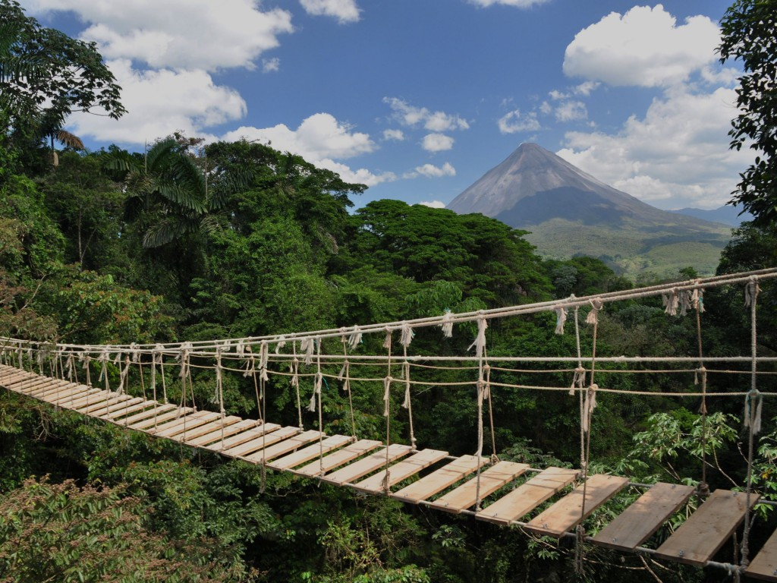
Like Matthew, You Are a Bridge!
And bridges can be broken.

Slide 3

Accept His Forgiveness!!!
God wants to forgive us of our sins, and we need to agree with Him that we are sinners in need of a saviour who can do nothing to save ourselves from the separation from God that sin creates.
When I say: “If not, why not?” it is because I am confused why anyone who has heard the gospel message would not accept it and take the purity and future eternity in heaven that God is offering.

Slide 4
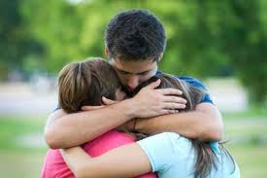
Developing Community Through Fellowship
Today we look at our calling as ministers of reconciliation.

Slide 5
What is Reconciliation?
A basic English dictionary definition says that reconciliation is:
“The restoration of friendly relations.”
With effort and change the distance in the relationship has been repaired.

Slide 6
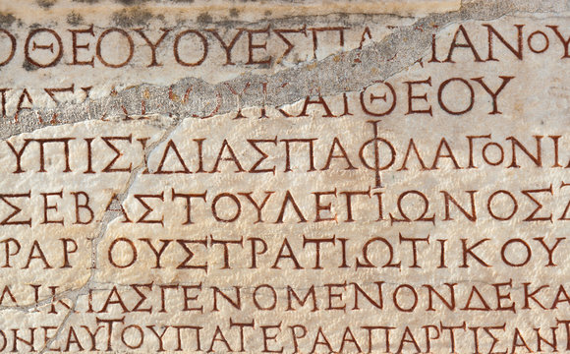
What is Reconciliation?
The relational side:
2644 katallássō (from 2596 /katá, "down to an exact point," intensifying 236 /allássō, "to change") – properly, decisively change, as when two parties reconcile when coming ("changing") to the same position.

Slide 7
What is Reconciliation?
The exchange sense:
[2644 (katallássō) was originally used for the exchange of coins; "properly, to change, exchange (especially of money); hence, of persons, to change from enmity to friendship, to reconcile" (A-S).]

Slide 8

Make The Exchange!
Our passages today will focus on the exchange that has been made by Jesus offering His sinlessness for our sinfulness.
His innocence, Holiness, and perfection, are now ours and our sins, and the punishment that they deserve, are now His.

Slide 9
Make The Exchange!
The account has been reconciled and there is nothing owing on either side.
We offer the message of reconciliation, and we urge everyone to make the exchange in baptism to let go of your old life of sin and take on the perfection of Jesus to live a new life under His guidance.

Slide 10
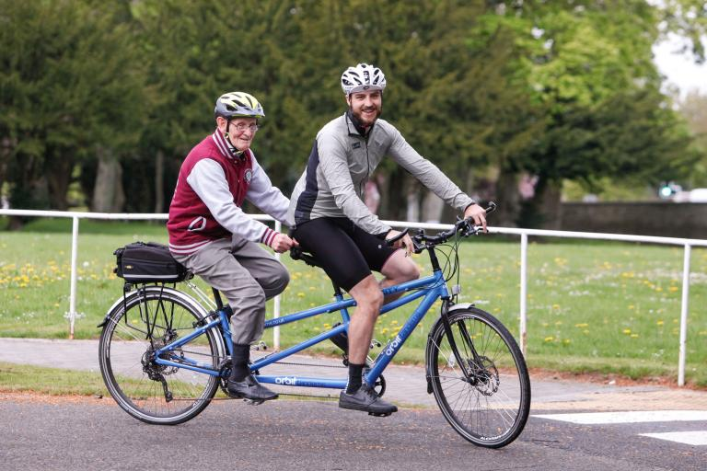
A Story:
Two men were riding a bicycle built for two when they came to a big steep hill. …
"Yes, and if I hadn't kept the brakes on all the way we would certainly have rolled down backwards."

Slide 11

Ephesians 2:11-22 Page 1819:
Therefore, remember that formerly you who are Gentiles by birth and called "uncircumcised" by those who call themselves "the circumcision" (that done in the body by the hands of men) — 12 remember that at that time you were separate from Christ, excluded from citizenship in Israel and foreigners to the covenants of the promise, without hope and without God in the world. 13 But now in Christ Jesus you who once were far away have been brought near through the blood of Christ.

Slide 12
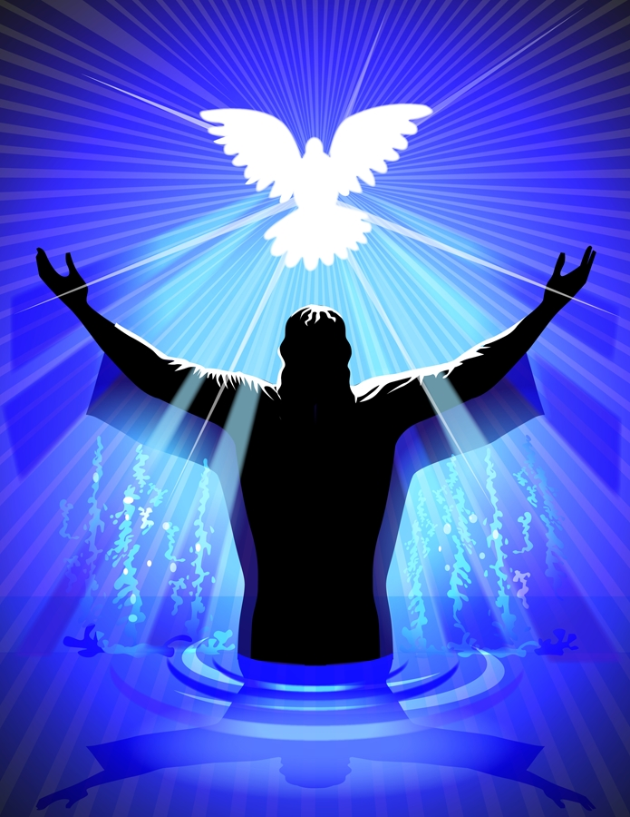
Ephesians 2:14-15:
14 For he himself is our peace, who has made the two one and has destroyed the barrier, the dividing wall of hostility, 15 by abolishing in his flesh the law with its commandments and regulations. His purpose was to create in himself one new man out of the two, thus making peace,…

Slide 13
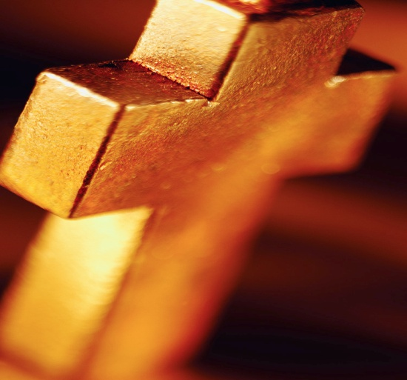
Ephesians 2:16-18
16 and in this one body to reconcile both of them to God through the cross, by which he put to death their hostility. 17 He came and preached peace to you who were far away and peace to those who were near. 18 For through him we both have access to the Father by one Spirit.

Slide 14
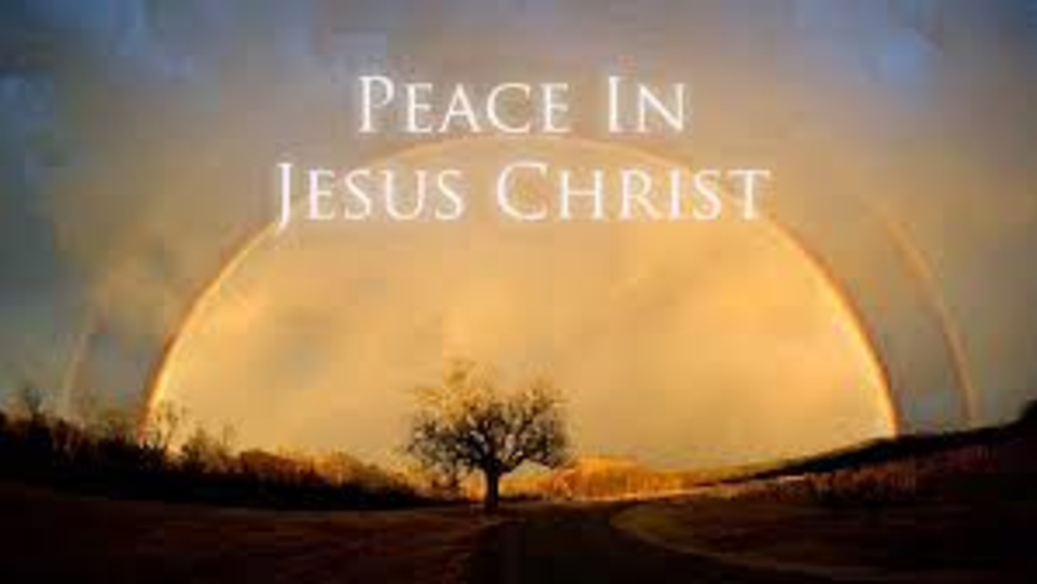
Thinking about it:
Christ and no one else solved the problem of our relationship with God and with other people. He draws people to God and to each other in his own person. It is not simply the message he proclaimed or even the message proclaimed about him that effects this reconciliation. It is himself. Christ is both peace and peacemaker. In Him we find this to be true.

Slide 15
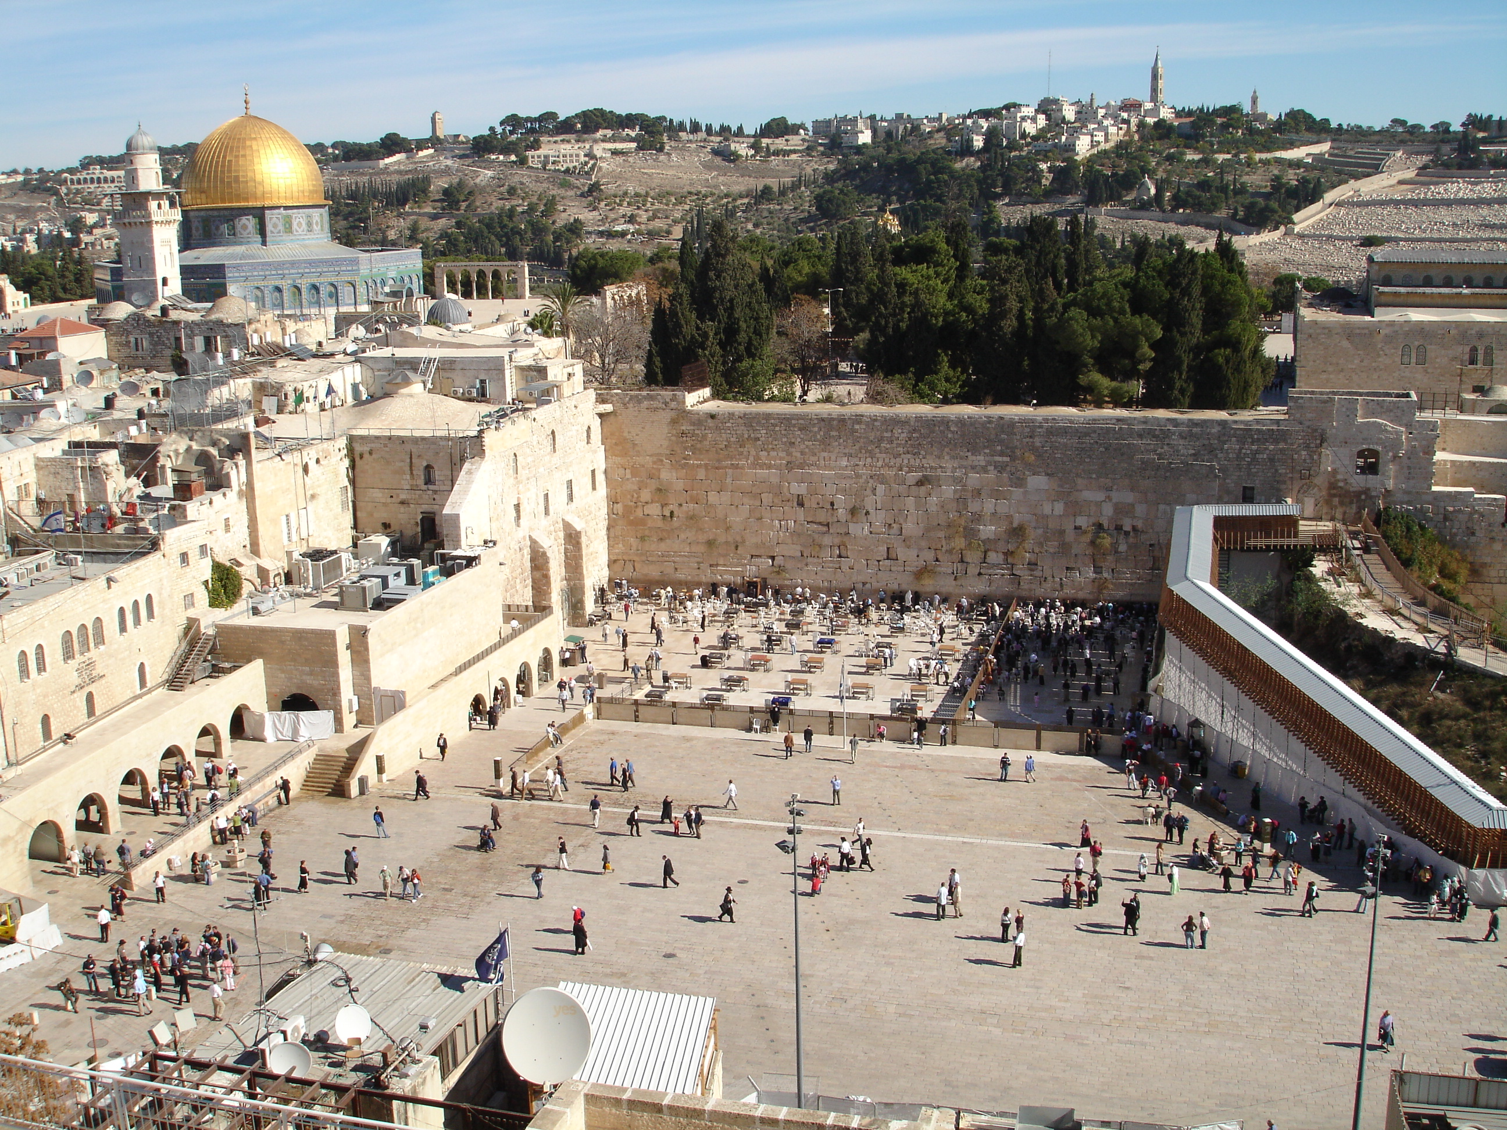
The Barrier:
Josephus used these terms to refer to the barricade in the Jerusalem temple separating the court of the Gentiles from the temple proper. On it was an inscription that read: "No foreigner may enter within the barricade which surrounds the sanctuary and enclosure. Anyone who is caught doing so will have himself to blame for his ensuing death."

Slide 16
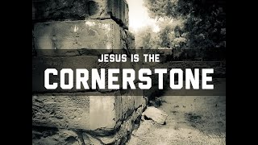
Ephesians 2:19-22
19 Consequently, you are no longer foreigners and aliens, but fellow citizens with God's people and members of God's household, 20 built on the foundation of the apostles and prophets, with Christ Jesus himself as the chief cornerstone.

Slide 17
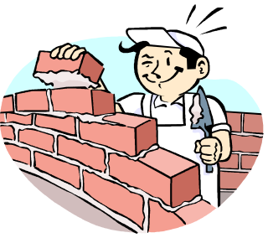
Ephesians 2:19-22
21 In him the whole building is joined together and rises to become a holy temple in the Lord. 22 And in him you too are being built together to become a dwelling in which God lives by his Spirit.

Slide 18
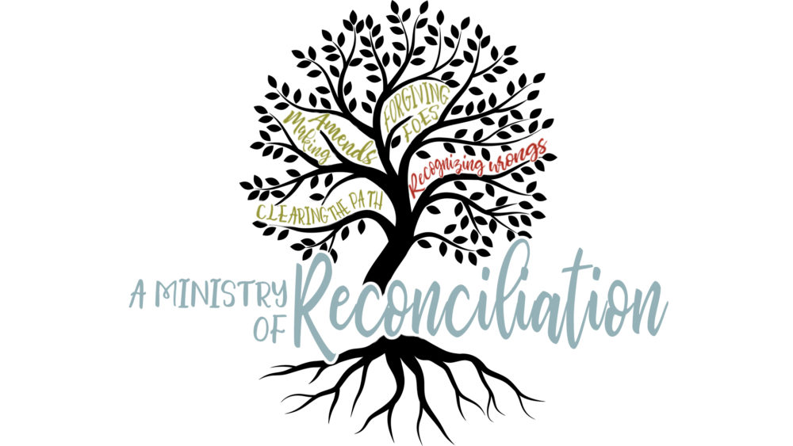
Creating Community
Begins with our reconciliation with God.
This reconciliation does not end with accepting salvation and being added into the church, it calls us back into the world to offer the same blessing to others as peacemakers as His Ambassadors who have been given the ministry of reconciliation.

Slide 19
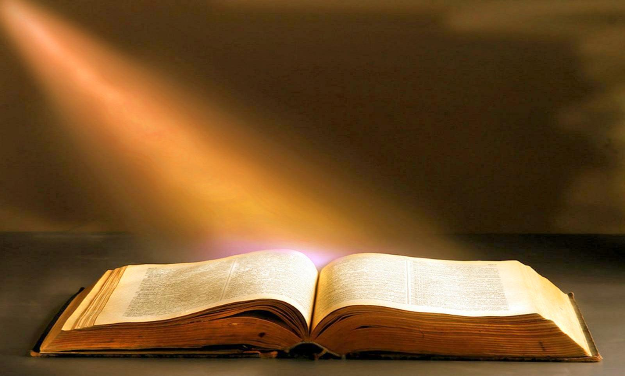
2 Corinthians 5:14-6:1 on page 1799.
14 For Christ's love compels us, because we are convinced that one died for all, and therefore all died. 15 And he died for all, that those who live should no longer live for themselves but for him who died for them and was raised again.

Slide 20
2 Corinthians 5:14-6:1 on page 1799.
16 So from now on we regard no one from a worldly point of view. Though we once regarded Christ in this way, we do so no longer.

Slide 21
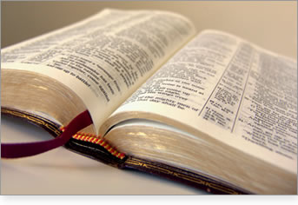
2 Corinthians 5:14-6:1 on page 1799.
17 Therefore, if anyone is in Christ, he is a new creation; the old has gone, the new has come! 18 All this is from God, who reconciled us to himself through Christ and gave us the ministry of reconciliation: 19 that God was reconciling the world to himself in Christ, not counting men's sins against them. And he has committed to us the message of reconciliation.

Slide 22
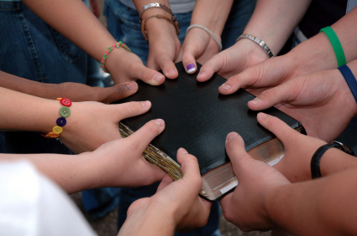
2 Corinthians 5:14-6:1 on page 1799.
20 We are therefore Christ's ambassadors, as though God were making his appeal through us. We implore you on Christ's behalf: Be reconciled to God. 21 God made him who had no sin to be sin for us, so that in him we might become the righteousness of God. 6:1 As God's fellow workers we urge you not to receive God's grace in vain.

Slide 23
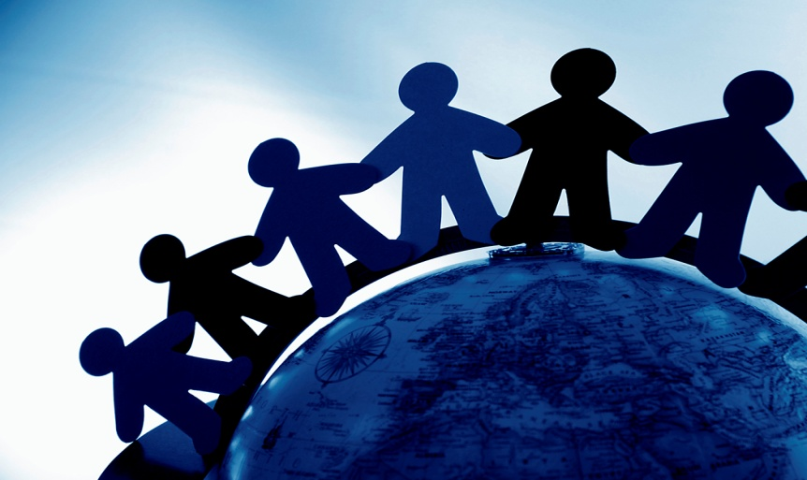
Application:
We appreciate what God has done for us.
Appreciate the people God has placed in your life by investing God’s time with them.
Have the conversations that help you know where people are at spiritually. Pick one person to do this with this week and invite them to connect.

Slide 24
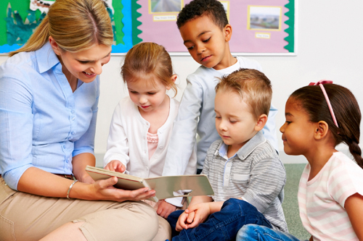
Application:
Inform, or remind people that God offers salvation and a family. Be one beggar who has been given bread showing another one where to find it.
Appreciate the church family that God has brought you into and invest God’s time with them.

Slide 25
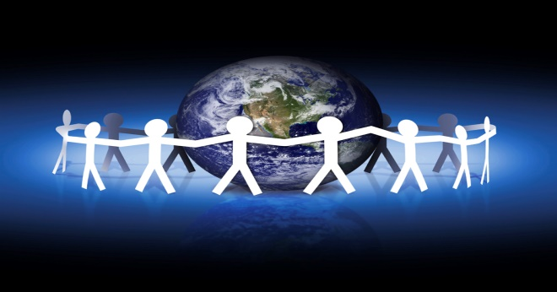
Application:
Give God the glory for His hand at work and be thankful for the calling and preparation to be His ministers of reconciliation.
What a wonderful privilege!
Next Week: Fellowship with Immanuel, God with Us.

