Slide 1
Developing Community Through Fellowship
Sermon 8: Fellowship With the Holy Spirit
Romans 8:1-17 Page 955

Slide 2

Within This Series
Fellowship With Enemies.
Fellowship With Believers.
Fellowship With God.
Fellowship With Unbelievers.
Fellowship and Forgiveness.
Fellowship and Reconciliation.
“Immanuel” God With Us.
Fellowship with the Holy Spirit.
God’s Promise of Matthew 28.
Eternal Fellowship in Heaven.

Slide 3
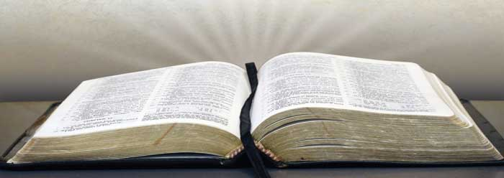
“I am Not Ashamed…” Romans 1:16
A Study Through Romans

Slide 4
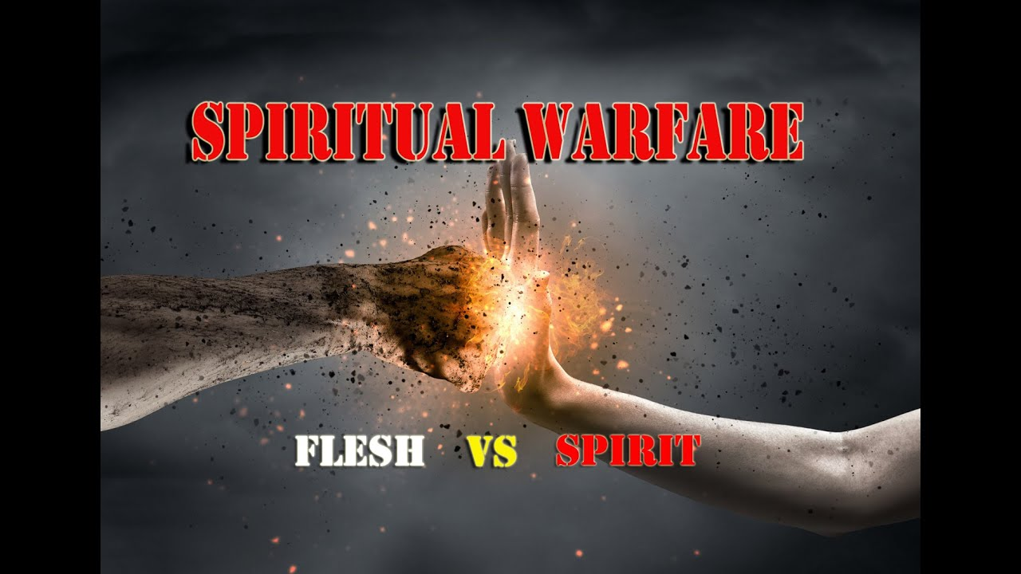
Contrasting Perspectives
Today:
We will be looking at the work of the Spirit in believers contrasted against the person who is directed by their own spirit.

Slide 5

Quote:
Every time we say, "I believe in the Holy Spirit," we mean that we believe that there is a living God able and willing to enter human personality and change it. J. B. Phillips (1906-1982)

Slide 6

Quote:
God does not fill with his Holy Spirit those who believe in the fullness of the Spirit, or those who desire him, but those who obey him. F. B. Meyer (1847-1929)

Slide 7
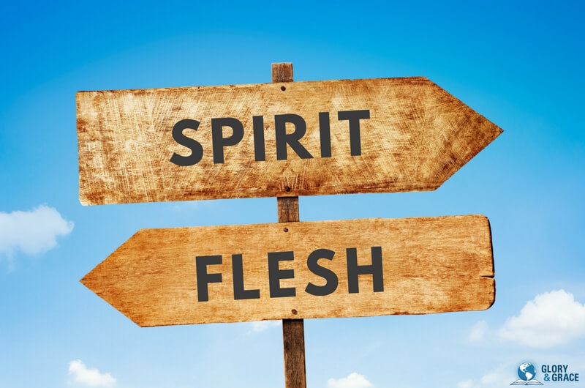
Quote:
The great idea is not that we are at work for God, but that he is at work in us ... that he is working out a strong family likeness to his Son in us. Oswald Chambers (1874-1917)

Slide 8

The Big Question:
The big question for the application is this one:
As people watched your life this week what did they learn about the work of the Spirit?

Slide 9

Quote:
“If the Holy Ghost is indwelling a man or woman, no matter how sweet, how beautiful, how Christ-like they are, the lasting thought you go away with is-what a wonderful being the Lord Jesus Christ is.” Oswald Chambers (1874-1917)
Have people noticed the beauty of Jesus in you?

Slide 10

In Romans 6
In Romans 6 we have the call to accept Christ in baptism, which is a call that we offer today as well. Forgiveness of sins and a new life in Christ for now and eternity is found in the grace of Jesus. Accept His gift and start your new life in Christ.

Slide 11
Romans 6:1-4
What shall we say, then? Shall we go on sinning so that grace may increase? 2 By no means! We are those who have died to sin; how can we live in it any longer? 3 Or don’t you know that all of us who were baptized into Christ Jesus were baptized into his death? 4 We were therefore buried with him through baptism into death in order that, just as Christ was raised from the dead through the glory of the Father, we too may live a new life.

Slide 12

Romans 7
Paul has just laid out the truth that believers struggle with sin and the way to defeat the power of sin is through death.
Unless we die to our old life we will be hounded by sin as a mean task master.
Release is only found in death, burial, and resurrection.

Slide 13

Romans 8:1-17 (955):
Therefore, there is now no condemnation for those who are in Christ Jesus,
2 because through Christ Jesus the law of the Spirit who gives life has set you free from the law of sin and death.

Slide 14
Romans 8:3-4
For what the law was powerless to do because it was weakened by the flesh, (sinful nature) God did by sending his own Son in the likeness of sinful flesh to be a sin offering. And so he condemned sin in the flesh, 4 in order that the righteous requirement of the law might be fully met in us,
Now who are the ones who he is talking about?
who do not live according to the flesh but according to the Spirit.

Slide 15

Romans 8:5
Those who live according to the flesh have their minds set on what the flesh desires; but those who live in accordance with the Spirit have their minds set on what the Spirit desires.

Slide 16
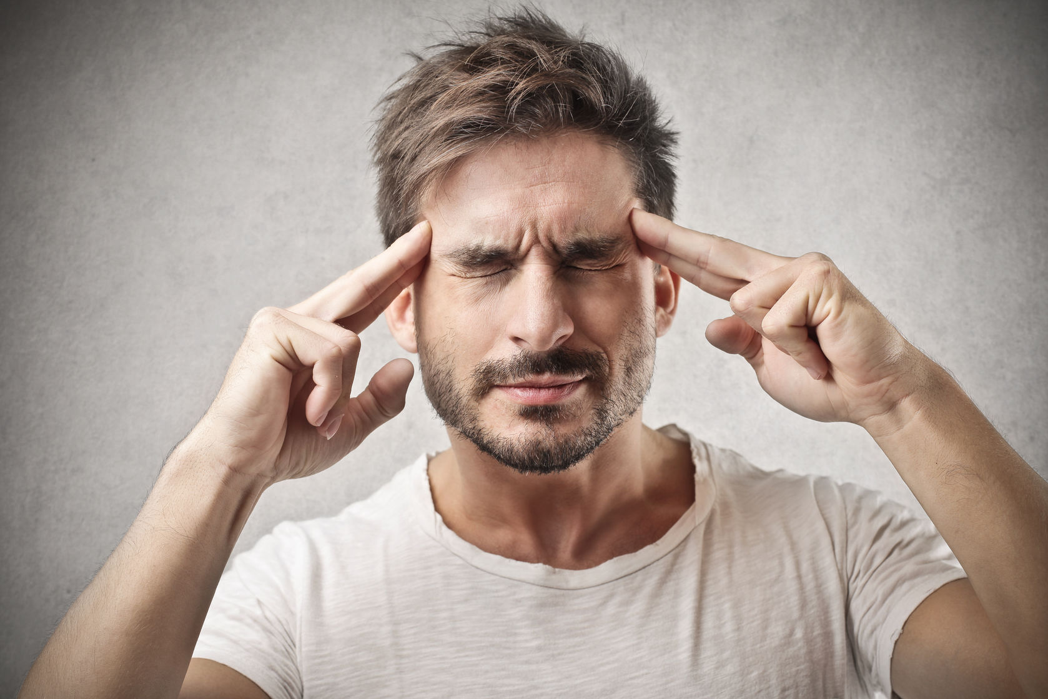
Romans 8:6-8
6 The mind governed by the flesh is death, but the mind governed by the Spirit is life and peace. 7 The mind governed by the flesh is hostile to God; it does not submit to God’s law, nor can it do so.
What is the result of an unchanged mind?
8 Those who are in the realm of the flesh cannot please God.

Slide 17
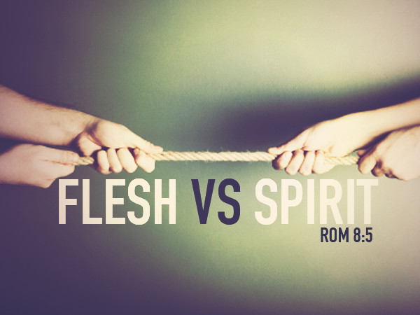
Romans 8:9
You, however, are not in the realm of the flesh but are in the realm of the Spirit, if indeed the Spirit of God lives in you. And if anyone does not have the Spirit of Christ, they do not belong to Christ.

Slide 18
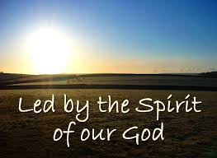
Romans 8:10
But if Christ is in you, then even though your body is subject to death because of sin, the Spirit gives life because of righteousness.

Slide 19
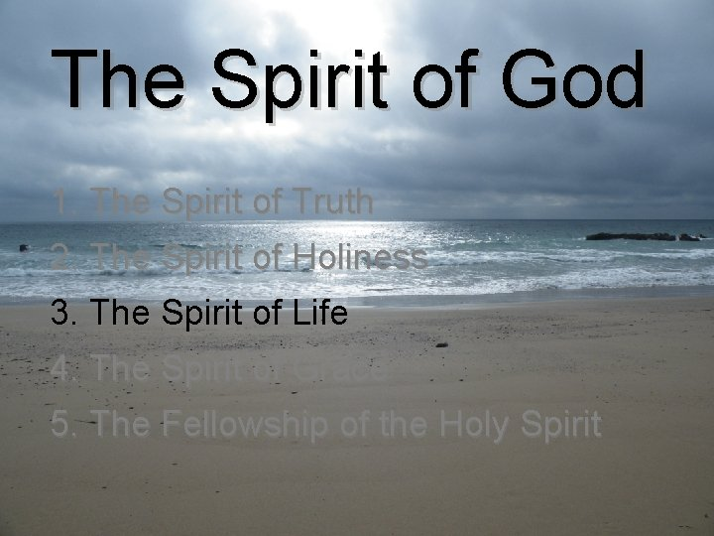
Romans 8:11
And if the Spirit of him who raised Jesus from the dead is living in you, he who raised Christ from the dead will also give life to your mortal bodies because of his Spirit, who lives in you.

Slide 20
Romans 8:12-14
Therefore, brothers and sisters, we have an obligation--but it is not to the flesh, to live according to it. 13 For if you live according to the flesh, you will die; but if by the Spirit you put to death the misdeeds of the body, you will live. 14 For those who are led by the Spirit of God are the children of God.

Slide 21

Romans 8:15-16
15 The Spirit you received does not make you slaves, so that you live in fear again ; (remember we have no condemnation! Romans 8:31-39) rather, the Spirit you received brought about your adoption to sonship. And by him we cry, “Abba, Father.” 16 The Spirit himself testifies with our spirit that we are God’s children.

Slide 22

Romans 8:17
Now if we are children, then we are heirs--heirs of God and co-heirs with Christ, if indeed we share in his sufferings in order that we may also share in his glory.

Slide 23

The Work of the Spirit:
One of the works of the Spirit is to fill us and purge us of our old way of life.
He makes room for God to work in our lives.
The Spirit bridges our flesh with our spirit.
He helps us to focus on the spiritual instead of the physical.
Without the Spirit we soon become slaves again to sin but with the Spirit we can serve God and His righteousness as our new master.

Slide 24

Fellowship With the Holy Spirit
We need to be in fellowship with the Spirit to lead a spiritual life.
We want to develop community with Him and those who He calls into the same community through the same Spirit.

Slide 25
Making the Connection
No matter who we are, we all struggle with sin and its desire to take us hostage again.
We have the chance and the choice to be sinners who have accepted salvation and who are becoming more holy through choice and surrender.
That is good news for everyone, and we all need hope.

Slide 26
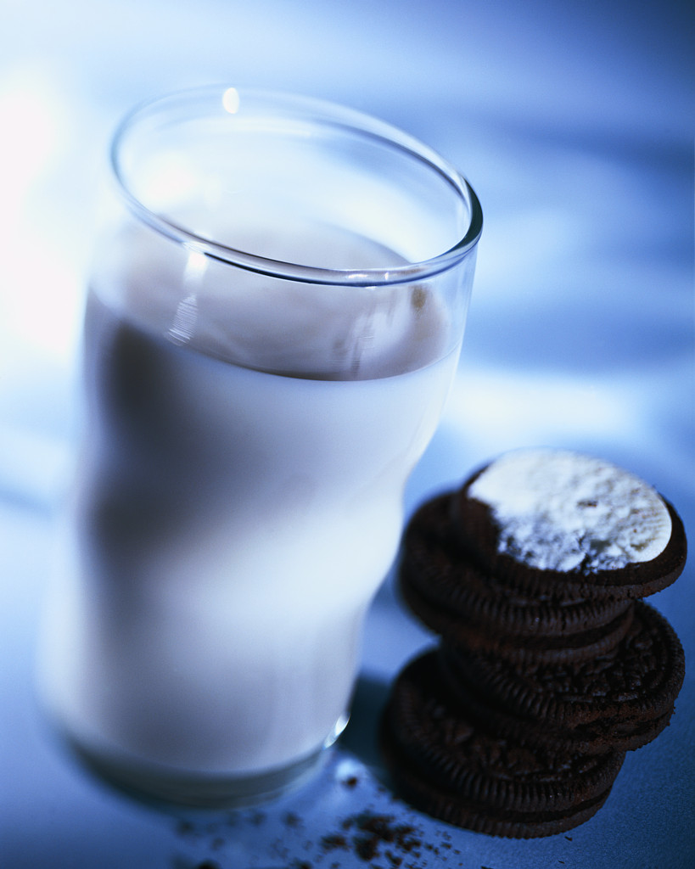
Conclusion:
An object Lesson helping to show why our lives change at such a slow pace and why we struggle with sin even after we have surrendered to God through our death, burial, and resurrection represented in baptism.

Slide 27

Object Lesson:
What is the difference?
All immersed believers have the whole Holy Spirit; the difference is how much of YOU does the Spirit have?
Open yourself up and offer yourself to Him, in wholeness, then you will experience the difference that surrender makes.

Slide 28
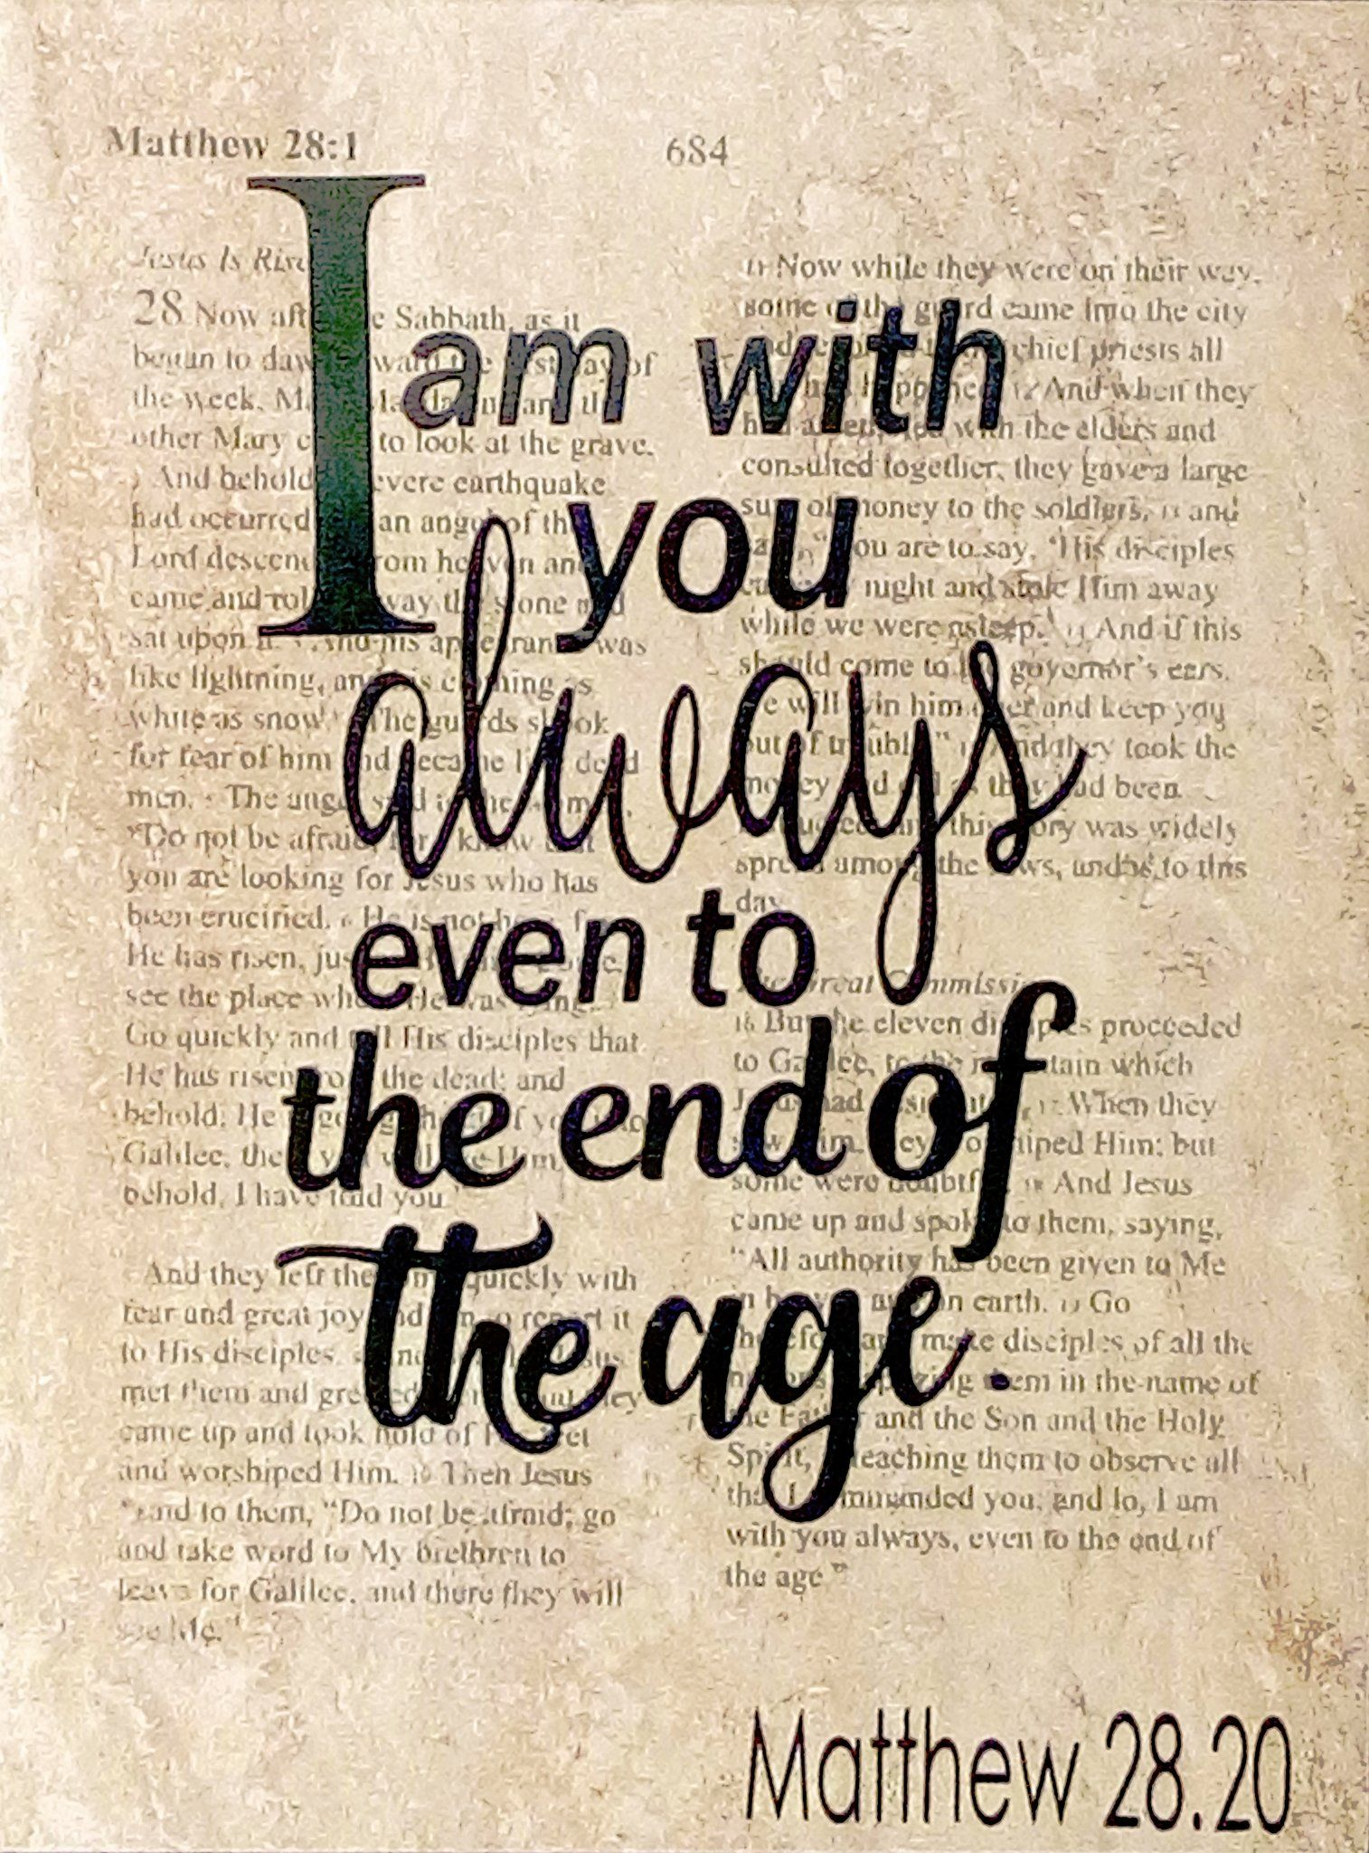
Next Week

