Slide 1

Living Hope Filled and HOPEFUL Lives.
A Vernon Church of Christ
Seven Part Sermon Series

Slide 2
Living Hope Filled and HOPEFUL LIVES
Sermon 3: Praise and Perseverance January 28th 2024

Slide 3
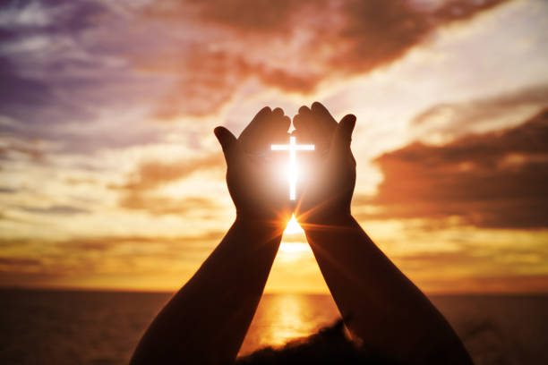
Praise and Hope
Do you remember the words of the Doxology that we sing?
“Praise God, from whom all blessings flow; Praise Him, all creatures here below; Praise Him above, ye heavenly host; Praise Father, Son, and Holy Ghost!”
How do those words, and the thoughts behind them, impact your hope?
The music was written in 1551 and the words were written in 1709 by Thomas Ken.
Sometimes, as Christians who are to be filled with Hope by the power of the Holy Spirit, we need the reminder to stop and praise God.

Slide 4
Memorize Romans 15:13
May the God of ---- fill you with all --- and ----- as you ----- in him, so that you may -------- with ---- by the ----- of the ---- ------.

Slide 5
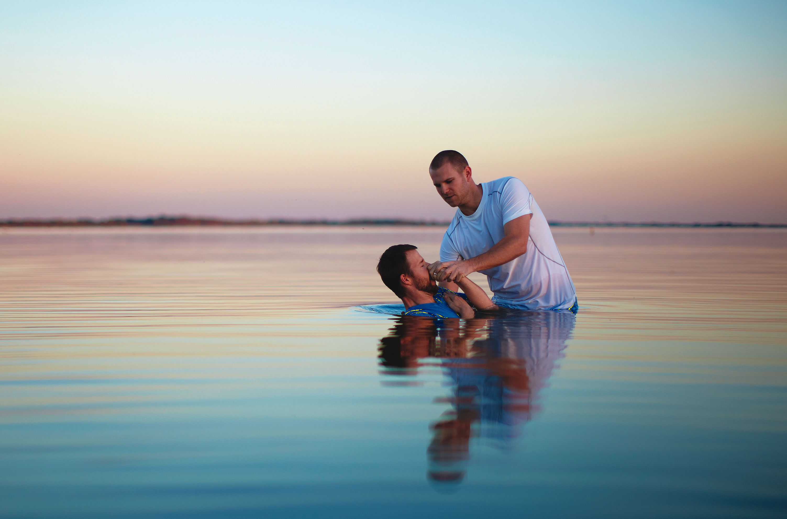
The Gift of Hope In Christ Jesus
Hope is a gift given to us by the Holy Spirit who lives within each believer once sins have been removed at baptism which is why we urge one another to be right with God and accept his grace through our own death, burial, and resurrection to a new life.
We don’t create hope we access it as a blessing from God in our lives for those who are In Christ.

Slide 6

Growing In Hope
So how do we develop hope in our lives? What are the traits of hopeful people?
To grow in hope, we must grow in humility and honesty as we learn to be Observant of God’s work in our lives and Obedient to His word.
Today we consider the impact that praise and perseverance have on hope.

Slide 7

Perspective, Perseverance, and Praising the Lord
How important is it to praise the Lord?
Did you realize that praising God is a command?
Consider Psalm 147:1 – Praise the Lord. (Hallelu Yah) How good it is to sing praises to our God, how pleasant and fitting to praise him!

Slide 8
Perspective, Perseverance, and Praising the Lord
Why would God command us to praise Him? For the same reason He has given a multitude of other commands – because they are for our good.
God says to His nation in Deuteronomy 5:29 – Oh, that their hearts would be inclined to fear me and keep all my commands always, so that it might go well with them and their children forever!

Slide 9
Perspective, Perseverance, and Praising the Lord
Praising God when things are going well is the easy part. But what happens to our praise when life gets hard?
In Acts 16 on page 1721, Paul and Silas teach us a great lesson on what it means to praise God in the hard times. They had been arrested for preaching the gospel.

Slide 10

Acts 16:22-24 on page 1721
The crowd joined in the attack against Paul and Silas, and the magistrates ordered them to be stripped and beaten with rods. 23 After they had been severely flogged, they were thrown into prison, and the jailer was commanded to guard them carefully. 24 When he received these orders, he put them in the inner cell and fastened their feet in the stocks.

Slide 11

4 Parallels to Our Lives
The crowd was against them.
They were struck with many blows.
They were thrown into prison.
Their feet were fastened in stocks.

Slide 12
Acts 16:25 on page 1721
About midnight Paul and Silas were praying and singing hymns to God, and the other prisoners were listening to them.
Have you noticed how much praise changes your perspective?
If I focus on my situation, I will probably be depressed. But when I turn my attention to the wonder and majesty of God, something supernatural happens – Hope Grows.

Slide 13
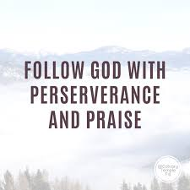
Praise Empowers Perseverance
Knowing the character of God gave them spiritual and mental strength, even when their emotional and physical strength failed. Can you think of times in your life where praise and perseverance helped you to grow in hope while you endured difficult situations?
Praise is declaring who God is.
Because God is sovereign, I can trust that He has a purpose in my pain.
Because God is powerful, I can rely on Him to see me through and provide what I need.

Slide 14
Praise Empowers Perseverance
Because God is merciful, I can take my fears, my burdens, my hurts, to Him.
Because God is gracious, I can see through the suffering to experience His presence.
Because God is loving, I can trust that this hardship comes because He desires to reveal Himself to me.
Because God is holy, I can do what is right despite what culture or the crowd says is good.
Because God is all-knowing, I can rest in the fact that my Father knows exactly what is going to happen.

Slide 15
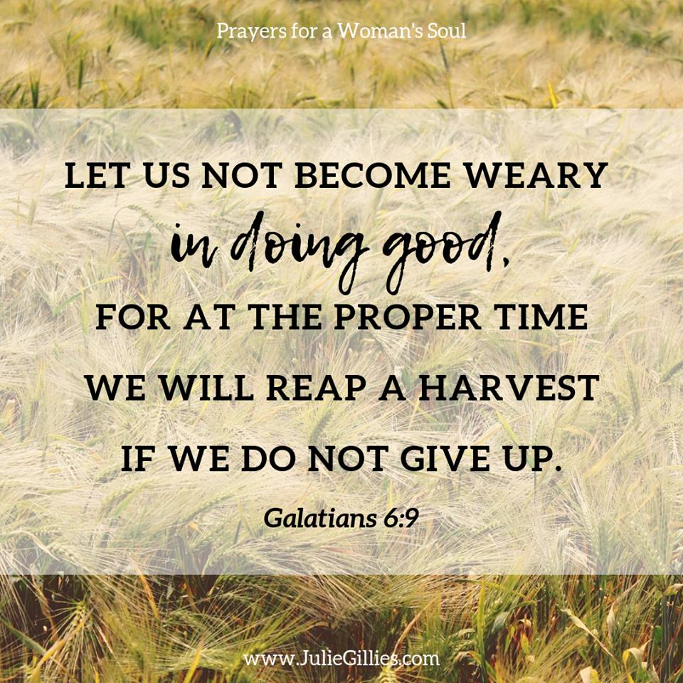
Making Personal Application
Knowing the character of God, and then praising Him according to that character in the middle of our hardships…this brings perspective and perseverance which help us grow in hope.
Are you suffering many blows?
Do you feel confined…trapped?
Does it seem the world is against you?
Don’t be discouraged. Spend some time praising God and see what a difference it makes! Psalm 42:5 says it this way: Why, my soul, are you downcast? Why so disturbed within me? Put your hope in God, for I will yet praise him, my Savior and my God.

Slide 16
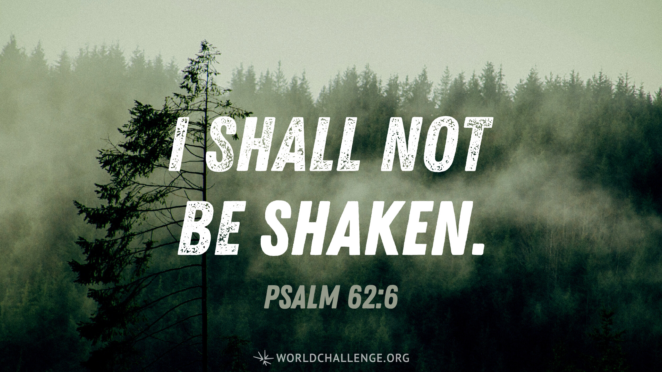
Learning Hope, Praise and Perseverance from King David
Psalm 62 on page 898.
The Psalm begins with acknowledging the hope that he comes to as he reminds himself to focus on God in praise.
1 Truly my soul finds rest in God; my salvation comes from him. 2 Truly he is my rock and my salvation; he is my fortress, I will never be shaken.

Slide 17
Psalm 62 on page 898.
3 How long will you assault me? Would all of you throw me down—this leaning wall, this tottering fence? 4 Surely they intend to topple me from my lofty place; they take delight in lies. With their mouths they bless, but in their hearts they curse.
5 Yes, my soul, find rest in God; my hope comes from him. 6 Truly he is my rock and my salvation; he is my fortress, I will not be shaken. 7 My salvation and my honor depend on God; he is my mighty rock, my refuge. 8 Trust in him at all times, you people; pour out your hearts to him, for God is our refuge.

Slide 18
Learning Hope, Praise and Perseverance from King David
9 Surely the lowborn are but a breath, the highborn are but a lie. If weighed on a balance, they are nothing; together they are only a breath. 10 Do not trust in extortion or put vain hope in stolen goods; though your riches increase, do not set your heart on them. 11 One thing God has spoken, two things I have heard: “Power belongs to you, God, 12 and with you, Lord, is unfailing love”; and, “You reward everyone according to what they have done.”

Slide 19

David’s Ups and Downs
Through the difficulties of life David vacillates between focusing on the issue and focusing on God.
He goes between times of despair and times of hope centered in praise and it is a cycle that we may know too well.
Growing in Hope by the power of the Holy Spirit enables us to spend less time in the despair side as we more quickly turn things over to God and praise Him

Slide 20
Memorize ….
May the God of hope fill you with all joy and peace as you trust in him, so that you may overflow with hope by the power of the Holy Spirit.

Slide 21
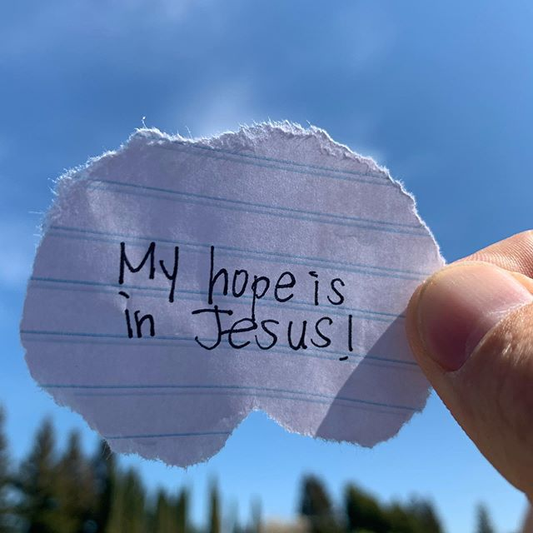
Consider the Impact
What impacts you from the sermon this week?
What draws you to praise God?
How are you doing at learning to praise during difficulty?
How are you doing with perseverance? How does hope in God help you to keep going?
To whose life can God’s hope overflow through you?
This week enjoy the hope that is in Jesus and share the invite for others to come to Jesus for salvation and that hope that God brings.

Slide 22
Next Week
The traits of being Expectant of God to act and Engaged in faithfulness as we await His deliverance as people who live HOPEFUL lives. May God bless our transformation this week.

