Slide 1

Living Hope Filled and HOPEFUL Lives.
A Vernon Church of Christ
Seven Part Sermon Series

Slide 2
Living Hope Filled and HOPEFUL LIVES
Sermon 4: Expectant and Engaged February 4th 2024

Slide 3
Our Sermon Series
Our sermon series is focused on living hope filled and HOPEFUL lives. By looking at and working at memorizing our key passage from… __________________we are reminded that we are filled with hope by God and the work of the Holy Spirit who overflows us with hope.

Slide 4
Memorize Romans 15:13
May the God of ---- fill you with all --- and ----- as you ----- in him, so that you may -------- with ---- by the ----- of the ---- ------.

Slide 5
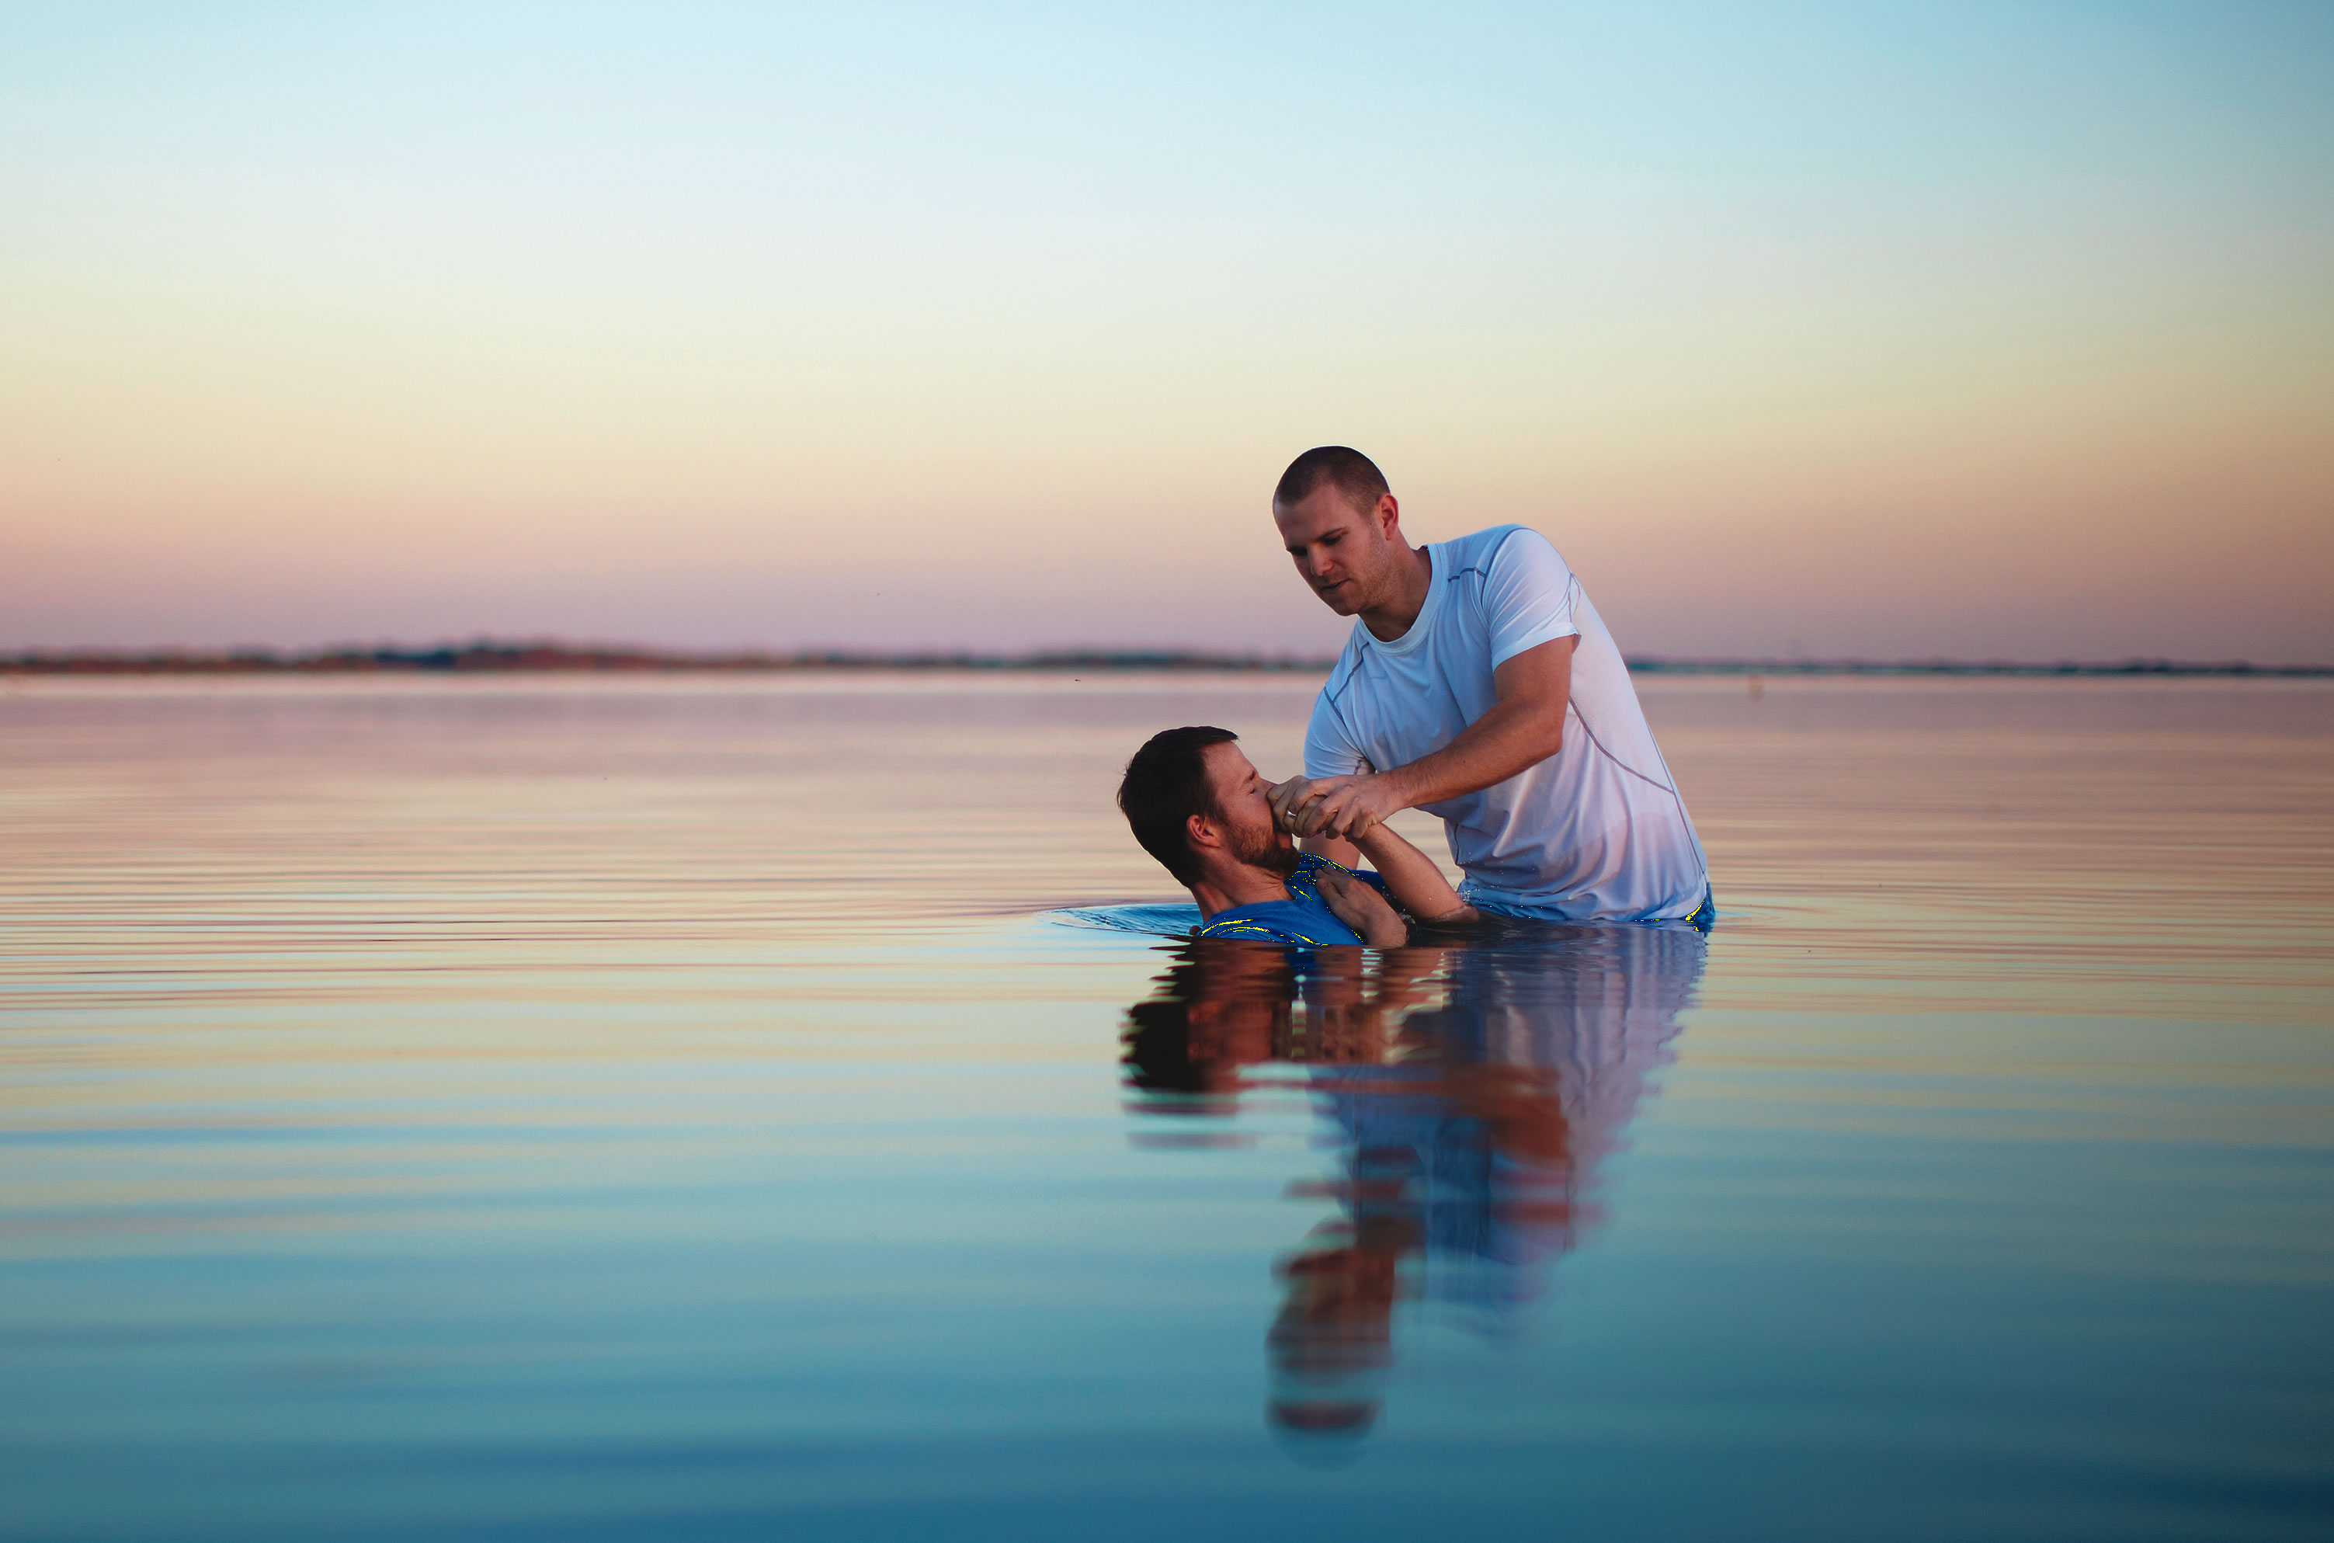
The Gift of Hope In Christ Jesus
Hope is a gift given to us by the Holy Spirit who lives within each believer once sins have been removed at baptism which is why we urge one another to be right with God and accept his grace through our own death, burial, and resurrection to a new life.
We don’t create hope we access it as a blessing from God in our lives for those who are In Christ.

Slide 6

Romans 15:13 and HOPEFUL
H – Humble, Honest
O – Observant, Obedient
P – Praise, Persevere
E- Expectant, Engaged
F- Faithful, Focused
U- Unswerving, United
L- Listening, Learning

Slide 7
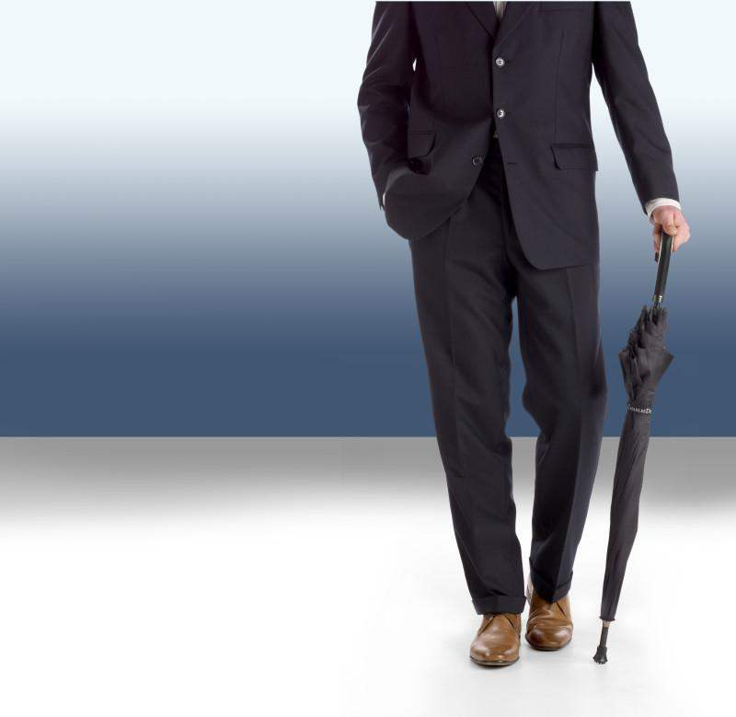
Pray and Pack!
“If you are asking God for rain, do you bring your umbrella?”
Knowing that God is powerful and sovereign, that is that he is able to act, and willing to act, needs to be matched by our action even if the action is patience.
Hopeful people go to God in prayer and await further orders.

Slide 8

Trust and Obey…
The bible is full of accounts of expectant and engaged people who trusted God and did their part.
Consider Noah, Abraham with Isaac, Daniel’s friends Hananiah, Mishael, and Azariah willingness to go into the furnace in Daniel 3 on page 1375.

Slide 9
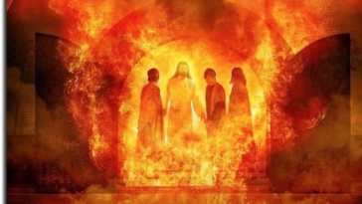
Daniel 3:16-18 on page 1375
“Shadrach, Meshach and Abednego (their Babylonian names) replied to him, “King Nebuchadnezzar, we do not need to defend ourselves before you in this matter. 17 If we are thrown into the blazing furnace, the God we serve is able to deliver us from it, and he will deliver us from Your Majesty’s hand. 18 But even if he does not, we want you to know, Your Majesty, that we will not serve your gods or worship the image of gold you have set up.”

Slide 10
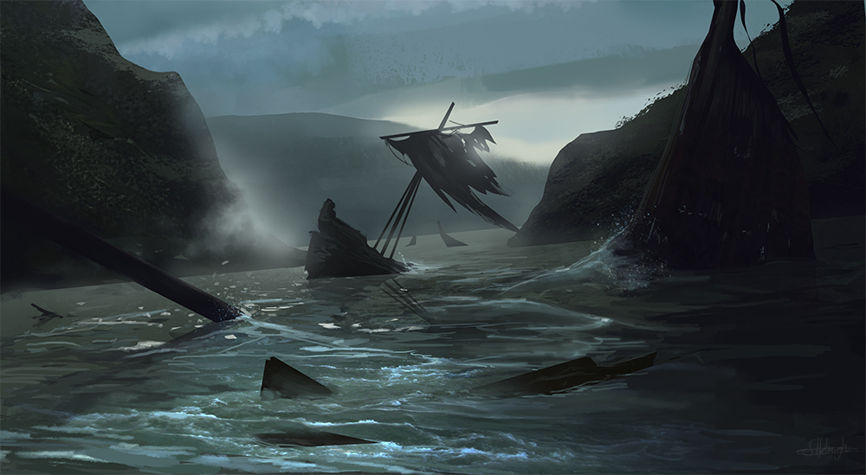
Being Expectant Without Demanding
Being expectant of God to act is a key trait of faith or trust in God because it takes trust, which is faith, in the character of God that He will act according to His will and for His glory.
Oftentimes that means that God delivers us from difficulty but not always.
The shipwreck may be our consequence and maybe God wants to act but is limited and He grieves with us during the difficulty.

Slide 11
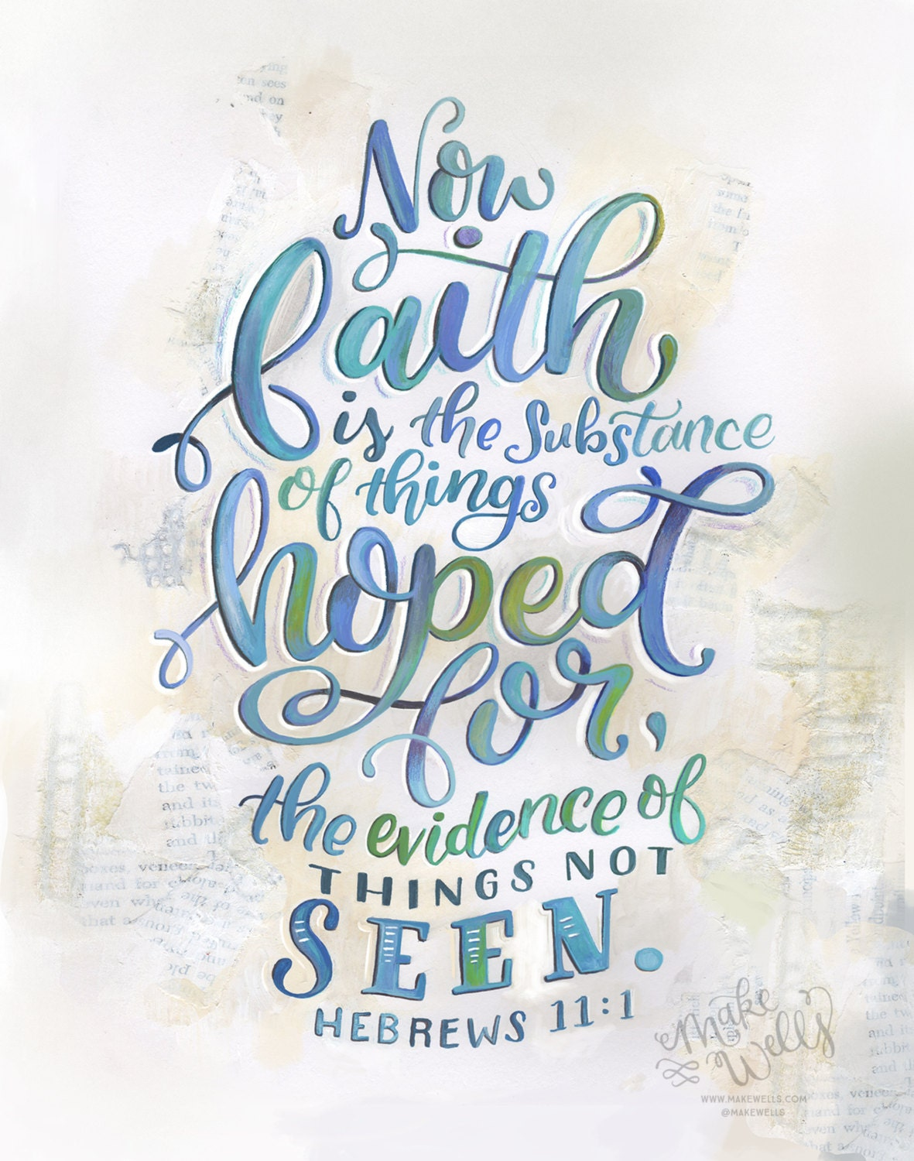
Learning from Hebrews 11
“Now faith is confidence in what we hope for and assurance about what we do not see. 2 This is what the ancients were commended for.”
Being confident in God and His love for us can help us step into the unknown as the record of the faithful lives of Hebrews 11 remind us.

Slide 12

Hebrews 11:35-40 on page 1876
35 Women received back their dead, raised to life again. There were others who were tortured, refusing to be released so that they might gain an even better resurrection. 36 Some faced jeers and flogging, and even chains and imprisonment. 37 They were put to death by stoning; they were sawed in two; they were killed by the sword. They went about in sheepskins and goatskins, destitute, persecuted and mistreated— 38 the world was not worthy of them. They wandered in deserts and mountains, living in caves and in holes in the ground.
39 These were all commended for their faith, yet none of them received what had been promised, 40 since God had planned something better for us so that only together with us would they be made perfect.

Slide 13
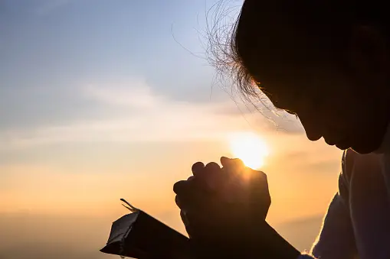
Hopeful Expectation
As hopeful people we go to God in expectation that He loves us and that He is more concerned about our holiness than our happiness. We go to a God that is beyond time and the only one that can bless us in eternity even if things do not work the way that we are asking for within our lifetime. No matter the outcome we go to God in expectation, and we stay engaged in praise to see how, when, or if, He will act in the ways that we were thinking.

Slide 14

Luke 5:17-20 on page 1598
“One day Jesus was teaching, and Pharisees and teachers of the law were sitting there. They had come from every village of Galilee and from Judea and Jerusalem. And the power of the Lord was with Jesus to heal the sick. 18 Some men came carrying a paralyzed man on a mat and tried to take him into the house to lay him before Jesus. 19 When they could not find a way to do this because of the crowd, they went up on the roof and lowered him on his mat through the tiles into the middle of the crowd, right in front of Jesus. 20 When Jesus saw their faith, he said, “Friend, your sins are forgiven.

Slide 15
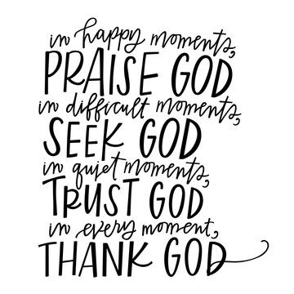
Expectant and Engaged Faith
Expecting God to act involves a combination of trust, courage, integrity, and an active anticipation of divine intervention.
How have you found this to be true in your life and to whom can you share your story so that hope might flow into their life?

Slide 16
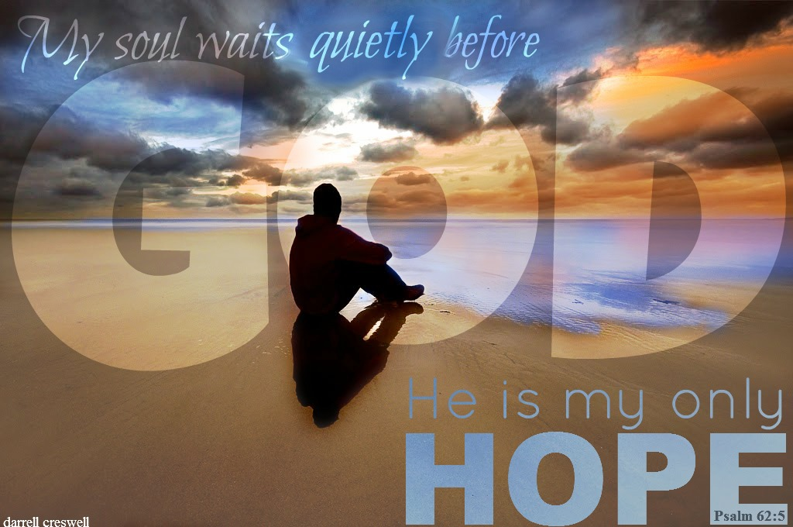
What to Do While You’re Waiting on God
1. Believe that the God who saved you hears your cries (Micah 7:7)
2. Watch with expectancy, but be prepared for unexpected answers (Psalm 5:3).
3. Put your hope in his Word (Psalm 130:5-6).
4. Trust in the Lord, not in your own understanding (Proverbs 3:5-6).
5. Resist fretting, refrain from anger, be still, and choose patience (Psalm 37:7-8).

Slide 17
What to Do While You’re Waiting on God
6. Be strong and take courage (Psalm 27:13-14; 31:24).
7. See it as an opportunity to experience God’s goodness (Psalm 27:13; Lamentations 3:25).
8. Wait for God’s promise instead of going your own way (Acts 1:4).
9. Continue steadfastly in prayer, being watchful with thanksgiving (Colossians 4:2).
10. Remember the blessings yet to come (Isaiah 30:18) – Colossians 3:2-4.

Slide 18
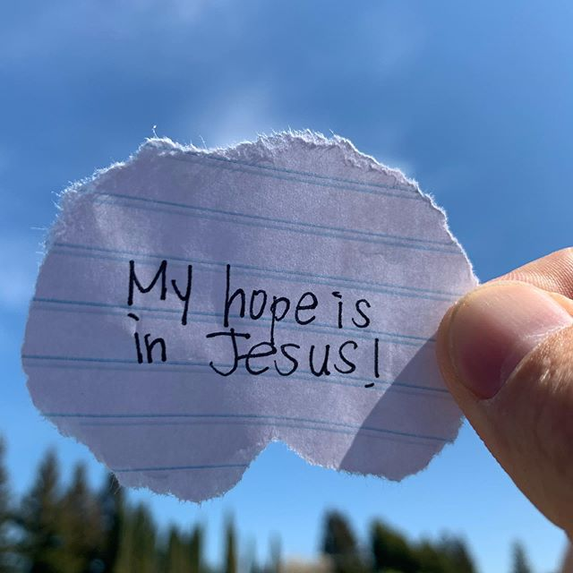
Consider the Impact
What impacts you from the sermon this week?
What helps you to come to God in expectation and engagement?
What are your standing stones, your memories of God’s faithfulness in the past?
How have you seen God in action and how does that help light the way in times of darkness?

Slide 19
Consider the Impact
What have you asked of God and what umbrella do you carry for when He answers?
To whose life can God’s hope overflow through you?
This week enjoy the hope that is in Jesus and share the invite for others to come to Jesus for salvation and that hope that God brings.

Slide 20
Next Week
Next week we look build on these traits as we talk about being Faithful and Focused as people who live HOPEFUL lives. May God bless our transformation and witness this week.

