Slide 1

Living Hope Filled and HOPEFUL Lives.
A Vernon Church of Christ
Seven Part Sermon Series

Slide 2
Living Hope Filled and HOPEFUL LIVES
Sermon 5: Faithful and Focused February 11th 2024

Slide 3

How Are You Doing?
How are you doing with being hope filled and hopeful?
This week we build on the concepts of expectancy and engagement with the concepts of being faithful and focused on God as hope grows in us and shines through us to those who are in the darkness.

Slide 4
Memorize Romans __:__
____ the ___ of ---- __ you ___ all --- and ----- as you ----- in him, so that you may -------- with ---- by the ----- of the ---- ------.

Slide 5

The Impact of Faithfulness and Focus
Today we grow in hope as we consider the impact of being faithful and focused on God as our saviour and Lord.
When you think of the traits of being faithful and focused on God who comes to your mind?
Who might have you as their example?

Slide 6
Faithful and Focused Verses
Romans 8:5 “Those who live according to the flesh have their minds set on what the flesh desires; but those who live in accordance with the Spirit have their minds set on what the Spirit desires.”
1 Peter 1:13 “Therefore, with minds that are alert and fully sober, set your hope on the grace to be brought to you when Jesus Christ is revealed at his coming.”

Slide 7
Faithful and Focused Verses
Hebrews 12:1-3
“Therefore, since we are surrounded by such a great cloud of witnesses, let us throw off everything that hinders and the sin that so easily entangles. And let us run with perseverance the race marked out for us, 2 fixing our eyes on Jesus, the pioneer and perfecter of faith. For the joy set before him he endured the cross, scorning its shame, and sat down at the right hand of the throne of God. 3 Consider him who endured such opposition from sinners, so that you will not grow weary and lose heart.”

Slide 8
Faithful and Focused Verses
Matthew 6:33 “But seek first his kingdom and his righteousness, and all these things will be given to you as well.”
Philippians 4:8 “Finally, brothers and sisters, whatever is true, whatever is noble, whatever is right, whatever is pure, whatever is lovely, whatever is admirable—if anything is excellent or praiseworthy—think about such things.”

Slide 9
Faithful and Focused Verses
Colossians 3:1-4
“Since, then, you have been raised with Christ, set your hearts on things above, where Christ is, seated at the right hand of God. 2 Set your minds on things above, not on earthly things. 3 For you died, and your life is now hidden with Christ in God. 4 When Christ, who is your (our) life, appears, then you also will appear with him in glory.”

Slide 10

The Faithful and the Focused
What bible accounts would you focus on?
I want us to read a little about a woman in the bible that shows focus on God and needs a deliverer. While most of her neighbours are in fear of an enemy attack, she is presented with an opportunity to pledge faithfulness to God as she speaks of how her understanding of God has impacted her and her family….

Slide 11

Joshua 2:1-14 on page 322
Jos 2:1 Then Joshua son of Nun secretly sent two spies from Shittim. “Go, look over the land,” he said, “especially Jericho.” So they went and entered the house of a prostitute named Rahab and stayed there.
2 The king of Jericho was told, “Look! Some of the Israelites have come here tonight to spy out the land.” 3 So the king of Jericho sent this message to Rahab: “Bring out the men who came to you and entered your house, because they have come to spy out the whole land.”

Slide 12
Joshua 2:1-14 on page 322
4 But the woman had taken the two men and hidden them. She said, “Yes, the men came to me, but I did not know where they had come from. 5 At dusk, when it was time to close the city gate, the men left. I don’t know which way they went. Go after them quickly. You may catch up with them.” 6 (But she had taken them up to the roof and hidden them under the stalks of flax she had laid out on the roof.) 7 So the men set out in pursuit of the spies on the road that leads to the fords of the Jordan, and as soon as the pursuers had gone out, the gate was shut.
8 Before the spies lay down for the night, she went up on the roof 9 and said to them, …

Slide 13
Joshua 2:1-14 on page 322
“I know that the LORD has given this land to you and that a great fear of you has fallen on us, so that all who live in this country are melting in fear because of you. 10 We have heard how the LORD dried up the water of the Red Sea for you when you came out of Egypt, and what you did to Sihon and Og, the two kings of the Amorites east of the Jordan, whom you completely destroyed. 11 When we heard of it, our hearts melted and everyone’s courage failed because of you, for the LORD your God is God in heaven above and on the earth below.

Slide 14
Joshua 2:1-14 on page 322
12 Now then, please swear to me by the LORD that you will show kindness to my family, because I have shown kindness to you. Give me a sure sign 13 that you will spare the lives of my father and mother, my brothers and sisters, and all who belong to them, and that you will save us from death.”
14 “Our lives for your lives!” the men assured her. “If you don’t tell what we are doing, we will treat you kindly and faithfully when the LORD gives us the land.”

Slide 15

The Accounts of Joshua 6:17, 23-25
Joshua 6:17 The city and all that is in it are to be devoted to the LORD. Only Rahab the prostitute and all who are with her in her house shall be spared, because she hid the spies we sent.
23 So the young men who had done the spying went in and brought out Rahab, her father and mother and brothers and all who belonged to her. They brought out her entire family and put them in a place outside the camp of Israel. 24 Then they burned the whole city and everything in it, but they put the silver and gold and the articles of bronze and iron into the treasury of the LORD'S house. 25 But Joshua spared Rahab the prostitute, with her family and all who belonged to her, because she hid the men Joshua had sent as spies to Jericho—and she lives among the Israelites to this day.

Slide 16

The Rest of Her Story…
Rahab became the wife of Salmon, the father of Boaz, who married Ruth and she had Obed who had Jesse the father of King David which is the line of Jesus of Nazareth.
Her actions of faithfulness and righteousness are mentioned in Hebrews 11:31 and James 2:25-26.

Slide 17

The Rest of Her Story…
James 2:25-26 says: “In the same way, was not even Rahab the prostitute considered righteous for what she did when she gave lodging to the spies and sent them off in a different direction? 26 As the body without the spirit is dead, so faith without deeds is dead.”
Rahab's story emphasizes the themes of faith, redemption, and the inclusivity of God's salvation plan.

Slide 18
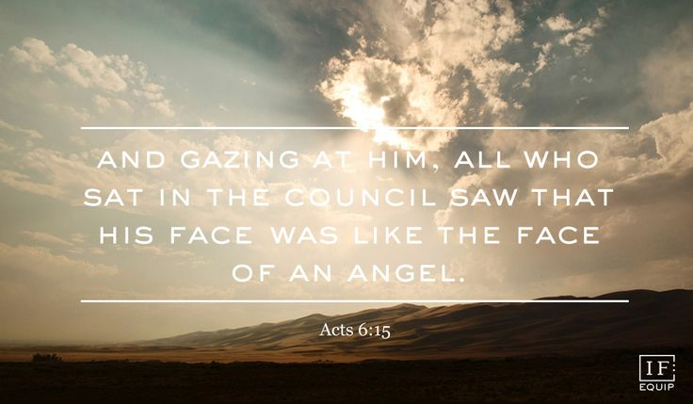
A Second Example of Faithful and Focused
Acts 6:5 on page 1700 it says: “They chose Stephen, a man full of faith and of the Holy Spirit…” and in 6:8 it says: “Now Stephen, a man full of God’s grace and power, did great wonders and miraculous signs among the people.”
In Acts 6:18 as he was facing trial is says: “All who were sitting in the Sanhedrin looked intently at Stephen, and they saw that his face was like the face of an angel.”

Slide 19
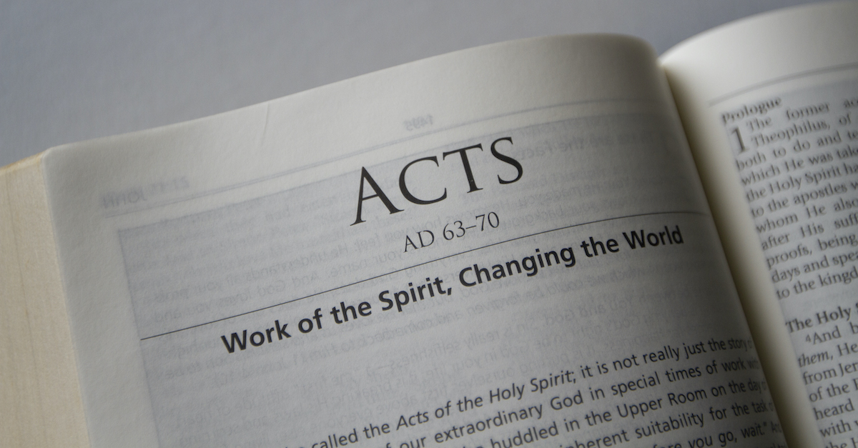
The Faithful Focus of Stephen
In Acts 7:1 the trial starts as the high priest asked him, “Are these charges true?” Starting in Acts 7:2 we have a great sermon that summarizes God’s action throughout the Old Testament and the response of the leaders as Stephen begins with “To this he replied: “Brothers and fathers, listen to me! The God of glory appeared to our father Abraham…” and ends with the words from Acts 7:51-53.

Slide 20
The Faithful Focus of Stephen
Acts 7:51-53 which say: “You stiff-necked people, with uncircumcised hearts and ears! You are just like your fathers: You always resist the Holy Spirit! 52 Was there ever a prophet your fathers did not persecute? They even killed those who predicted the coming of the Righteous One. And now you have betrayed and murdered him— 53 you who have received the law that was put into effect through angels but have not obeyed it.””

Slide 21
The Faithful Focus of Stephen
Acts 7:54-58: “ When they heard this, they were furious and gnashed their teeth at him. 55 But Stephen, full of the Holy Spirit, looked up to heaven and saw the glory of God, and Jesus standing at the right hand of God. 56 “Look,” he said, “I see heaven open and the Son of Man standing at the right hand of God.”
57 At this they covered their ears and, yelling at the top of their voices, they all rushed at him, 58 dragged him out of the city and began to stone him. Meanwhile, the witnesses laid their clothes at the feet of a young man named Saul.

Slide 22
The Impact of Faithfulness and Focus
The impact of Rahab.
Did Stephen impact Saul?
We have been impacted by the faithfulness and focus on God that people in our lives have shown to us.
Who is being influenced by your faithfulness and focus on God and the hope that faithfulness and focus bring?

Slide 23
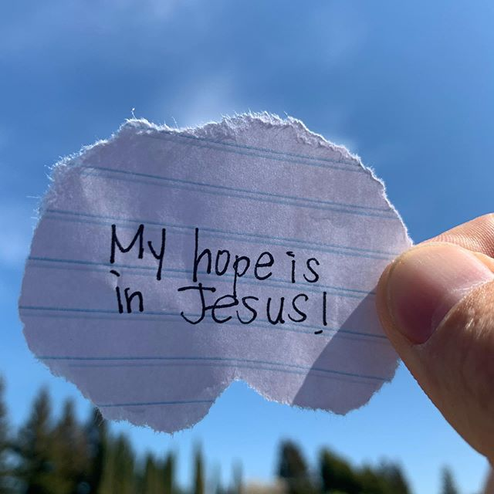
Consider the Impact
This week take time in prayer to be thankful for the faithfulness and focus of those who have influenced your faith and hope.
Ask God to show you who you are influencing and be aware of the opportunities to draw attention to God and the hope that he grows in you.
What impacts you from the sermon this week and to whom can you share the impact?

Slide 24
Next Week
Next week we look build on these traits as we talk about being Unswerving and United as people who live HOPEFUL lives. May God bless our transformation and witness this week.

