Slide 1

Living Hope Filled and HOPEFUL Lives.
A Vernon Church of Christ
Seven Part Sermon Series

Slide 2
Living Hope Filled and HOPEFUL LIVES
Sermon 6: Unswerving and United February 18th 2024

Slide 3

The End is Near!!
How are you doing with being hope filled and HOPEFUL?
This week we build on the concepts of Humble and Honest, Observant and Obedient, Praise and Perseverance, Expectant and Engaged, Faithful and Focused as we conclude with:
U- Unswerving, United
L- Listening, Learning

Slide 4
Memorize Romans __:__
May….

Slide 5
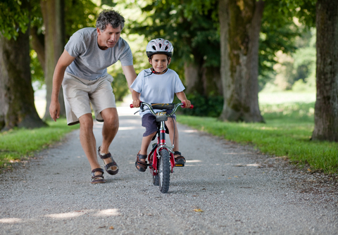
Swervers!
Learning to ride a bike.
A toddler.
Distracted driver!!!
Swerving can be a part of developing maturity and it can be connected to immaturity and selfishness.
Opposite words include steadfast, stand firm, solid, mature, trustworthy, etc..

Slide 6

Joshua 2:14 on page 322
14 “Our lives for your lives!” the men assured her. “If you don’t tell what we are doing, we will treat you kindly and faithfully when the LORD gives us the land.”
NEB: “The men said to her, "If you die, may we die too! If you do not report what we've been up to, then, when the LORD hands the land over to us, we will show unswerving allegiance to you."”

Slide 7
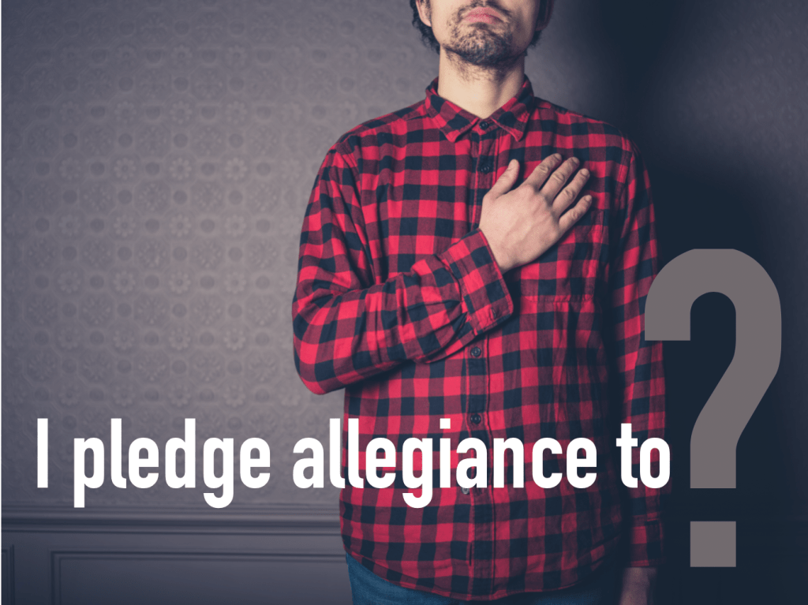
Connecting to Unswerving Allegiance
How are you doing at showing unswerving allegiance in all of your relationships?
Who is thankful for your unswerving allegiance? Who “has your back?”
How does God’s unswerving allegiance to you fill your prayers and encourage your connection to others?

Slide 8
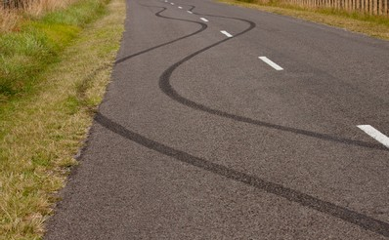
1 Chronicles 28:6-7
“He said to me: ‘Solomon your son is the one who will build my house and my courts, for I have chosen him to be my son, and I will be his father. 7 I will establish his kingdom forever if he is unswerving in carrying out my commands and laws, as is being done at this time.”
Solomon was a swerver!

Slide 9
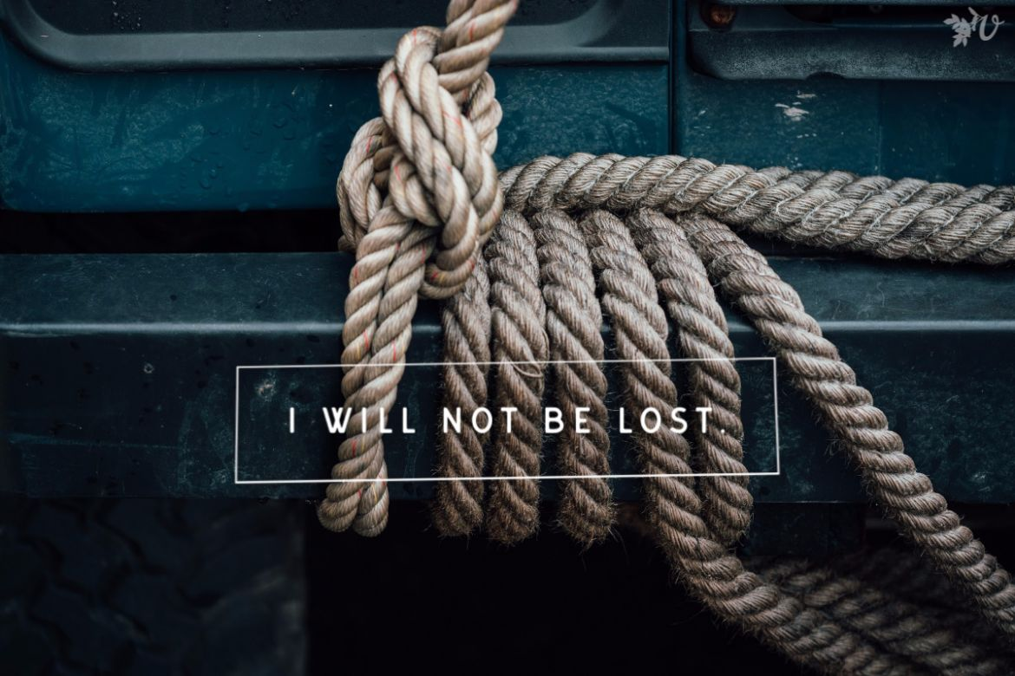
Unswerving in the NT
Strongs Greek 2722
Original Word: κατέχω
Part of Speech: Verb
Transliteration: kat echo
Definition: It is the action and effort to hold fast, hold back
Usage: (a) I hold fast, bind, arrest, (b) I take possession of, lay hold of, (c) I hold back, detain, restrain, (d) I hold a ship, keep its head.

Slide 10
katechó: to hold fast, hold back
Luke 8:15 But the seed on good soil stands for those with a noble and good heart, who hear the word, retain it – (hold it fast unswervingly), and by persevering produce a crop.
1st Corinthians 15:2 By this gospel you are saved, if you hold firmly – (hold it fast unswervingly) to the word I preached to you. Otherwise, you have believed in vain.

Slide 11
katechó: to hold fast, hold back
1st Thessalonians 5:19-22 19 Do not quench the Spirit. 20 Do not treat prophecies with contempt 21 but test them all; hold on – (hold it fast unswervingly) to what is good, 22 reject every kind of evil.
Toddling away, or swerving out of the lines, of your connection to God’s word, the gospel message, or the truth of God’s word will lead us into a shipwrecked faith which Paul warns Timothy about in 1 Timothy 1:18-20.

Slide 12

Hold Firmly in Hebrews
Hebrews 3:6 But Christ is faithful as the Son over God’s house. And we are his house, if indeed we hold firmly – (hold it fast unswervingly) to our confidence and the hope in which we glory.
Hebrews 3:14 (showing 12-14) 12 See to it, brothers and sisters, that none of you has a sinful, unbelieving heart that turns away from the living God. 13 But encourage one another daily, as long as it is called “Today,” so that none of you may be hardened by sin’s deceitfulness. 14 We have come to share in Christ, if indeed we hold our original conviction firmly to the very end.

Slide 13

Hebrews 10:19-25 on page 1873.
Therefore, brothers and sisters, since we have confidence to enter the Most Holy Place by the blood of Jesus, 20 by a new and living way opened for us through the curtain, that is, his body, 21 and since we have a great priest over the house of God,

Slide 14
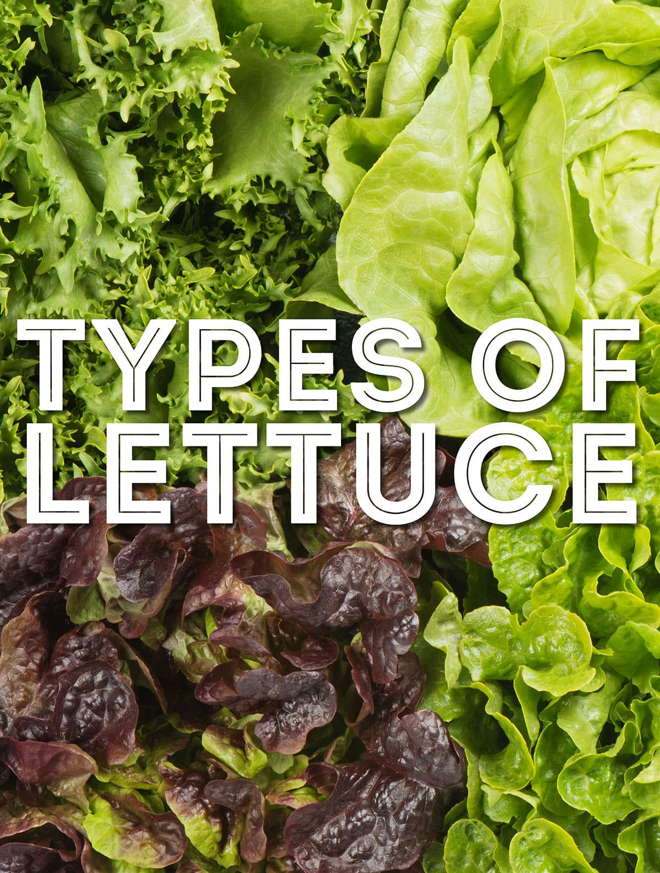
Hebrews 10:19-25 on page 1873.
22 let us draw near to God with a sincere heart and with the full assurance that faith brings, having our hearts sprinkled to cleanse us from a guilty conscience and having our bodies washed with pure water. (baptism imagery) 23 Let us hold unswervingly to the hope we profess, for he who promised is faithful. 24 And let us consider how we may spur one another on toward love and good deeds, 25 not giving up meeting together, as some are in the habit of doing, but encouraging one another—and all the more as you see the Day approaching.

Slide 15
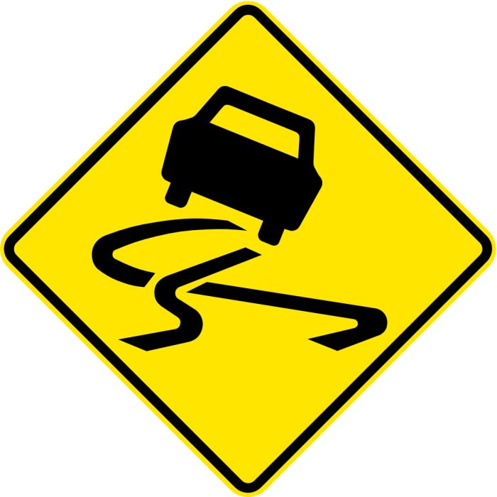
Swervers and Servants
As you think through scripture, we have some swervers and some unswerving servants.
Because the truth of their lives is not hidden, we read of the swerves and mistakes of Noah, Abraham, David, Solomon, and the nation that swerved so far away from God that they lost ten tribes to the Assyrians and the two tribes went into Babylonian exile despite the warnings of the prophets.

Slide 16

The Unswerving Legacy in Daniel
Daniel served God and foreign nations all through the 70 years of captivity.
Consider the legacy recorded in
Daniel 2:47
Daniel 3:28-29
Daniel 6:5
Daniel 6:16

Slide 17

The Impact of Daniel
Daniel 6:25-27:
Then King Darius wrote to all the nations and peoples of every language in all the earth: “May you prosper greatly! 26 “I issue a decree that in every part of my kingdom people must fear and reverence the God of Daniel. “For he is the living God and he endures forever; his kingdom will not be destroyed, his dominion will never end. 27 He rescues and he saves; he performs signs and wonders in the heavens and on the earth. He has rescued Daniel from the power of the lions.”

Slide 18
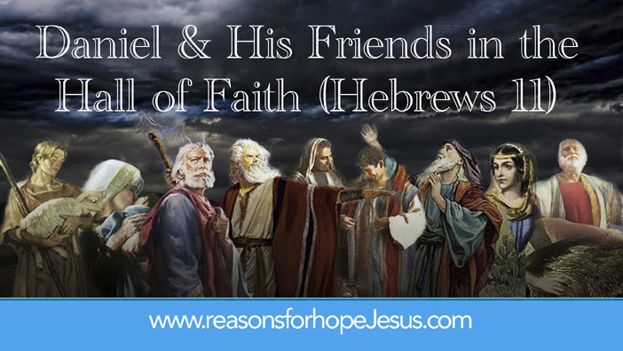
Unswerving and United
Daniel was an influence in a pagan land because he was unswerving, and he was united with his friends. These four young men, middle aged men, and old men, prayed together, worked together, and suffered together in faithfulness to God in an unwelcome land.
They lived and served the God of Israel and foreign King in ways that brought honor and praise to God as they held onto the hope of the return from exile.

Slide 19
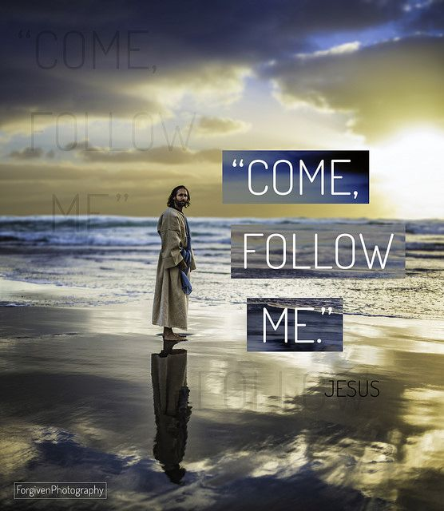
The Rest of Our Story…
Living the Christian life is not easy, and it can draw opposition while it is also the best life and full of great blessings as we serve together.
As we face the uncertainties and the temptation to wander and toddle away from Jesus in difficult times, we can be thankful for the call of repentance and grace of Jesus.

Slide 20
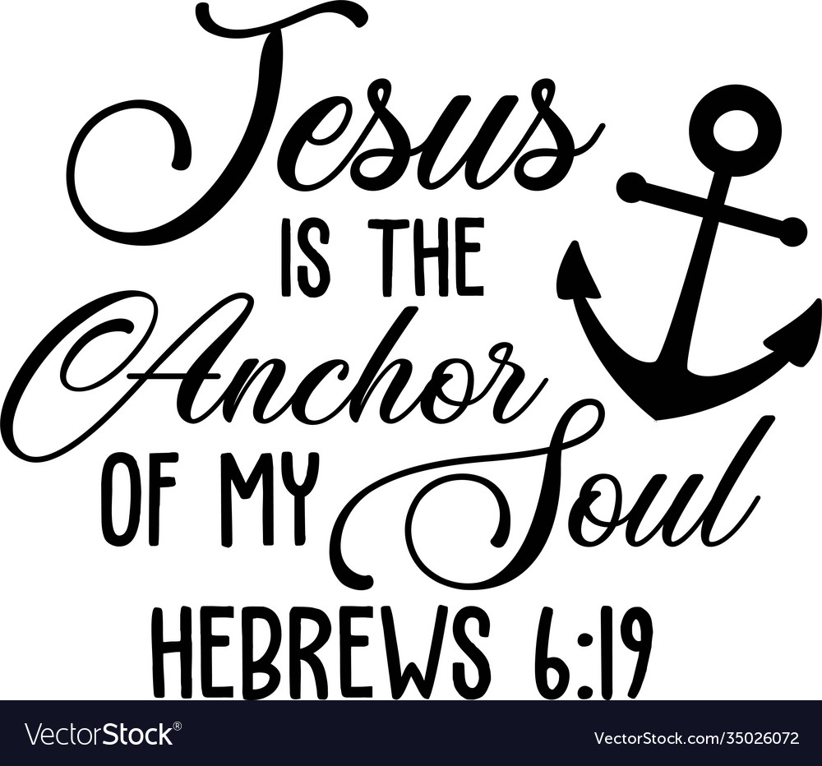
Jesus is the Anchor of Our Soul
Only Jesus never swerved in his faithfulness to God and so Our hope is built on His faithfulness.
We need one another to remind each other to hope and trust in God as we share the struggle and impact of faithfulness to each other and the world around us.

Slide 21
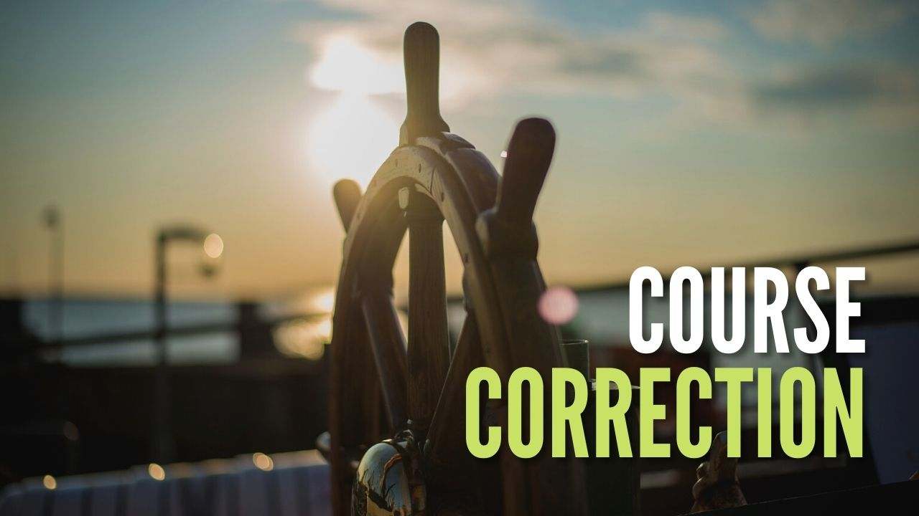
Course Corrections
Hopeful Christians are as unswerving as they can be, and they course correct when they waver.
They need others who are united in the faith and the call to faithfulness.
Thank you for your example and encouragement!

Slide 22
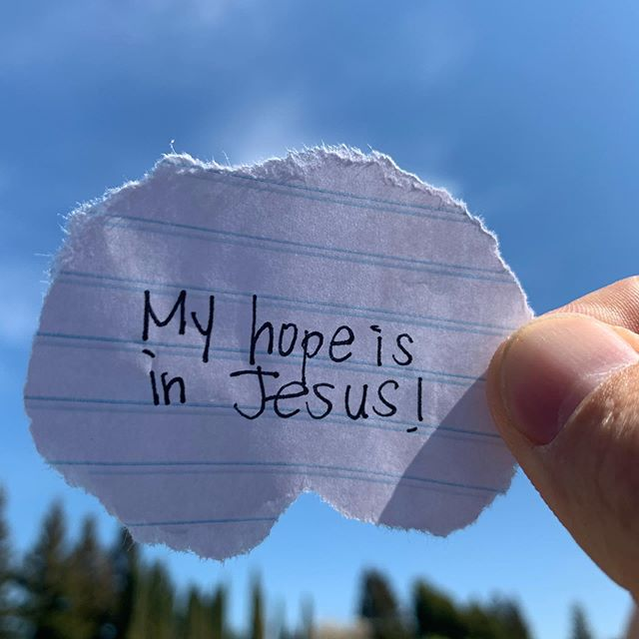
Consider the Impact
This week take time in a prayer of thanks for the unswerving faithfulness of Jesus and His grace that calls you to repentance.
Spend time in thanks for the congregation as those who are united in the faith.
What impacts you from the sermon this week and to whom can you share the impact?

Slide 23
Next Week
Next week we look build on these traits as we talk about the impact of Listening and Learning as people who live HOPEFUL lives. May God bless our transformation and witness this week.

