Slide 1

Living Hope Filled and HOPEFUL Lives.
A Vernon Church of Christ
Seven Part Sermon Series

Slide 2
Living Hope Filled and HOPEFUL LIVES
Sermon 7: Listening and Learning February 25th 2024

Slide 3
A Series on Hope.
I chose a series on Hope because of the impact that hope has in our daily lives and the pull of the world to have us focus on the hopeless aspects of life.
How would you define or describe Hope?
What are some synonyms? (similar words)
Anticipation, Assurance, A Wish
What are some antonyms? (opposite words)
Despair, Fear, Uncertainty

Slide 4

Hope is More Than Wishful Thinking
In my material the concepts were tied to Agency Thinking – Where or what do we want to get to from here?
And Pathway Thinking … what are the motivations and actions that can help us to go from where we are to where we want to be?

Slide 5

The Hope for Those In Christ
Because of the change available by the washing away of the old and new life after baptism we have access to true and eternal hope in Jesus our Lord and Saviour. Because God is the God of hope we reflect his character through the power of the Holy Spirit within us.

Slide 6

Romans 15:13 and HOPEFUL
H – Humble, Honest
O – Observant, Obedient
P – Praise, Persevere
E- Expectant, Engaged
F- Faithful, Focused
U- Unswerving, United
L- Listening, Learning

Slide 7
Memorize Romans 15:13
May the God of ---- fill you with all --- and ----- as you ___ in him, so that you may ____ with hope by the ----- of the ____ Spirit.

Slide 8

Swervers!
Learning to ride a bike.
A toddler.
Distracted driver!!!
Swerving can be a part of developing maturity and it can be connected to immaturity and selfishness.
Opposite words include steadfast, stand firm, solid, mature, trustworthy, etc..

Slide 9

Course Corrections
Hopeful Christians are as unswerving as they can be, and they course correct when they waver.
They need others who are united in the faith and the call to faithfulness.
Thank you for your example and encouragement!

Slide 10

Learning from Jesus
Jesus models the traits of listening and learning that we are examining today. He modeled them and his Apostles learned to listen and learn as well.
He needed to learn how to listen, and he learned how to be obedient to His Father and God’s will which is a truth that is well developed in the gospel of John.

Slide 11

Jesus Listened, Learned, and Obeyed.
John 4:34 “My food,” said Jesus, “is to do the will of him who sent me and to finish his work.
John 5:30 By myself I can do nothing; I judge only as I hear, and my judgment is just, for I seek not to please myself but him who sent me.
John 6:38 For I have come down from heaven not to do my will but to do the will of him who sent me.

Slide 12
Jesus Listened, Learned, and Obeyed.
John 8:26 “I have much to say in judgment of you. But he who sent me is trustworthy, and what I have heard from him I tell the world.”
John 10:18 No one takes it from me, but I lay it down of my own accord. I have authority to lay it down and authority to take it up again. This command I received from my Father.”
John 12:49-50 For I did not speak on my own, but the Father who sent me commanded me to say all that I have spoken. 50 I know that his command leads to eternal life. So whatever I say is just what the Father has told me to say.”

Slide 13
Jesus Listened, Learned, and Obeyed.
John 14:30-31 I will not say much more to you, for the prince of this world is coming. He has no hold over me, 31 but he comes so that the world may learn that I love the Father and do exactly what my Father has commanded me. “Come now; let us leave.
John 15:10 If you keep my commands, you will remain in my love, just as I have kept my Father’s commands and remain in his love.

Slide 14

Learning to Listen from Jesus
The Son can do nothing of Himself, but what He sees the Father do; for whatever He does, the Son also does in like manner. For the Father loves the Son, and shows Him all things that He Himself does” (John 5:19-20).
Jesus, in his flesh, had to rely on a daily inner working of the Father’s voice to direct him.
Luke 5:15-16: “Yet the news about him spread all the more, so that crowds of people came to hear him and to be healed of their sicknesses. 16 But Jesus often withdrew to lonely places and prayed.”

Slide 15

Jesus Learned Things!
As a child, He obeyed His parents (Luke 2:51); as an adult, He obeyed the Law (Matthew 5:17) and fulfilled all righteousness (Matthew 3:15). All His life, Jesus completely fulfilled the Father’s will (John 8:29; 15:10; Hebrews 10:9). He knew what obedience was prior to His incarnation, of course, but He “learned” obedience on earth by experiencing it. In every situation, no matter how difficult, the Son was obedient to the Father.

Slide 16

Hebrews 2:17-18
“For this reason (helping humans instead of angels) he had to be made like them, fully human in every way, in order that he might become a merciful and faithful high priest in service to God, and that he might make atonement for the sins of the people. 18 Because he himself suffered when he was tempted, he is able to help those who are being tempted.

Slide 17

Hebrews 5:7-10
During the days of Jesus’ life on earth, he offered up prayers and petitions with fervent cries and tears to the one who could save him from death, and he was heard because of his reverent submission. 8 Son though he was, he learned obedience from what he suffered 9 and, once made perfect, he became the source of eternal salvation for all who obey him 10 and was designated by God to be high priest in the order of Melchizedek.

Slide 18
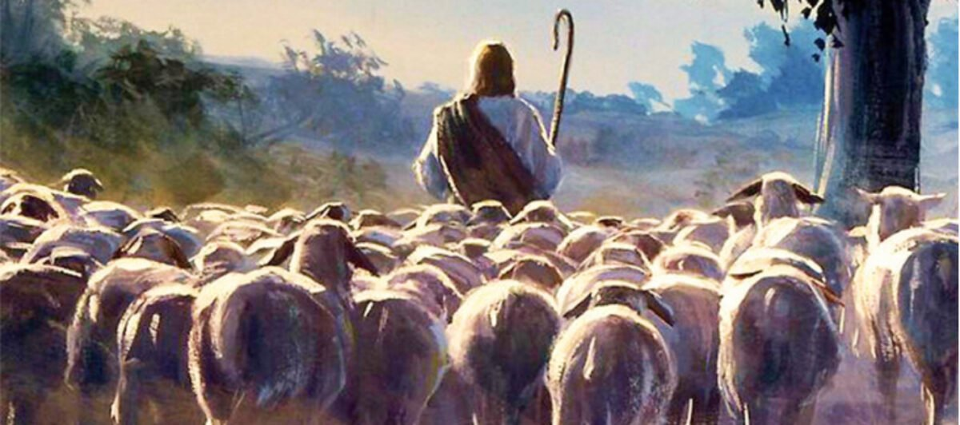
Following His Example: John 10:14-16
“I am the good shepherd; I know my sheep and my sheep know me— 15 just as the Father knows me and I know the Father—and I lay down my life for the sheep. 16 I have other sheep that are not of this sheep pen. I must bring them also. They too will listen to my voice, and there shall be one flock and one shepherd.

Slide 19

Matthew 17:5
While he was still speaking, a bright cloud covered them, and a voice from the cloud said, “This is my Son, whom I love; with him I am well pleased. Listen to him!”

Slide 20

Growing in Hope by Listening and Learning
The inward disciplines:
Meditation, Prayer, Fasting & Study
The outward disciplines (inward realities resulting in outward lifestyles):
Simplicity, Solitude, Submission, & Service.
And the corporate disciplines:
Confession, Worship, Guidance, & Celebration.
Which ones do you practice and how do they help you?

Slide 21

Following His Example
Jesus modeled these for His followers and people have modeled them for you and who is learning how to listen to Jesus and learn from Him from your example and practices?
People need a connection to God, but we may connect to God in different situations, circumstances, or ways which is the focus of our next sermon series!

Slide 22
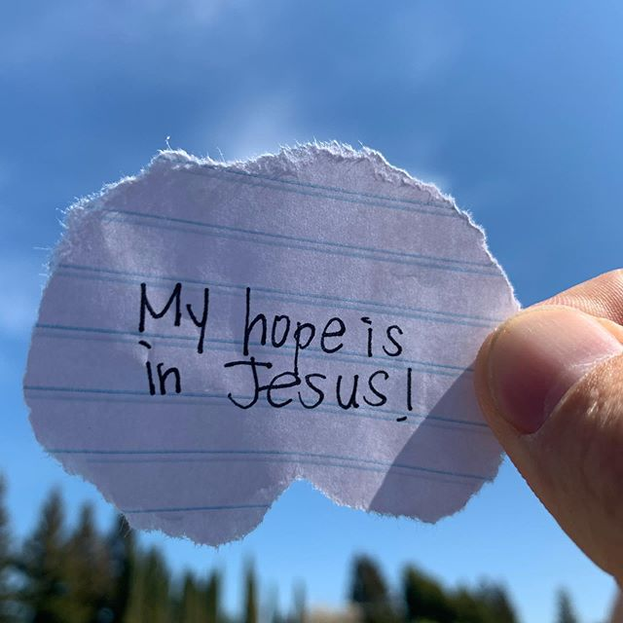
Consider the Impact
•What impacts you from the sermon, and series?
•Where do you think you will connect with the application or the need for the topic of hope?
•To whose life can God’s hope overflow through you?
•How have you grown being hope filled and HOPEFUL? Where and how might you have room for further development?
•This week enjoy the hope that is in Jesus and share the invite for others to come to Jesus for salvation and that hope that God brings.

Slide 23

A Call of Blessing!

