Slide 1
Resurrection Impact
March 31st 2024

Slide 2
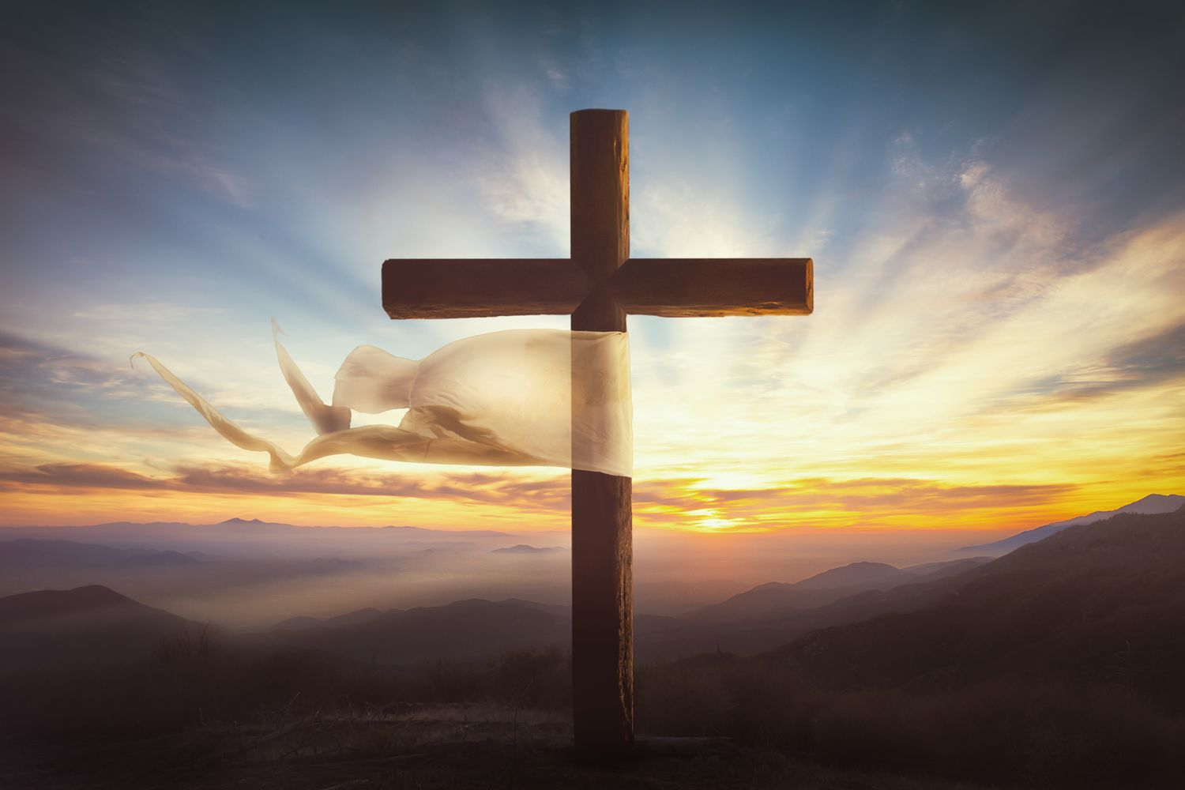
The Theme of Resurrection
We see resurrection in:
The Sun.
Sleep.
Generations.
Seasons.
Seeds.
And in Scripture…

Slide 3
Luke 9:23 and 24
“Then He said to all, ‘If anyone desires to come after Me, let him deny himself, and take up his cross daily, and follow Me. For whoever desire to save his life will lose it, but whoever loses his life for My sake will save it.’”
Jesus fully intended His death, burial, and resurrection to be carried on in the transforming of his believers from the world of sin to walk in righteousness.
His resurrection impacts our lives.

Slide 4
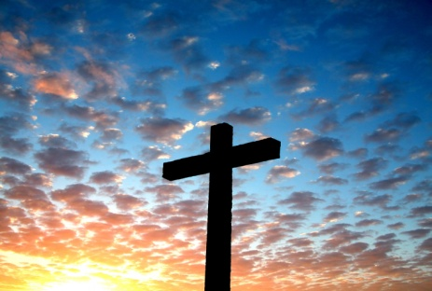
The Turning Point
The life, death, burial, and resurrection of Jesus is the turning point in human history.
To appreciate the resurrection, we need to see the pain and the loss that occurred at the cross.
Without the cross the resurrection has limited value and that is true in our own lives as well.

Slide 5
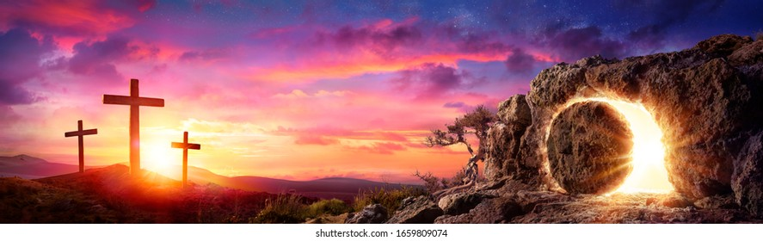
The Sacrifice:
Jesus death as a sinless, willing sacrifice, changes everything. We, humans, now have a way to be right with God again.
We can come to God and receive His blessings because of Jesus’ life, death, burial, and resurrection.

Slide 6
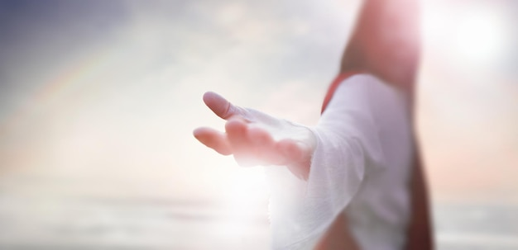
He Lives!
It is the resurrection, because of His sinless life which appeased the needs of the righteous Father, that changes human destiny.
The Bible even records a few people who were raised from the dead, but they were raised to demonstrate God’s power and they all died again.
Jesus was raised and remains alive today.

Slide 7
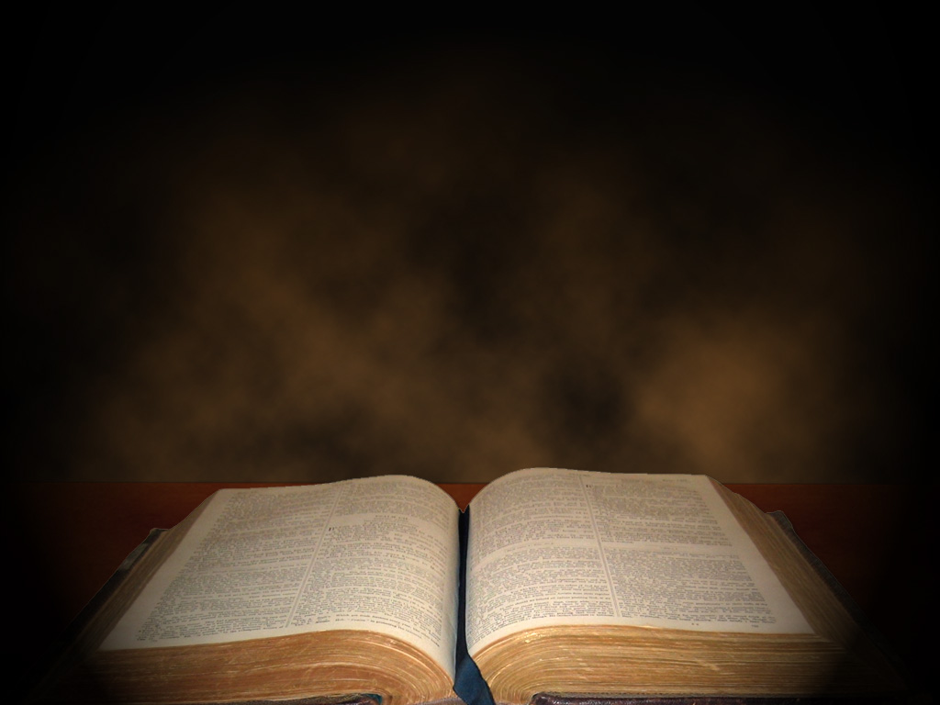
The Gospel Accounts
We read of the crucifixion, death, and burial of Jesus in Matthew 27:32-61, Mark 15:21-47, Luke 23:26-56 and John 19:16-42.
In these verses we read of the torment, suffering, pain, anguish, sacrifice, and surrender that Jesus underwent to make salvation available to all of us and any of us. These verses lead us into the darkness.

Slide 8
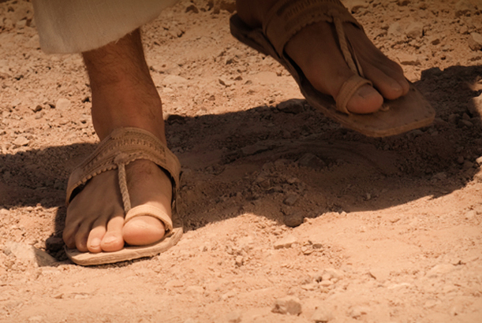
Slip Into Their Sandals
Connect to the feelings of being:
Confused
Abandoned and Alone
Sorrowful
Suffering
Scared

Slide 9
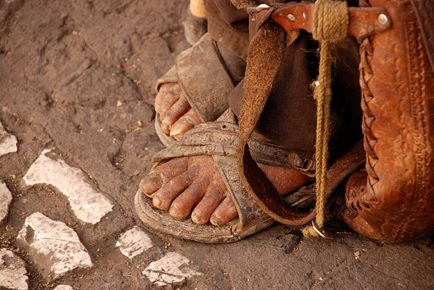
Uncomfortable!
These are not very comfortable sandals, are they?
But the disciples wrestled with the darkness for three days then the incredible happened.

Slide 10
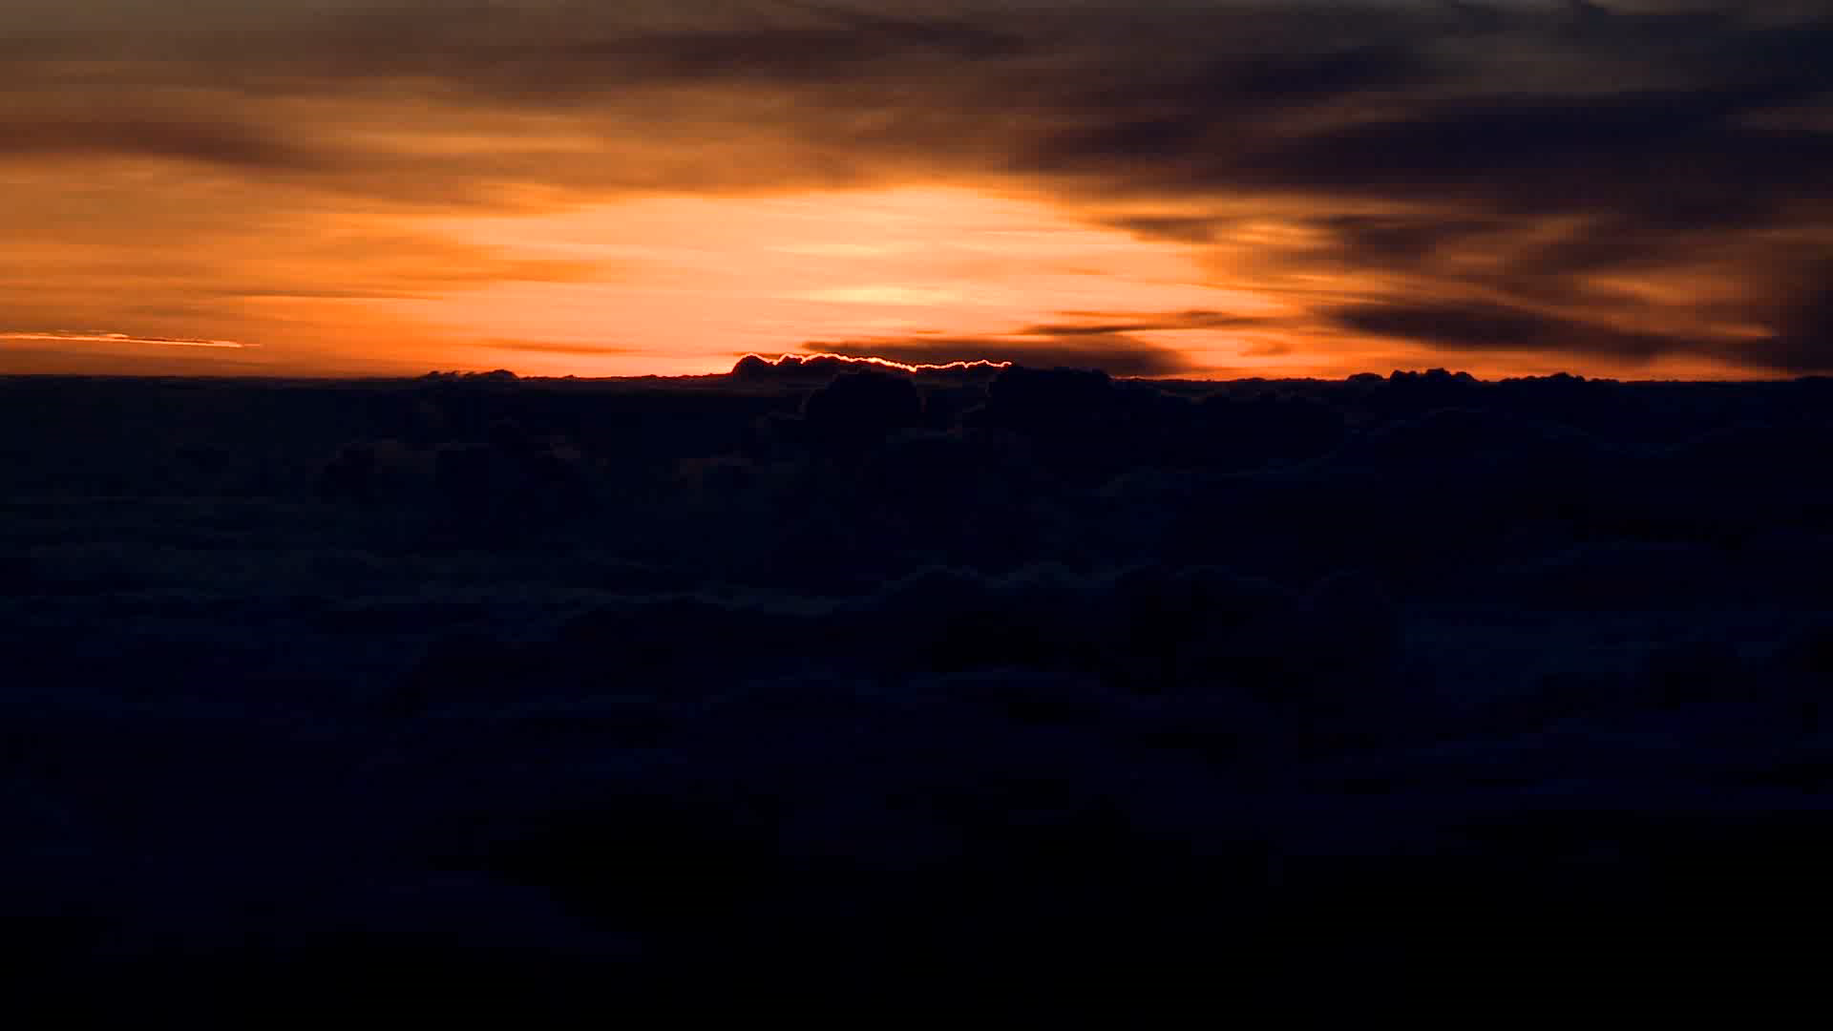
From the Darkness and Despair…

Slide 11
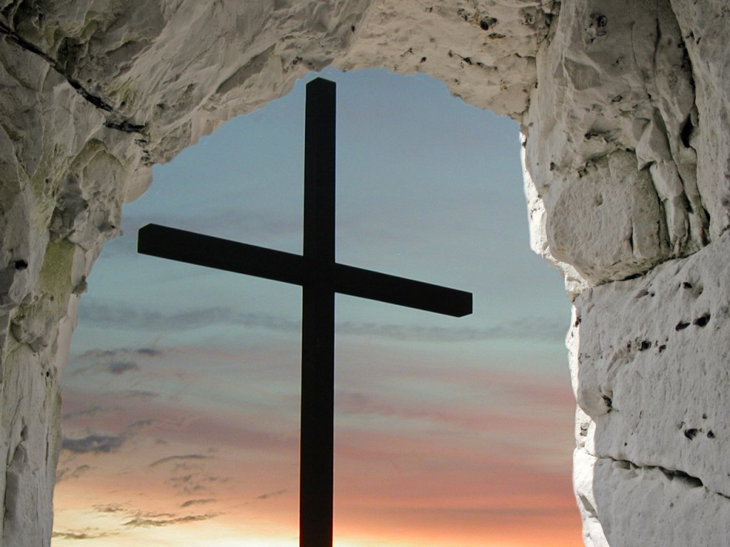
The Power of a Sunrise!
Power shown in a Son-Rise.
Romans 1:1-4 on page 1746: “Paul, a servant of Christ Jesus, called to be an apostle and set apart for the gospel of God— 2 the gospel he promised beforehand through his prophets in the Holy Scriptures 3 regarding his Son, who as to his human nature was a descendant of David, 4 and who through the Spirit of holiness was declared with power to be the Son of God by his resurrection from the dead: Jesus Christ our Lord.”

Slide 12
Matthew 27:45-56 on page 1548
We see the power of God in the mid-day darkness in verse 45.
We read of Jesus’ anguish and his quote of Psalm 22 in verse 46.
Then we have the events of verse 50 “And when Jesus had cried out again in a loud voice, he gave up his spirit.”

Slide 13
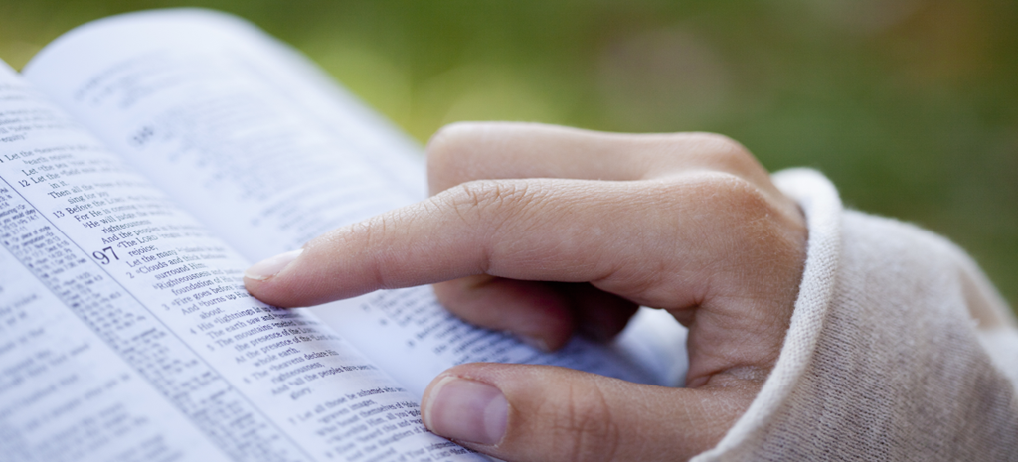
Matthew 27:51-53 on page 1548
Mt 27:51 At that moment the curtain of the temple was torn in two from top to bottom. The earth shook and the rocks split. 52 The tombs broke open and the bodies of many holy people who had died were raised to life. 53 They came out of the tombs, and after Jesus’ resurrection they went into the holy city and appeared to many people.

Slide 14
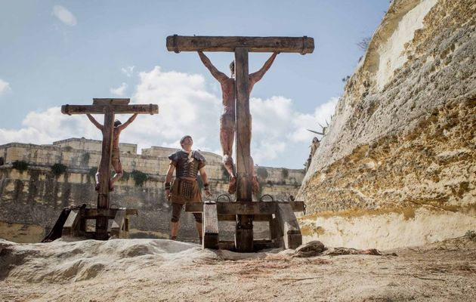
The Power is Seen in the Changed Lives
Matthew 27:54 records the words of the centurion and those who were with him guarding the now deceased Jesus as they see the earthquake and other events. The verse says “they were terrified, and exclaimed “Surely he was the Son of God!”
The “holy ones” and their families…
Matthew 27:55-56, Mark 15:40-41, and Luke 23:49 speak of the women who were near the cross. John 20:1-18 Mary Magdalene…

Slide 15
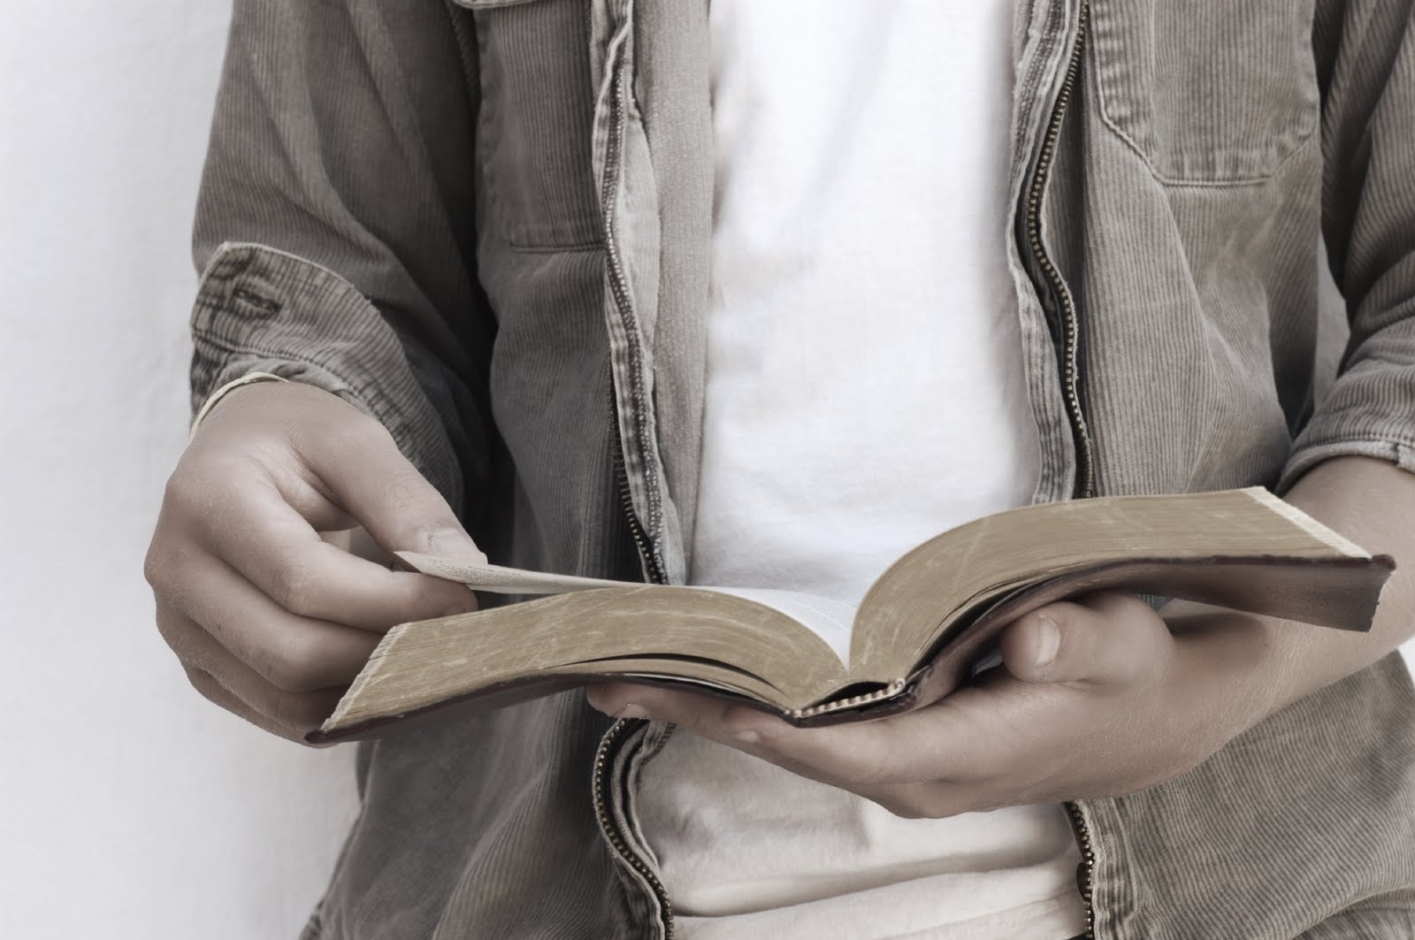
The Disciples Changed…
Luke 24:36-49 on page 1644
Luke 24:45 which reads “Then he opened their minds so that they could understand Scriptures.”
Jesus foretells a responsibility that will be given them as witnesses which is fulfilled in Acts 1:8.

Slide 16
Nicodemus and Joseph
Matthew 27:57-61 on page 1549
Mt 27:57 As evening approached, there came a rich man from Arimathea, named Joseph, who had himself become a disciple of Jesus. 58 Going to Pilate, he asked for Jesus’ body, and Pilate ordered that it be given to him. 59 Joseph took the body, wrapped it in a clean linen cloth, 60 and placed it in his own new tomb that he had cut out of the rock. He rolled a big stone in front of the entrance to the tomb and went away. 61 Mary Magdalene and the other Mary were sitting there opposite the tomb.

Slide 17
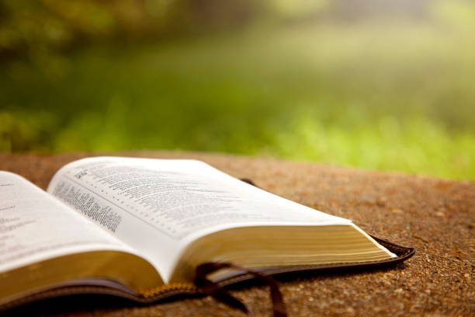
John 19:39-40 on page 1685
“He was accompanied by Nicodemus, the man who earlier had visited Jesus at night. Nicodemus brought a mixture of myrrh and aloes, about seventy-five pounds. 40 Taking Jesus’ body, the two of them wrapped it, with the spices, in strips of linen. This was in accordance with Jewish burial customs.”

Slide 18
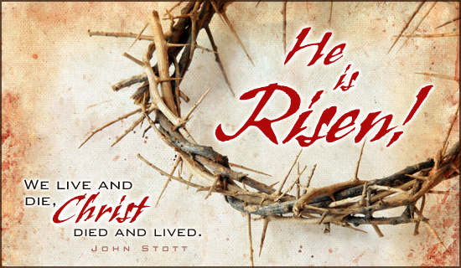
People Changed!
Luke 23:55-56 tells us “The women who had come with Jesus from Galilee followed Joseph and saw the tomb and how his body was laid in it. 56 Then they went home and prepared spices and perfumes. But they rested on the Sabbath in obedience to the commandment.”
Luke 24:1 tells us that they returned Sunday morning very early (just after sunrise Mark 16:2) to apply the spices.
Luke 24:13-35 tells us of two others on the road to Emmaus.

Slide 19
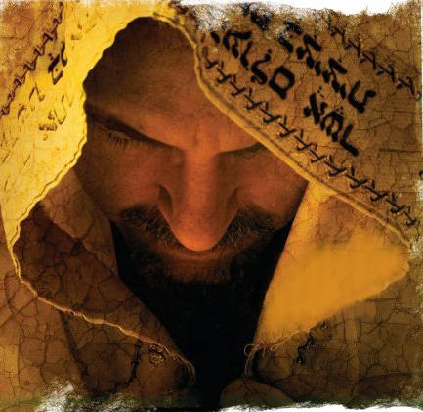
The Resurrected Jesus Was The Same But Different
Jesus looked and sounded like himself.
John 20:17 “Do not hold onto me, for I have not yet returned to the Father.”
He was not a ghost Luke 24:41-43.
We read that he came and “stood among them” in John 20:26 and Luke 24:36 in a way that “they were startled and frightened, thinking they saw a ghost.”
Luke 24:16 as the disciples on the road to Emmaus “were kept from recognizing him.”

Slide 20
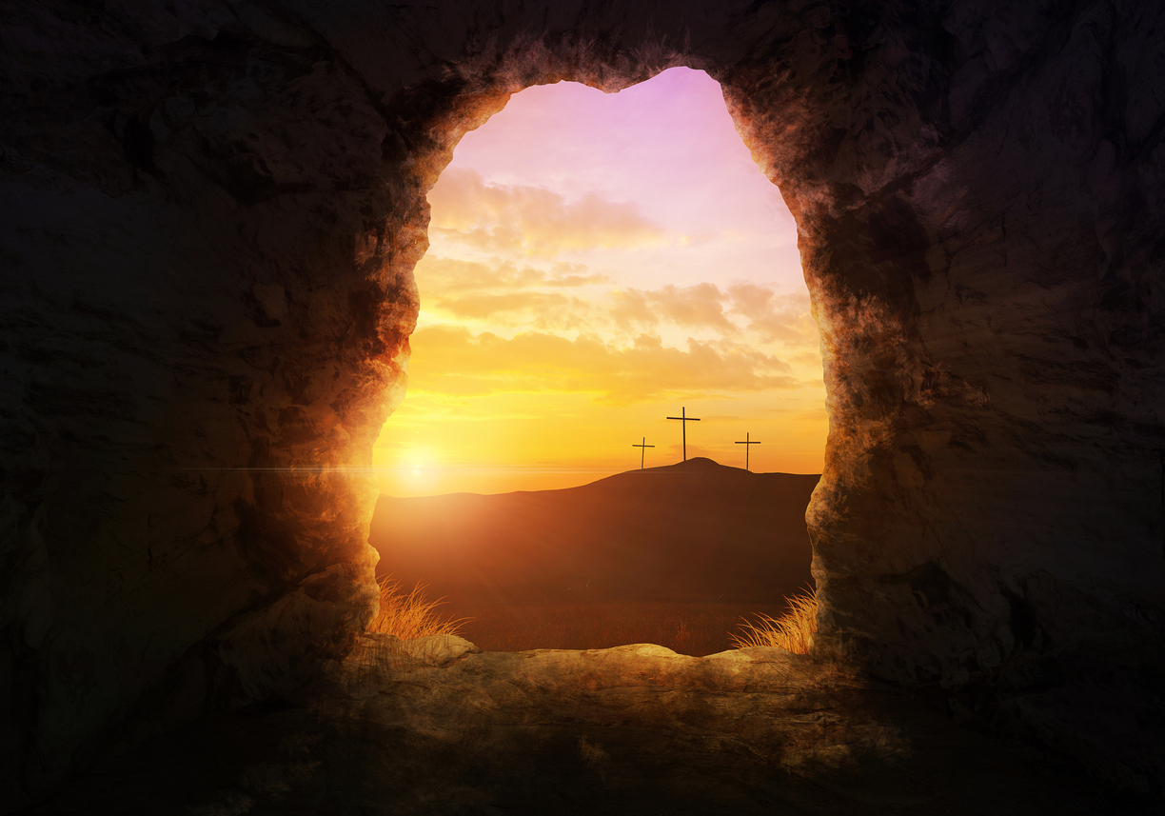
The Resurrection Made An Impact
The resurrection of Jesus was powerful enough to cause supernatural events including the raising of holy people.
It was strongly attested to by His Father, witnessed by His disciples, and evidenced by the changed lives of many people.
Read 1 Corinthians 15 on page 1789.

Slide 21
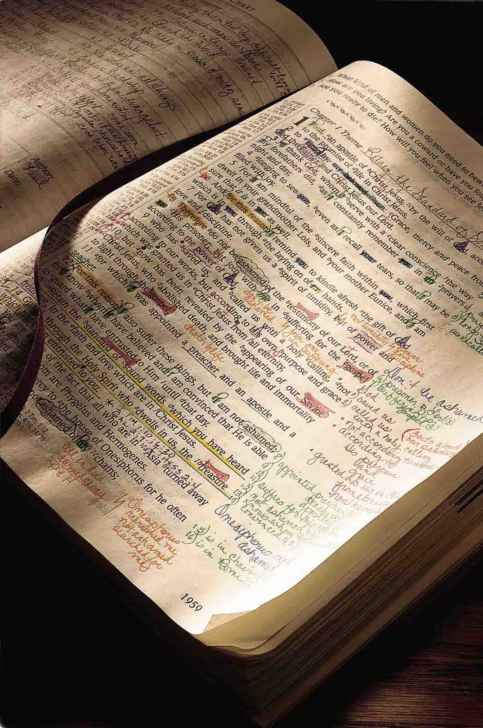
We Are the Same and Changed!!
1 Corinthians 15:17
“And if Christ has not been raised, your faith is futile; you are still in your sins.”
The positive way of saying this is “because of the resurrection of Jesus we have the hope of salvation through the removal of our sins.”

Slide 22

Making the Connection
In baptism we are washed and purified, buried in water, and raised to live a new life, cleansed by grace, and empowered by the Holy Spirit.

Slide 23

Making the Connection:
Where are you at with your spiritual death and burial because they precede resurrection. Leave the old and come to Jesus in baptism to have a changed life now and for eternity.
He has Risen! How have you been changed by His resurrection?
In what ways are you the same as before?
In what ways have you changed or are changing?

Slide 24
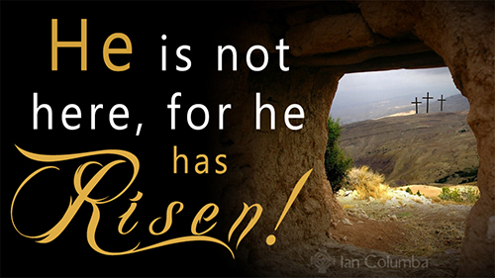
Making the Connection:
How will you be a witness for Jesus and His resurrection this week?
In the darkness of life, we are thankful for the power of the Son-Rise!
May you be blessed this week as you seek first His kingdom and serve a Risen King.

