Slide 1
8 Ways People Connect With God
Through Others, God’s Word, Experiences, Victory, Day to Day, in Honesty, the Long Term, and in Crisis.

Slide 2

Connecting to God
Changes Lives
Learning from Josiah
2 Chronicles 34 Page 726
Connecting to God Through His Word

Slide 3

The Premise of the Series
Connecting to God changes people and people start their connection to God from different points.
Personal mentors are not the only way that people start a connection to God and some people start with a connection to God through His word.
Throughout the Bible we see how people, and nations are changed through encountering God in His word.
Consider the change in Nehemiah Chapters 8-9!

Slide 4
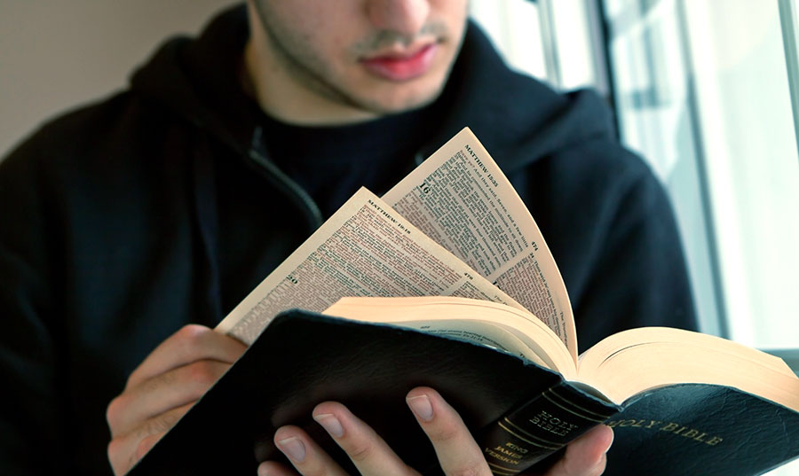
Today:
Today we are going to see how Josiah’s life was changed by an encounter with God and we will see connections between his change and the change that can occur in us when we connect to God in the same way.

Slide 5
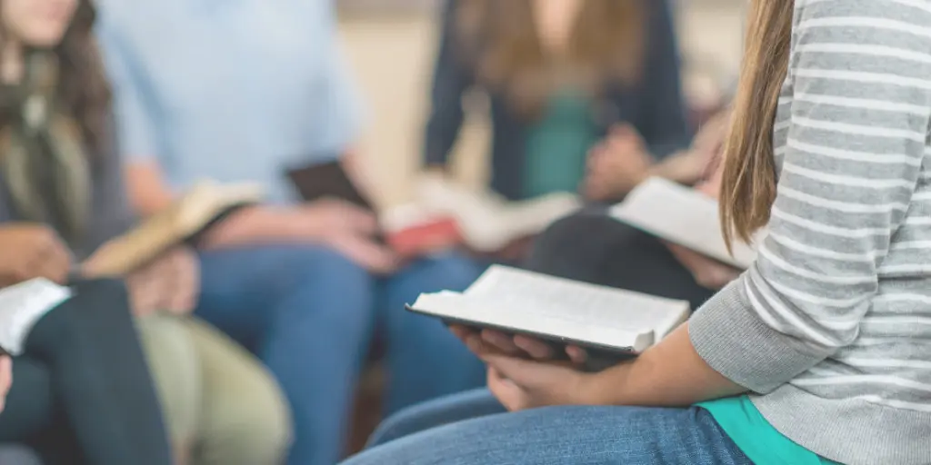
Thinking About Evangelism and Discipleship
Who helps you to know God and who, and how, are you helping to know God and make Him known?
With whom did you study the bible with last week?

Slide 6
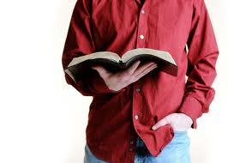
Connecting to the Word of God
How well do you know these passages?
2 Timothy 3:16-17
Hebrews 4:12
Psalm 119:105
James 1:21-22
Luke 11:28
Matthew 7:24
John 7:38
Matthew 4:4
1 Peter 2:2

Slide 7
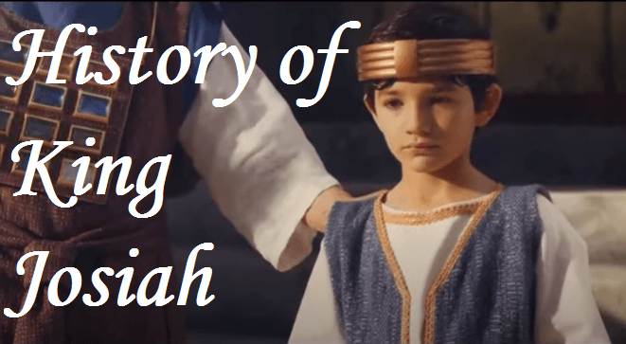
About Josiah:
Josiah was a king in Israel (650 BC) who ruled from Jerusalem.
He began his reign as king at the age of eight years old.
So, is he going to be a good king or a bad king and what will influence him?

Slide 8

Background:
Josiah’s Name: Jehovah Supports Him.
Last major beneficial ruler before the captivity of 586 BC.
At 16 he begins to seek God.
At 20 he makes national reform.

Slide 9
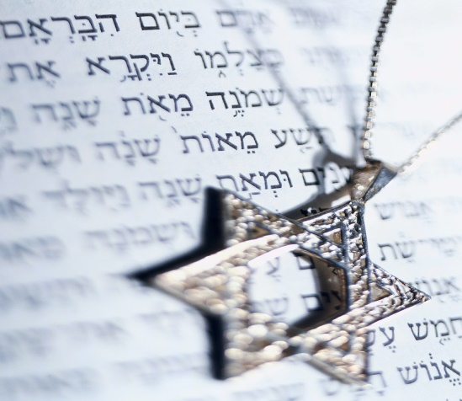
Background:
At age 28 he encounters God in a more accurate way.
In the course of renovating the temple (622 B.C.) the Book of the Law was recovered.
King Josiah is transformed when he encounters God through his written word. He connects to God by reading the book of the Law.

Slide 10
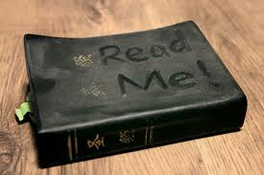
What About You?
Has your life been transformed in the same way?
Would you like a transformation?
We can help you connect with the word of God!

Slide 11

2 Chronicles 34:14-33 Page 726
14 While they were bringing out the money that had been taken into the temple of the LORD, Hilkiah the priest found the Book of the Law of the LORD that had been given through Moses. 15 Hilkiah said to Shaphan the secretary, "I have found the Book of the Law in the temple of the LORD." He gave it to Shaphan.

Slide 12
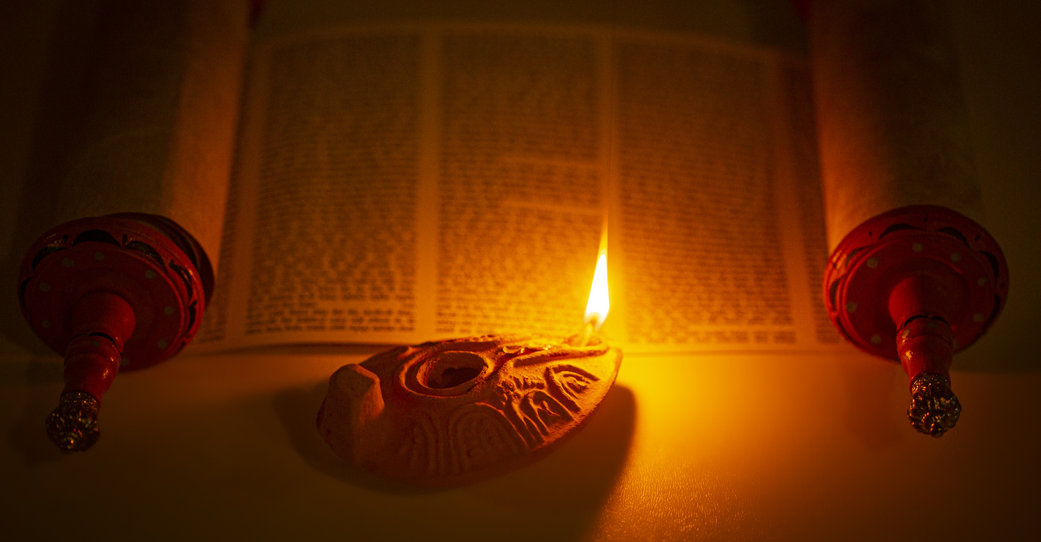
2 Chronicles 34:14-33
16 Then Shaphan took the book to the king and reported to him: "Your officials are doing everything that has been committed to them. 17 They have paid out the money that was in the temple of the LORD and have entrusted it to the supervisors and workers." 18 Then Shaphan the secretary informed the king, "Hilkiah the priest has given me a book." And Shaphan read from it in the presence of the king.

Slide 13
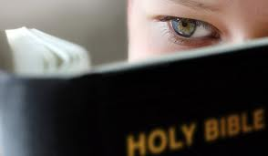
2 Chronicles 34:14-33
19 When the king heard the words of the Law, he tore his robes. 20 He gave these orders to Hilkiah, Ahikam son of Shaphan, Abdon son of Micah, Shaphan the secretary and Asaiah the king's attendant: 21 "Go and inquire of the LORD for me and for the remnant in Israel and Judah about what is written in this book that has been found. Great is the LORD's anger that is poured out on us because our fathers have not kept the word of the LORD; they have not acted in accordance with all that is written in this book."

Slide 14
2 Chronicles 34:14-33
22 Hilkiah and those the king had sent with him went to speak to the prophetess Huldah, who was the wife of Shallum son of Tokhath, the son of Hasrah, keeper of the wardrobe. She lived in Jerusalem, in the Second District.

Slide 15
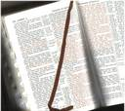
2 Chronicles 34:14-33
23 She said to them, "This is what the LORD, the God of Israel, says: Tell the man who sent you to me, 24 `This is what the LORD says: I am going to bring disaster on this place and its people--all the curses written in the book that has been read in the presence of the king of Judah. 25 Because they have forsaken me and burned incense to other gods and provoked me to anger by all that their hands have made, my anger will be poured out on this place and will not be quenched.'

Slide 16

26 Tell the king of Judah, who sent you to inquire of the LORD, `This is what the LORD, the God of Israel, says concerning the words you heard: 27 Because your heart was responsive and you humbled yourself before God when you heard what he spoke against this place and its people, and because you humbled yourself before me and tore your robes and wept in my presence, I have heard you, declares the LORD.

Slide 17
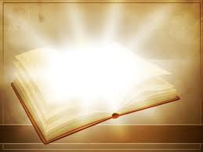
2 Chronicles 34:14-33
28 Now I will gather you to your fathers, and you will be buried in peace. Your eyes will not see all the disaster I am going to bring on this place and on those who live here.' " So they took her answer back to the king.

Slide 18
2 Chronicles 34:14-33
29 Then the king called together all the elders of Judah and Jerusalem. 30 He went up to the temple of the LORD with the men of Judah, the people of Jerusalem, the priests and the Levites--all the people from the least to the greatest.

Slide 19
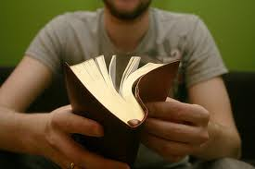
2 Chronicles 34:14-33
He read in their hearing all the words of the Book of the Covenant, which had been found in the temple of the LORD. 31 The king stood by his pillar and renewed the covenant in the presence of the LORD--to follow the LORD and keep his commands, regulations and decrees with all his heart and all his soul, and to obey the words of the covenant written in this book.

Slide 20

2 Chronicles 34:14-33
32 Then he had everyone in Jerusalem and Benjamin pledge themselves to it; the people of Jerusalem did this in accordance with the covenant of God, the God of their fathers.

Slide 21

2 Chronicles 34:14-33
33 Josiah removed all the detestable idols from all the territory belonging to the Israelites, and he had all who were present in Israel serve the LORD their God. As long as he lived, they did not fail to follow the LORD, the God of their fathers.

Slide 22
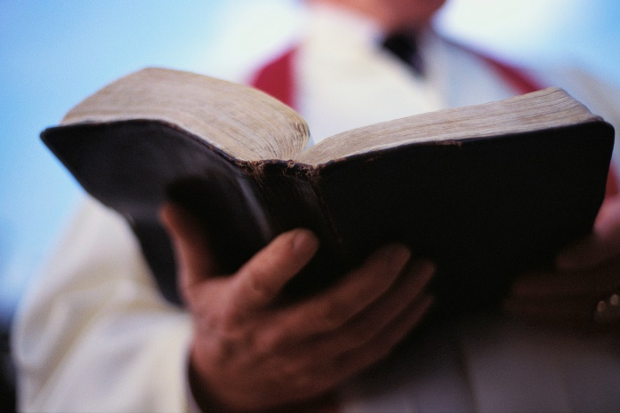
How Does It End?
He leads a Passover.
Ungodly Priests are removed.
He interferes with Pharaoh Neco's plans to aid the Assyrians and dies in 609 BC.
The nation mourns His death.

Slide 23
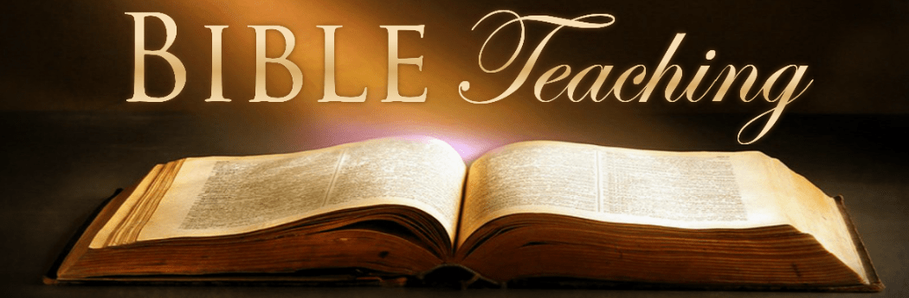
What About You?
Do you have people in your life that help make the word of God understandable?
Do you spend time reading God’s word for yourself?
Do you need help getting into the word of God and getting something out of it?
We believe that God’s word changes people because God is behind it.

Slide 24

What About You?
It not just a Bible, it is God working through it. Those who are ready to hear and to follow become transformed.
Following Jesus involves knowing His word and living in obedience to it. Jesus’s disciples are drawn toward bible study and discussion of His word.
With whom did you study the bible with last week?

Slide 25

Last Week and This Week
Last week I asked who was watching you and this week I am asking that we consider the source of our transformation.

Slide 26
Thinking it Through:
How are you being led by God?
Do you know His voice?
Where are you connecting for group Bible study?
Now is the time to connect.

Slide 27

Next Week:
Connecting to God Through Experiences.

