Slide 1
8 Ways People Connect With God
Through Others, God’s Word, Experiences, Victory, Day to Day, in Honesty, the Long Term, and in Crisis.

Slide 2

Connecting to God Changes Lives
Deborah – Judges 4-5 Page 376
Connecting in Victory.

Slide 3
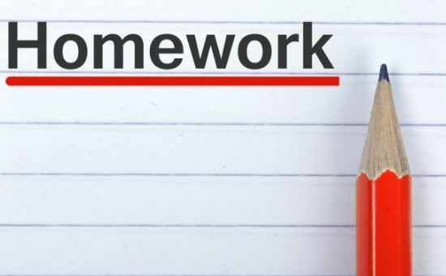
Homework Check In!
How did you do with the homework of sharing your story and asking people what God is doing in their life or what lessons they are learning from God right now?

Slide 4
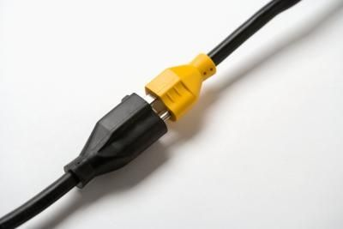
Powerful Connections
Through Mentors.
Through God’s Word.
Through Experiences.
Through Victory!

Slide 5
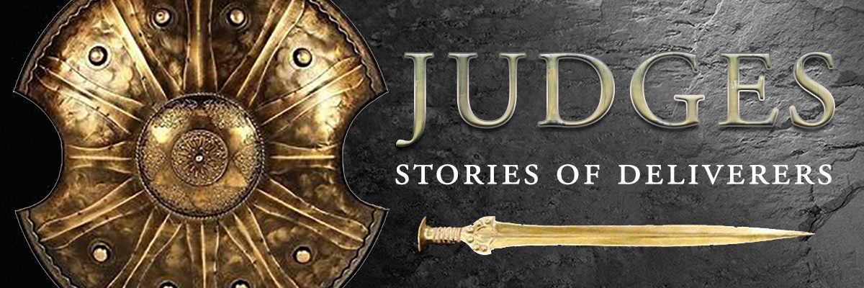
Connecting with our God of Victory
We will be looking in the book of Judges to see Deborah connect with God in victory and how that changed her life and the path of the nation.
Life can be tough, and our faith is increased when we connect to God in victory.

Slide 6

The Book of Judges:
Judges is a transitional book.
It covers a time in Israel’s history when God was trying to lead the people through Judges instead of a main leader like Moses or Joshua.

Slide 7

The Book of Judges:
God has led the nation:
Through the fathers.
Through the priests.
Through strong leaders.
Now, through Judges.

Slide 8
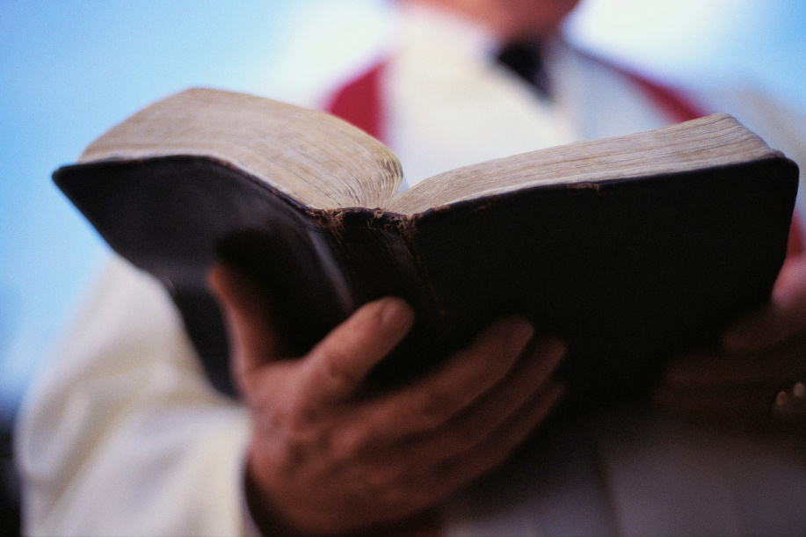
The Work of the Judges:
It was the role of the Judge to lead the people in war, law, and truth.
They were to provide guidance and justice for the people.

Slide 9

The Cycle of Judges:
People cry for deliverance.
God provides.
Peace.
Fall away.
Punishment.
Cry for deliverance.

Slide 10

Judges 4-5
The key characters in this account:
Deborah the Judge,
Barak the leader of Israel’s army,
Jabin the rival king and
Sisera the leader of the enemy army.
Judges 4:1-8 Page 376:

Slide 11
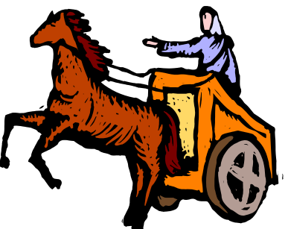
Judges 4:1-8:
After Ehud died, the Israelites once again did evil in the eyes of the LORD. 2 So the LORD sold them into the hands of Jabin, a king of Canaan, who reigned in Hazor. The commander of his army was Sisera, who lived in Harosheth Haggoyim. 3 Because he had nine hundred iron chariots and had cruelly oppressed the Israelites for twenty years, they cried to the LORD for help.

Slide 12
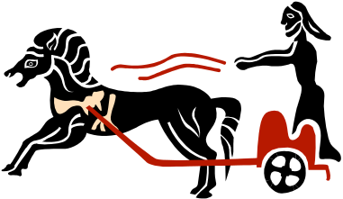
Judges 4:1-8:
4 Deborah, a prophetess, the wife of Lappidoth, was leading Israel at that time. 5 She held court under the Palm of Deborah between Ramah and Bethel in the hill country of Ephraim, and the Israelites came to her to have their disputes decided. 6 She sent for Barak son of Abinoam from Kedesh in Naphtali and said to him,

Slide 13

Judges 4:1-8:
"The LORD, the God of Israel, commands you: `Go, take with you ten thousand men of Naphtali and Zebulun and lead the way to Mount Tabor. 7 I will lure Sisera, the commander of Jabin's army, with his chariots and his troops to the Kishon River and give him into your hands.' " 8 Barak said to her, "If you go with me, I will go; but if you don't go with me, I won't go."

Slide 14

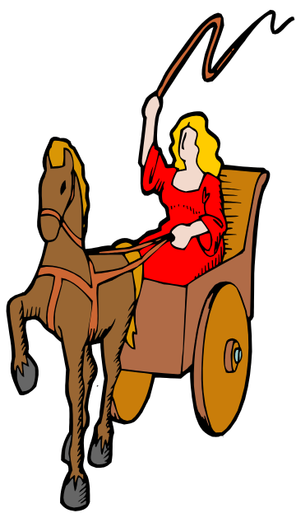
The Deliverance:
The Lord delivers Deborah and the nation in a spectacular, though natural, way.
God stops the power of the chariots by having it rain so hard the ground becomes too muddy to drive so the enemy is overtaken according to 5:4-5.

Slide 15

Judges 4:23-24:
Both Sisera and Jabin get their due.
Judges 4:23-24
On that day God subdued Jabin, the Canaanite king, before the Israelites. 24 And the hand of the Israelites grew stronger and stronger against Jabin, the Canaanite king, until they destroyed him.

Slide 16
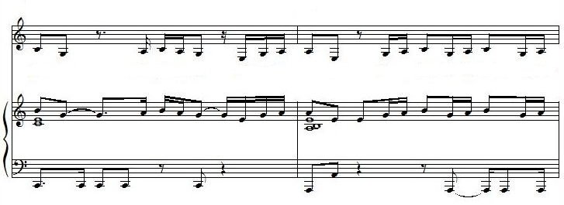
Judges 5:1-3:
On that day Deborah and Barak son of Abinoam sang this song: 2 "When the princes in Israel take the lead, when the people willingly offer themselves-- praise the LORD! 3 "Hear this, you kings! Listen, you rulers! I will sing to the LORD, I will sing; I will make music to the LORD, the God of Israel.
WHY? Because he is the deliverer!!

Slide 17

Her Story…
Deborah is a person with a connection to the Lord as one of his prophets.
She is the only female Judge and leader of the nation which may say something about her connection to God or her receptivity to His lead.

Slide 18
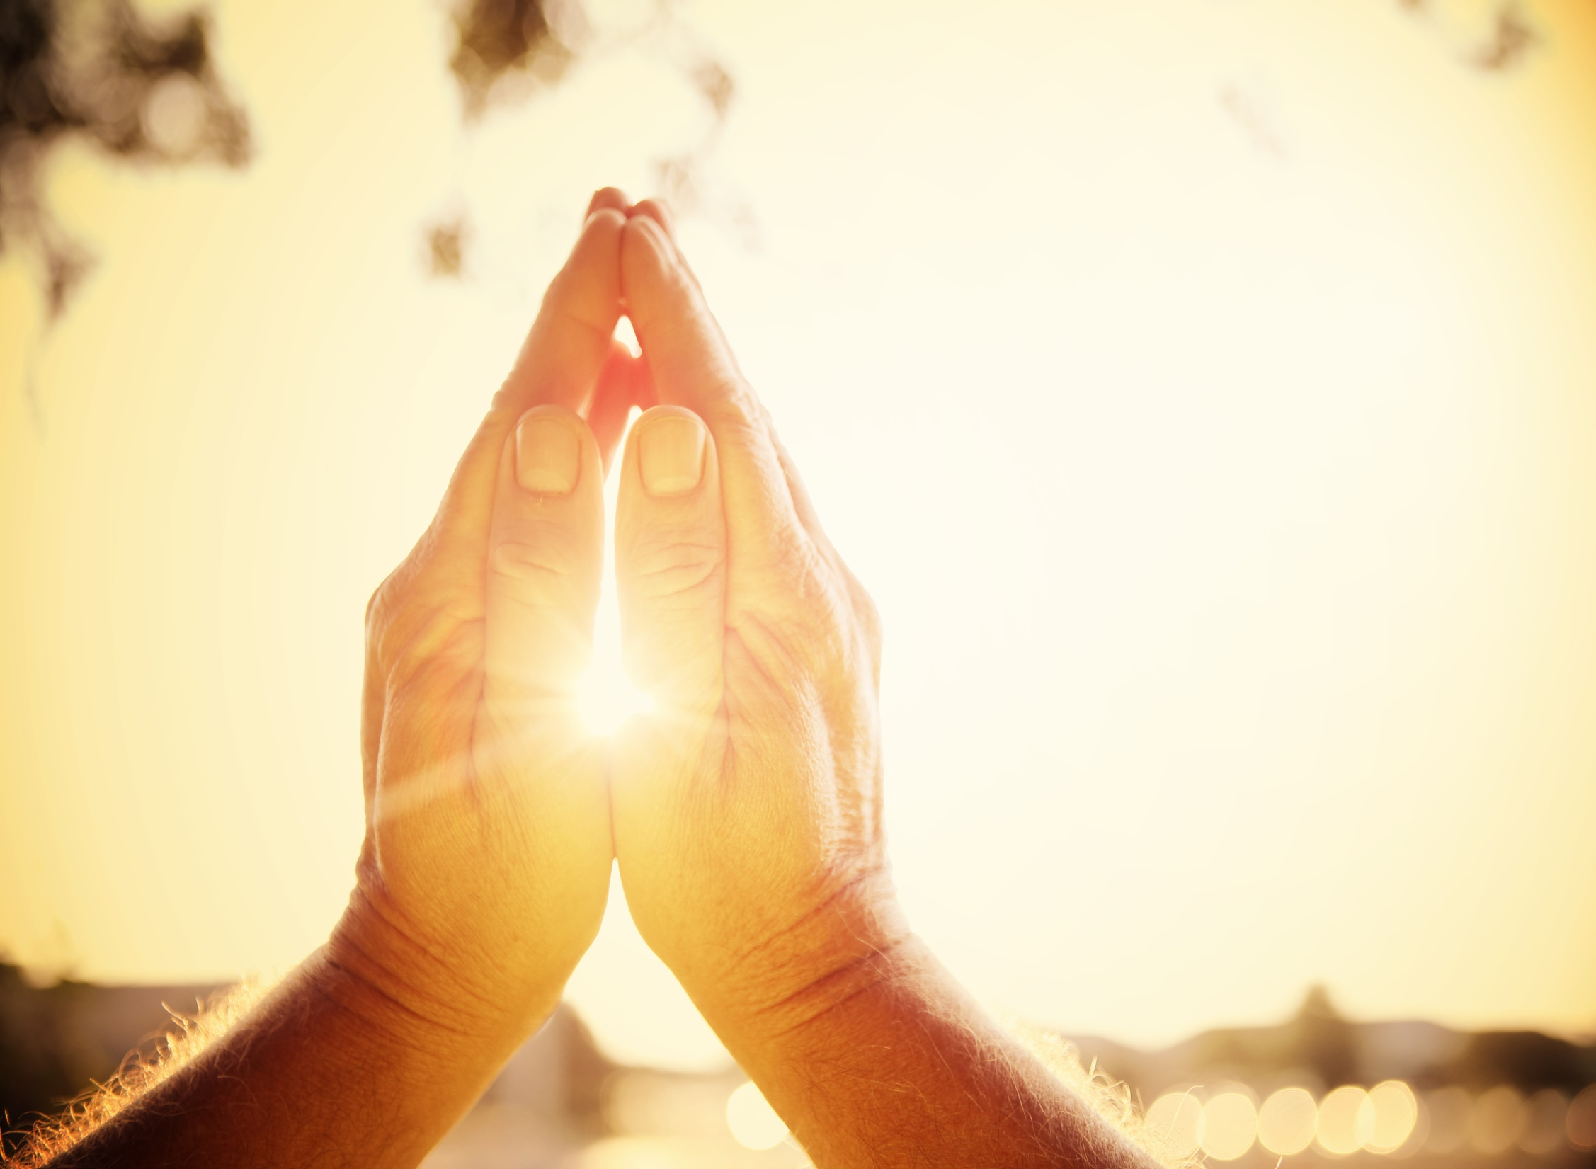
In Your Life??
How have you connected to God in victory?
Have you called out to God for strength, guidance, or deliverance and had Him answer?
It is a powerful way to connect to God.

Slide 19
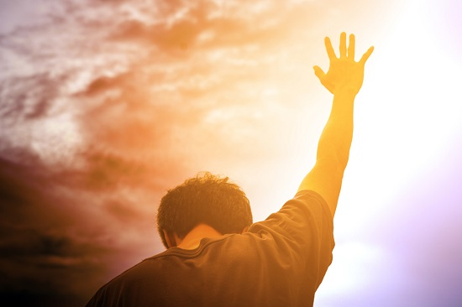
Thinking it Through:
God wants to be our deliverer.
He wants to be the one who rescues.
He wants to be our hero and our savior.
For that to happen we need to seek Him.
A story about Appreciating the cost of salvation.

Slide 20
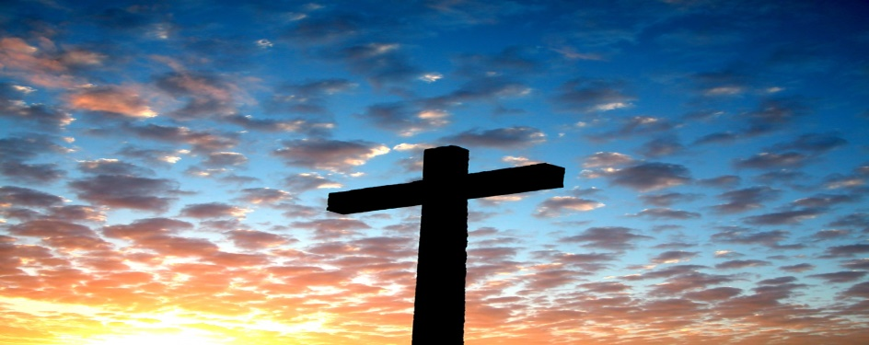
Our Greatest Need:
"If our greatest need had been information, God would have sent us an educator. If our greatest need had been technology, God would have sent us a scientist. If our greatest need had been money, God would have sent us an economist. But since our greatest need was forgiveness, God sent us a Savior."

Slide 21
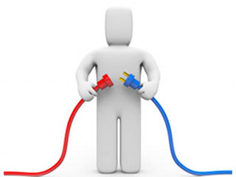
Making the Connection:
When we are delivered from turmoil, pain, sorrow, and all of the difficulties of life we rejoice in our deliverer.
When we ask Jesus to remove our sins and accept His victory over sin and death in baptism then we are truly transformed.
2 Corinthians 5:17 reminds us “we are a new creation; and the old has gone, the new has come.”
Only Jesus gives us eternal victory over sin and separation.

Slide 22
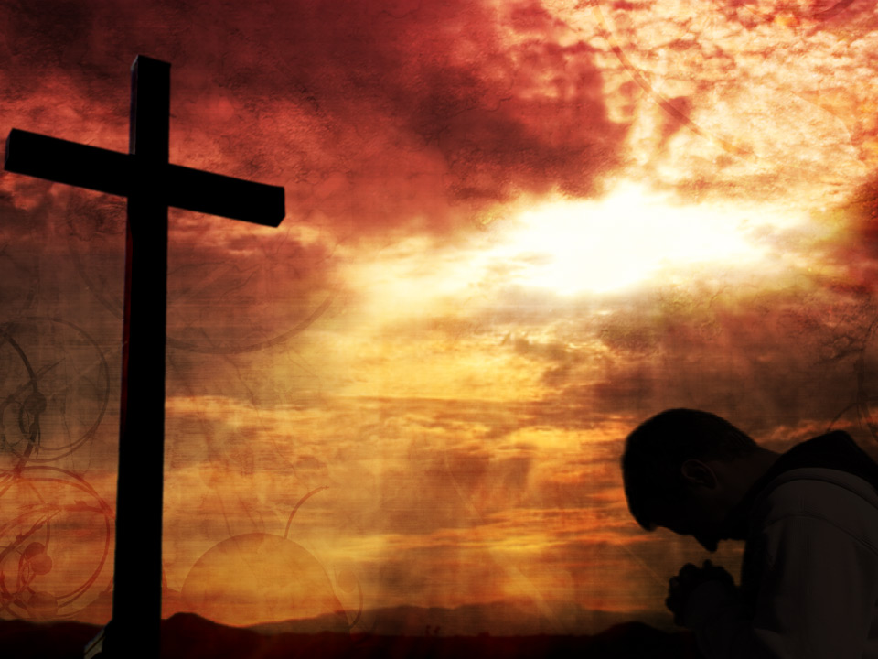
This Week:
Who do you know that needs victory and how can you help them come to Jesus?
No one, or nothing else, offers the victory that Jesus has provided.
He is the way, the truth, and the life and no one comes to the father except through Him.

Slide 23
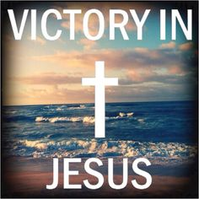
This Week:
This week come to Christ as your deliverer and thank him for the victory.
Our strength is limited but His is not.
Let’s celebrate the victory in Jesus.
Next Week: Easter Weekend – Resurrection Impact.
Then we look at Mary and Joseph
– Connecting to God in the Day to Day

