Slide 1
8 Ways People Connect With God
Through Others, God’s Word, Experiences, Victory, Day to Day, in Honesty, the Long Term, and in Crisis.

Slide 2
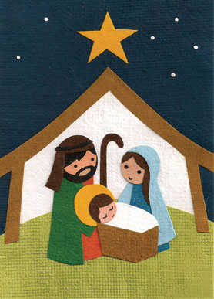
Connecting to God Changes Lives:
Mary and Joseph
Connecting with God in the Day to Day.

Slide 3

Connecting God in The New Testament
In the New Testament we will be looking at:
Mary and Joseph.
Thomas.
Zacchaeus.
Pilate.

Slide 4
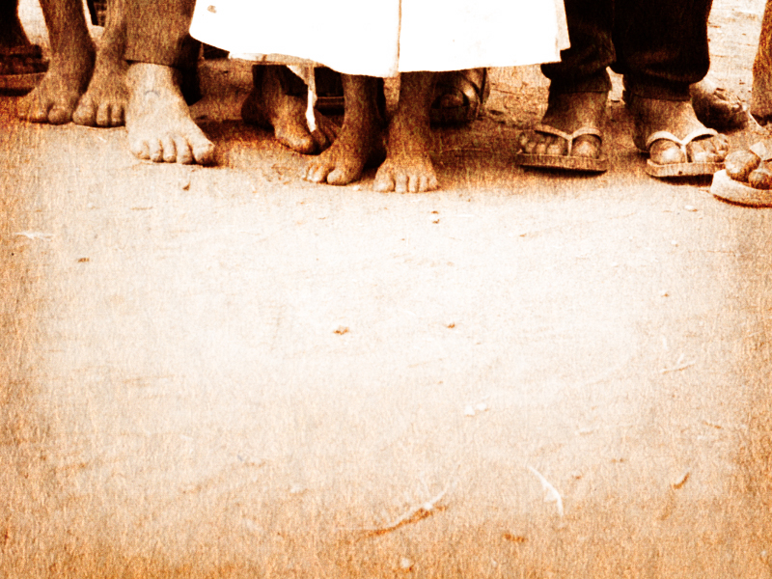
Once in a While, or Day to Day?
Church attenders add Jesus into their schedule…
Disciples of Jesus walk with Him each day…
The Great Commission – Matthew 28:16-20

Slide 5

A Blessing:

Slide 6
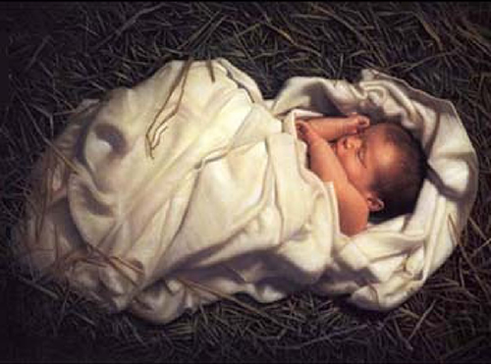
Mary and Joseph:
He is not just a godly child; He is God…now just think how that would change your life.

Slide 7
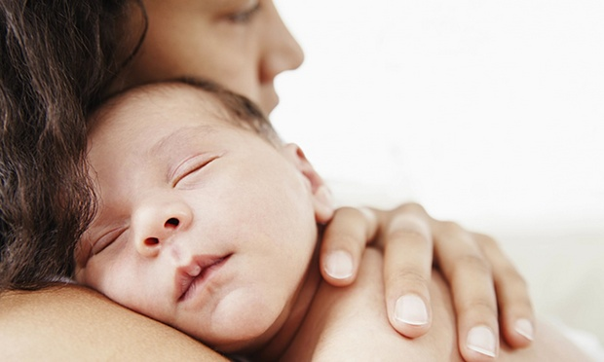
God With Us…
Not a message, or an angel,…
God has moved into Mary’s body and into Joseph’s house.
He is Immanuel – God with us.

Slide 8
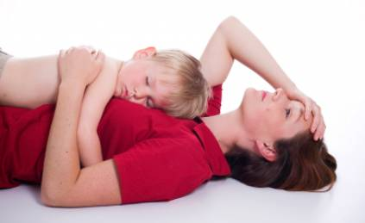
For You:
Just imagine, in your life right now, adding in a new member of the family: to have someone in your home, not as a guest, but as a resident.

Slide 9
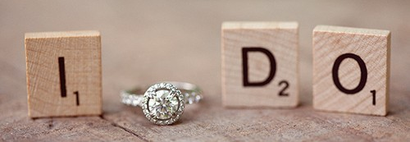
Matthew 1:18-25 Page 1497
18 This is how the birth of Jesus Christ came about: His mother Mary was pledged to be married to Joseph, but before they came together, she was found to be with child through the Holy Spirit. 19 Because Joseph her husband was a righteous man and did not want to expose her to public disgrace, he had in mind to divorce her quietly.

Slide 10
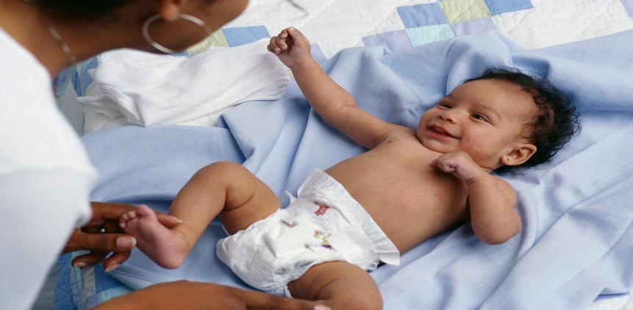
Matthew 1:18-25
20 But after he had considered this, an angel of the Lord appeared to him in a dream and said, "Joseph son of David, do not be afraid to take Mary home as your wife, because what is conceived in her is from the Holy Spirit. 21 She will give birth to a son, and you are to give him the name Jesus, because he will save his people from their sins."

Slide 11
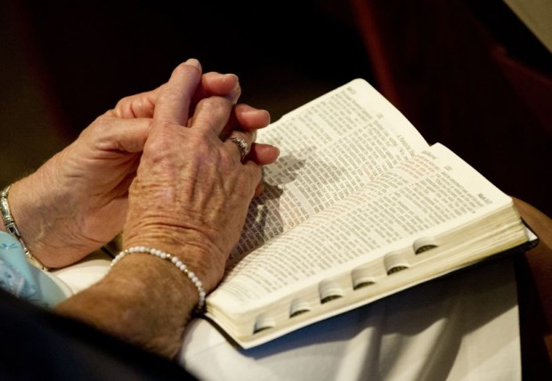
Matthew 1:18-25
22 All this took place to fulfill what the Lord had said through the prophet: 23 "The virgin will be with child and will give birth to a son, and they will call him Immanuel" --which means, "God with us."

Slide 12
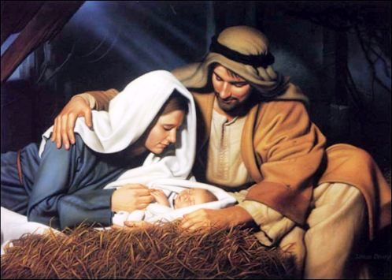
Matthew 1:18-25
MT 1:24 When Joseph woke up, he did what the angel of the Lord had commanded him and took Mary home as his wife. 25 But he had no union with her until she gave birth to a son. And he gave him the name Jesus.

Slide 13
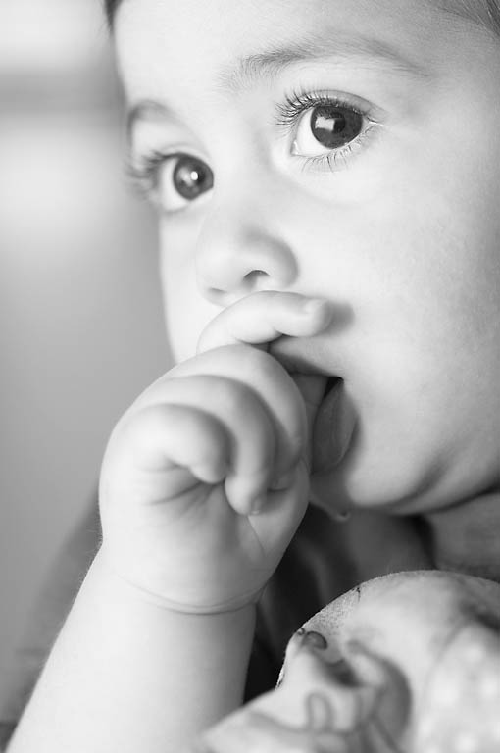
Luke 1:26-38 Page 1588
In the sixth month [of Elizabeth’s pregnancy], God sent the angel Gabriel to Nazareth, a town in Galilee, 27 to a virgin pledged to be married to a man named Joseph, a descendant of David. The virgin's name was Mary. 28 The angel went to her and said, "Greetings, you who are highly favored! The Lord is with you.

Slide 14
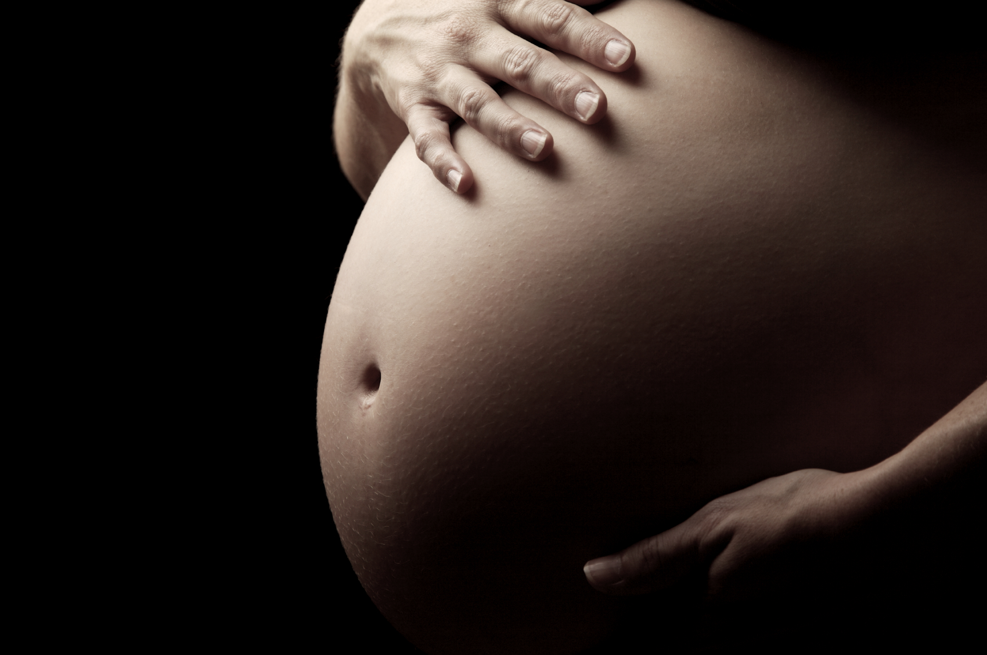
Luke 1:26-38
29 Mary was greatly troubled at his words and wondered what kind of greeting this might be. 30 But the angel said to her, "Do not be afraid, Mary, you have found favor with God. 31 You will be with child and give birth to a son, and you are to give him the name Jesus. 32 He will be great and will be called the Son of the Most High. The Lord God will give him the throne of his father David, 33 and he will reign over the house of Jacob forever; his kingdom will never end."

Slide 15
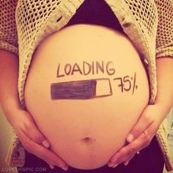
Luke 1:26-38
34 "How will this be," Mary asked the angel, "since I am a virgin?“ 35 The angel answered, "The Holy Spirit will come upon you, and the power of the Most High will overshadow you. So the holy one to be born will be called the Son of God. 36 Even Elizabeth your relative is going to have a child in her old age, and she who was said to be barren is in her sixth month. 37 For nothing is impossible with God."
LK 1:38 "I am the Lord's servant," Mary answered. "May it be to me as you have said." Then the angel left her.

Slide 16

Connecting:
God is now in their lives and the change can be overwhelming.
He is not a guest; he is a resident. God lives at their house!

Slide 17
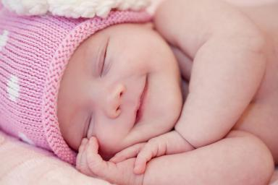
Connecting:
Do you remember this type of change?

Slide 18

Connecting:
They are connecting to God in the day to day.
How would you have spent those days with God?

Slide 19

In Your Life:
How about you?
Do you connect with God in the day to day?
Do you pray continually?
Do you see your life connected to God in every moment?
Do you focus on the spiritual aspect of each day along with the physical elements of each day?

Slide 20

How Can You Connect?
Take Jesus with you in every event, especially the common ones.
Look at meeting His needs before your own.
Talk with Him often.

Slide 21

How Do You Connect?:
Change your perspective. He is a resident not a guest.
Change your priorities.
Change your behavior.
Find people with whom you have this in common.

Slide 22

Following Their Example
Mary and Joseph went through a transformation as they connected to God in a whole new way, and we can be transformed as well.

Slide 23

Ephesians 2:1-10 Page 1818
As for you, you were dead in your transgressions and sins, 2 in which you used to live when you followed the ways of this world and of the ruler of the kingdom of the air, the spirit who is now at work in those who are disobedient. 3 All of us also lived among them at one time, gratifying the cravings of our sinful nature and following its desires and thoughts. Like the rest, we were by nature objects of wrath. …

Slide 24
Ephesians 2:1-10 Page 1818
But because of his great love for us, God, who is rich in mercy, 5 made us alive with Christ even when we were dead in transgressions--it is by grace you have been saved. 6 And God raised us up with Christ and seated us with him in the heavenly realms in Christ Jesus, 7 in order that in the coming ages he might show the incomparable riches of his grace, expressed in his kindness to us in Christ Jesus. …

Slide 25
Ephesians 2:1-10 Page 1818
…8 For it is by grace you have been saved, through faith--and this not from yourselves, it is the gift of God-- 9 not by works, so that no one can boast. 10 For we are God's workmanship, created in Christ Jesus to do good works, which God prepared in advance for us to do.

Slide 26
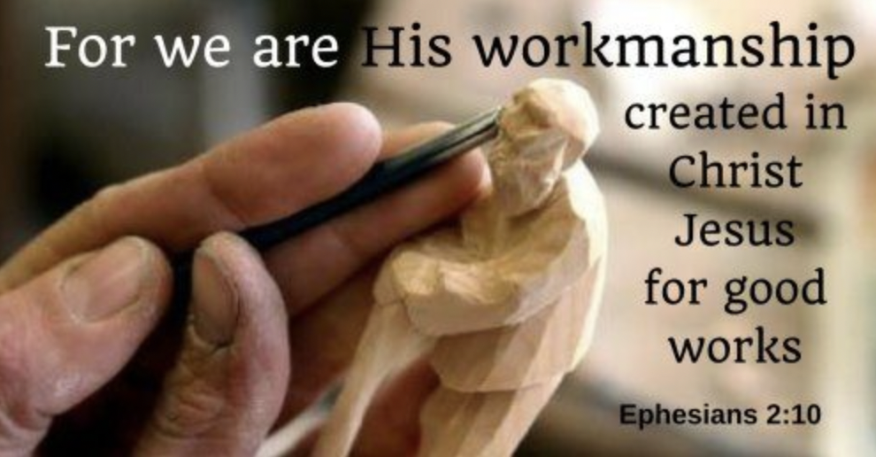
At Work Daily…
God has good works for us to do and He wants us to do them in the day to day.
Will you offer Him this week to work through you?
How will you connect with God this week in the day to day?

Slide 27

Next Week’s Sermon
Thomas.
Connecting to God in honesty.

