Slide 1
“Let Us” Thirsty Lessons
August 18th 2024
2 Corinthians 7:1– Page 1800
“Let Us Clean Up.”

Slide 2
Learning from the Let Us Passages
How are you doing with the call of action in the Let Us passages that we have looked at so far?
Who are you encouraging and helping to enter in, mature, appreciate, look ahead, dress up by exchanging the old life for the new, and to be considerate of the needs of the group over the preference of the individual in disputable matters? Who is part of your let us?
Who do you know who is Thirsty for a disconnection from worldliness?

Slide 3
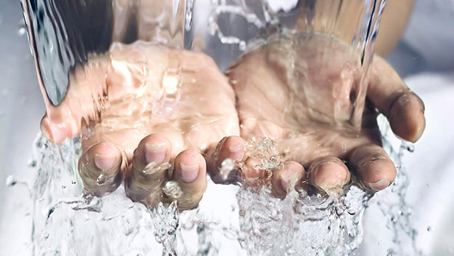
2 Corinthians 7:1 Page 1800
“Since we have these promises, dear friends, let us purify ourselves from everything that contaminates body and spirit, perfecting holiness out of reverence for God.”

Slide 4
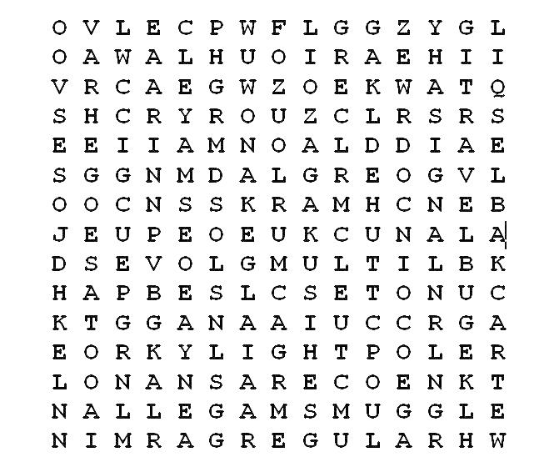
Word Game
Apostle,
Disciple,
Church,
Holy,
Sanctification,
Born Again,
Pure
Righteous

Slide 5
The Call…
They are all words that remind us that we are different and separate from the world around us.
The call is to purify ourselves from everything that contaminates body and spirit.

Slide 6
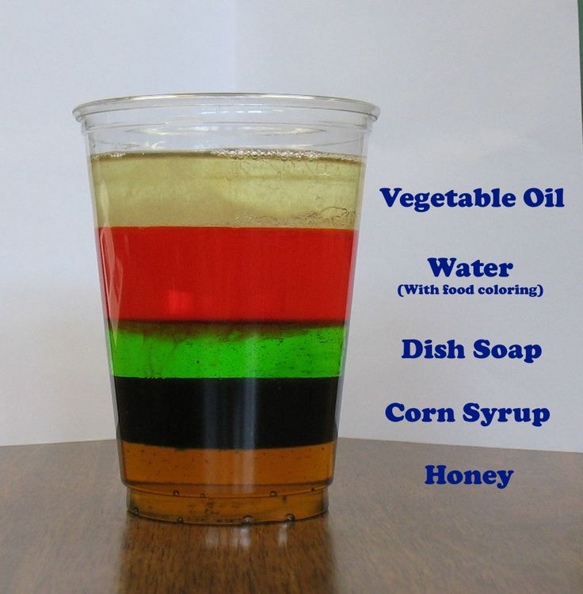
An Illustration…
Do we expect them to mix?
They can co-exist without mixing because separation is natural.

Slide 7

Disconnection and Reconnection
2 Corinthians 5:17 says “Therefore, if anyone is in Christ, he is a new creation; the old has gone, the new has come!”
This is a big change. We are now a new creation not just a better version of our old selves.
We are “the called out.”

Slide 8
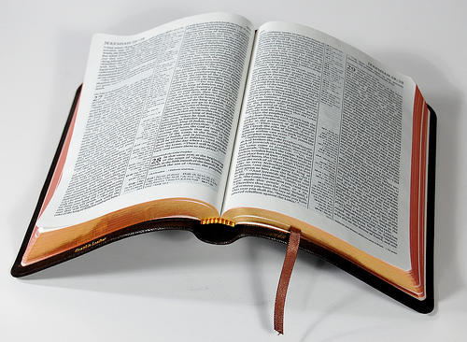
Disconnection Passages
Ephesians 5:6-11 “6 Let no one deceive you with empty words, for because of such things God’s wrath comes on those who are disobedient. 7 Therefore do not be partners with them. 8 For you were once darkness, but now you are light in the Lord. Live as children of light 9 (for the fruit of the light consists in all goodness, righteousness and truth) 10 and find out what pleases the Lord. 11 Have nothing to do with the fruitless deeds of darkness, but rather expose them.”

Slide 9
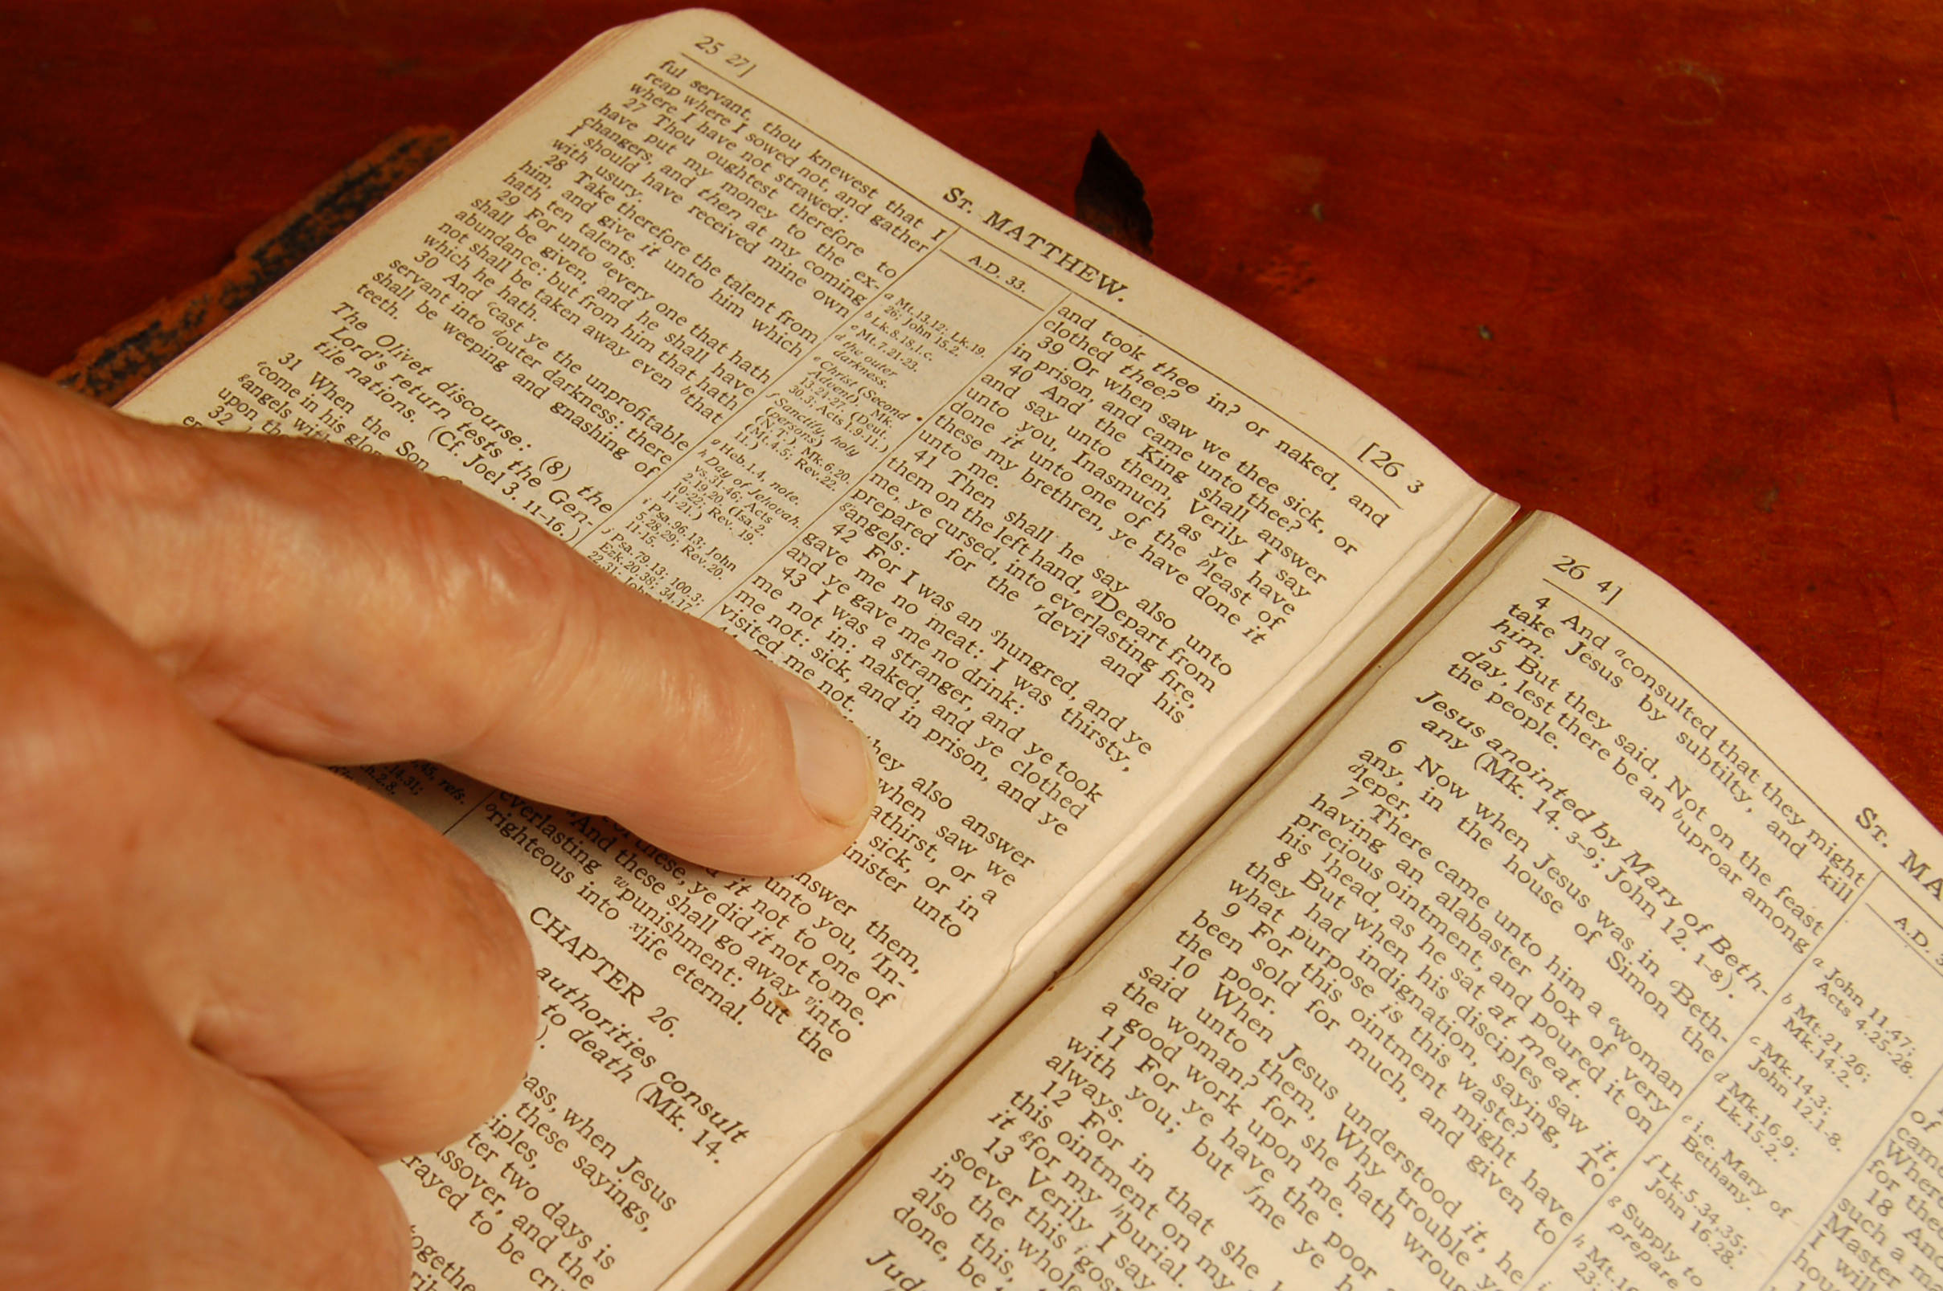
Disconnection Passages
1 John 1:6 “If we claim to have fellowship with him yet walk in the darkness, we lie and do not live by the truth.”
1 Corinthians 15:33-34 “Do not be misled: “Bad company corrupts good character.” ³⁴ Come back to your senses as you ought, and stop sinning; for there are some who are ignorant of God—I say this to your shame.”

Slide 10

Disconnection Passages
James 4:4-5 “You adulterous people, don’t you know that friendship with the world is hatred toward God? Anyone who chooses to be a friend of the world becomes an enemy of God. 5 Or do you think Scripture says without reason that the spirit he caused to live in us envies intensely?”
1 John 2:6 “Whoever claims to live in him must walk as Jesus did.”

Slide 11

Not a Surprise.
We are ambassadors with our citizenship in heaven as Paul reminds the church in Corinth and Philippi.
2 Corinthians 7:1 “Since we have these promises, dear friends, let us (1st plural) purify ourselves (3rd plural) from everything that contaminates body and spirit, perfecting holiness out of reverence for God.”

Slide 12
The Context
2 Corinthians 6:14 with the command of “Do not be yoked together with unbelievers.”
Things that do not mix:
Righteousness and wickedness.
Light and Dark.
Christ and Belial.
Temple of God and Idols.

Slide 13
2 Corinthians 6:16 -18
What agreement is there between the temple of God and idols? For we are the temple of the living God. As God has said: “I will live with them and walk among them, and I will be their God, and they will be my people.” 17 “Therefore come out from them and be separate, says the Lord. Touch no unclean thing, and I will receive you.” 18 “I will be a Father to you, and you will be my sons and daughters, says the Lord Almighty.” (Isaiah 52:11; Ezek. 20:34,41)

Slide 14
2 Corinthians 7:1
“Since we have these promises, dear friends, let us purify ourselves from everything that contaminates body and spirit, perfecting holiness out of reverence for God.”
We may focus on what we have to give up, but the passage focuses on the promises.

Slide 15

Honoring God
God is completely pure, Holy, and faithful, so we honor Him by making effort to clean up.
“Purify” – “Katharo” – Cathartic
The tense is focusing on the truth that we should be cleaning up and we will see the impact of that cleaning in the future.

Slide 16
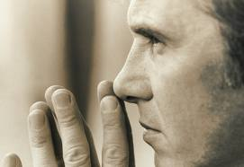
Living the Word
To apply this passage, we will need to know what it is that is contaminating our body and spirit.
“body” - the carnal human nature.
“spirit” - protect our soul from the pollution that surrounds us.

Slide 17
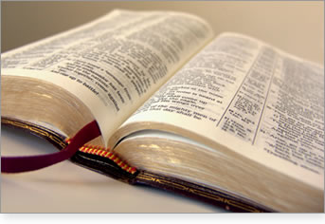
2 Corinthians 7:1
“perfecting holiness” - completing, accomplishing, or finishing holiness to the fullest level leaving nothing undone.
“reverence for God” - “phobo” – fear of God which is the beginning of wisdom.

Slide 18
Today’s Passage
Today’s passage is a call to the action of being holy as God is holy because we are Gods people, we are a new creation, we are sanctified, born again, pure and righteous because of what God has done and our acceptance of the change that he provides.

Slide 19

This Week…
Take extra effort to notice how you mix and how you separate as you interact with others this week.
Take time to thank God for the promises that He provides and invite others to Know God as you help Make Him Known.

Slide 20
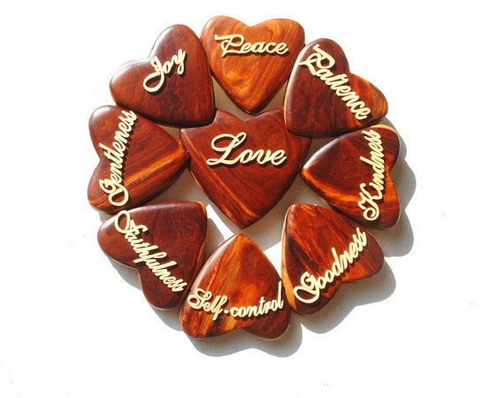
Next Week:
Next Week we look at the verses after the Fruit of the Spirit in Galatians 5:25-26 and the call to “Let Us Keep Walking.”

