Slide 1
“Let Us” Thirsty Lessons
August 25th 2024
Galatians 5:25-26 Page 1816
“Let Us Keep Walking.”

Slide 2

An Illustration…
Do we expect them to mix?
They can co-exist without mixing because separation is natural.

Slide 3

This Week, How Did You…
Make extra effort to notice how you mix and how you separate as you thank God for the promises that He provides and invite others to Know God as you help Make Him Known.

Slide 4

Jesus Fills Our Thirst
Last week we talked about the thirst that people have to leave worldliness and the way the world behaves.
This week the thirst relates to the reminder that there is a path and a process of change, and we are called forward and empowered to walk away from our old life and walk towards a new kind of life led by the Holy Spirit.
Who, in your life, is thirsty for this good news?

Slide 5
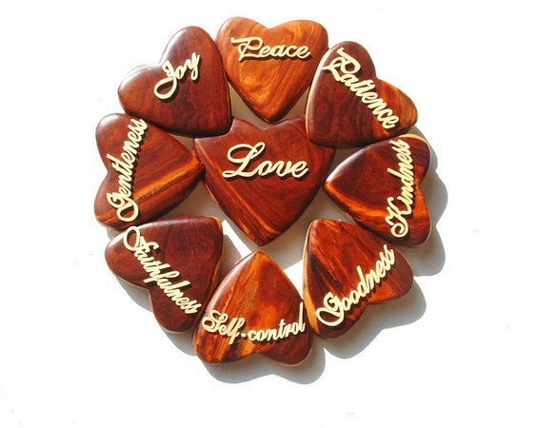
Galatians 5:25-26 Page 1816
“Since we live by the Spirit, let us keep in step with the Spirit. 26 Let us not become conceited, provoking and envying each other.”

Slide 6

The Context:
“Mini-Romans”
Christianity is not a revision of Judaism.

Slide 7

Galatians 3:23-25 Page 1813
Galatians 3:23-25. “Before this faith (in Jesus) came, we were held prisoners by the law, locked up until faith should be revealed. 24 So the law was put in charge to lead us to Christ that we might be justified by faith. 25 Now that faith has come, we are no longer under the supervision of the law.”

Slide 8
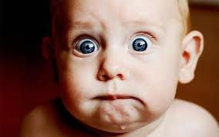
Galatians 5:15
“If you keep on biting and devouring each other, watch out or you will be destroyed by each other.”

Slide 9

Galatians 5:16-18 Page 1815
16 So I say, live by the Spirit, and you will not gratify the desires of the sinful nature. 17 For the sinful nature desires what is contrary to the Spirit, and the Spirit what is contrary to the sinful nature. They are in conflict with each other, so that you do not do what you want. 18 But if you are led by the Spirit, you are not under law.

Slide 10
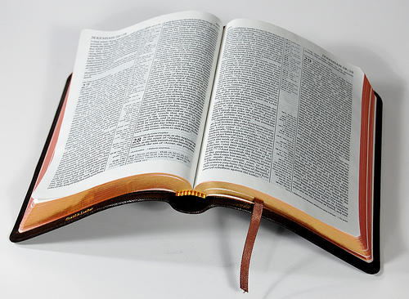
Galatians 5:19-21
19 The acts of the sinful nature are obvious: sexual immorality, impurity and debauchery; 20 idolatry and witchcraft; hatred, discord, jealousy, fits of rage, selfish ambition, dissensions, factions 21 and envy; drunkenness, orgies, and the like. I warn you, as I did before, that those who live like this will not inherit the kingdom of God.

Slide 11
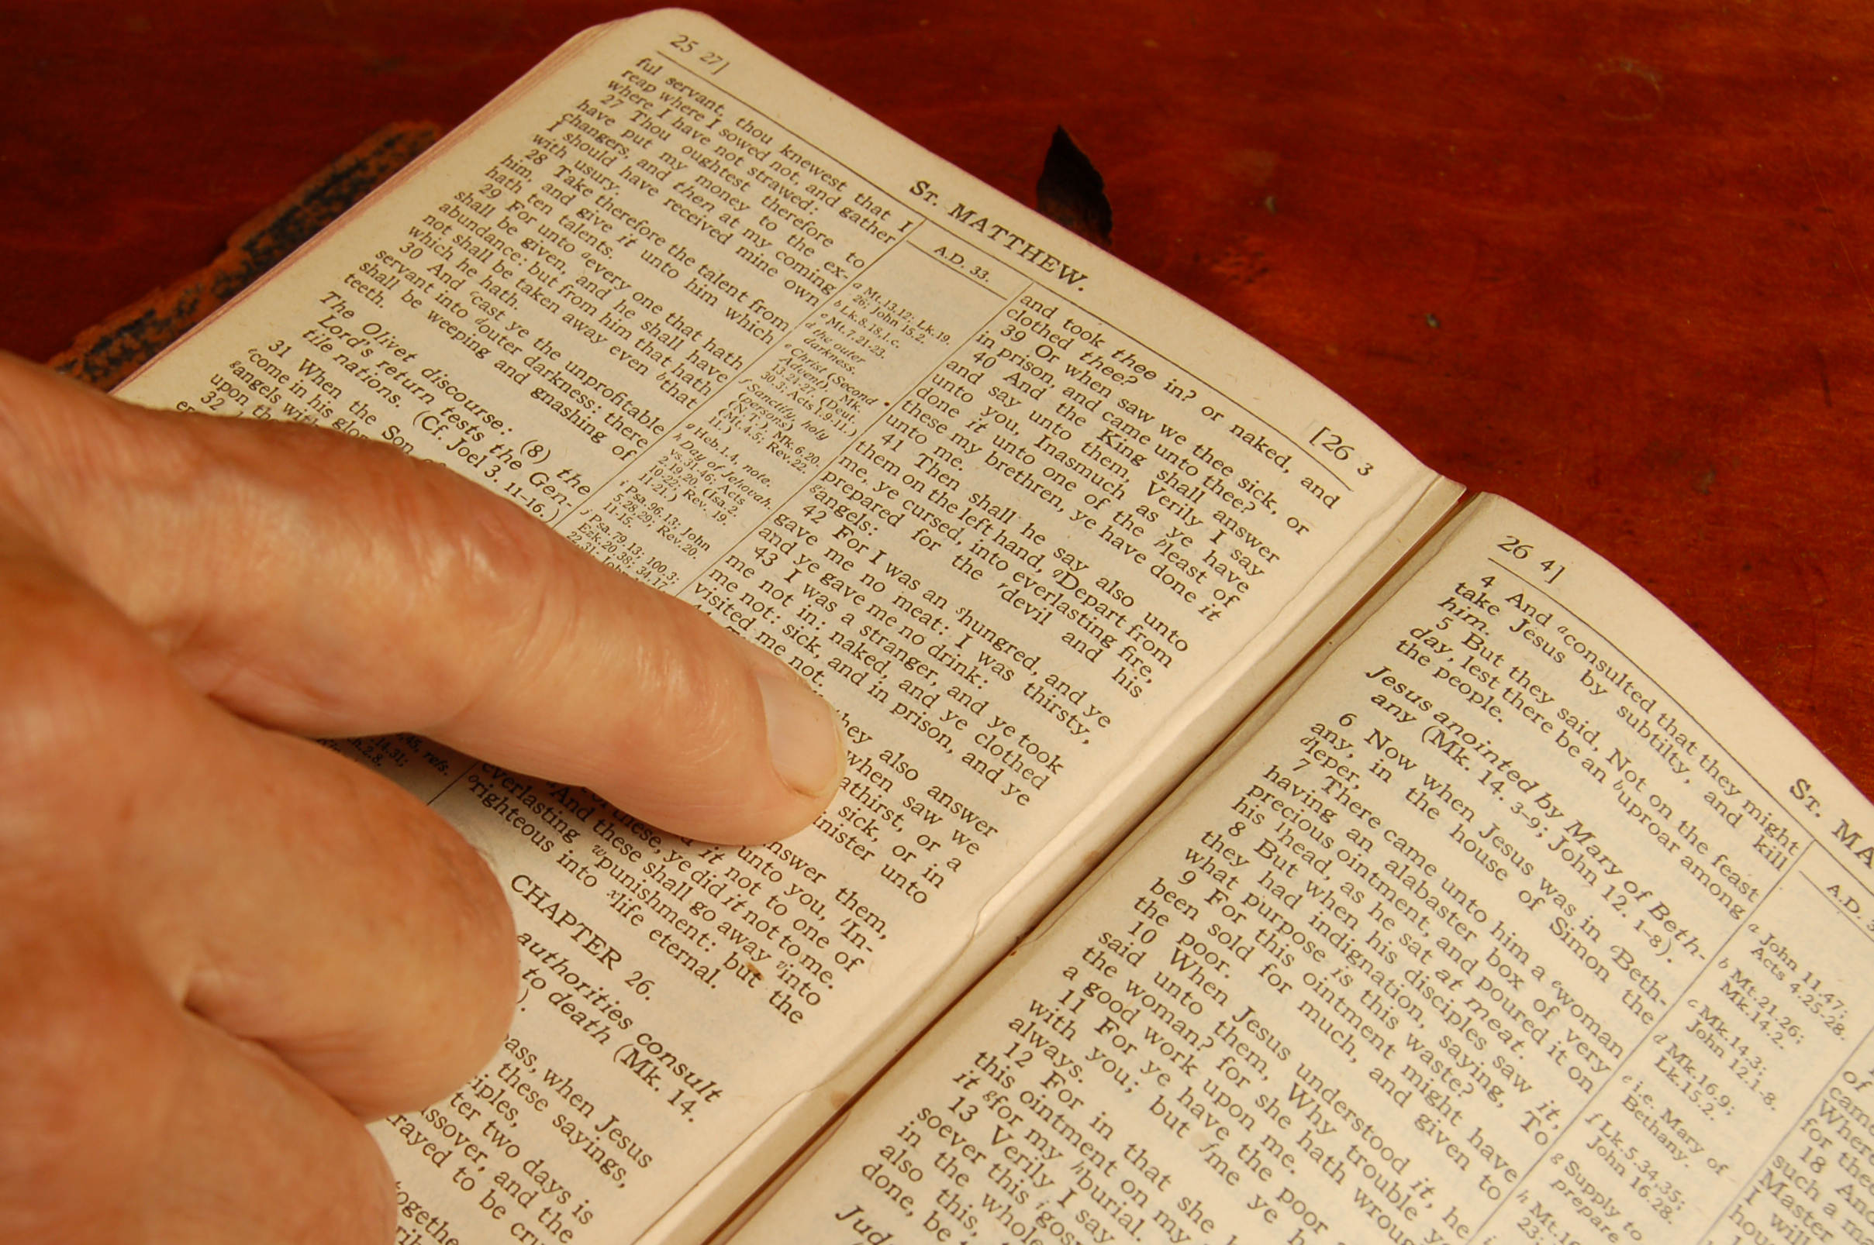
Galatians 5:22-24
22 But the fruit of the Spirit is love, joy, peace, patience, kindness, goodness, faithfulness, 23 gentleness and self-control. Against such things there is no law.
24 Those who belong to Christ Jesus have crucified the sinful nature with its passions and desires.

Slide 12
Galatians 5:25-26 Page 1816
“Since we live by the Spirit, let us keep in step with the Spirit. 26 Let us not become conceited, provoking and envying each other.”

Slide 13

Thinking About the Holy Spirit
Consider Acts 2:38-47.
Consider John 14:23-27
(23) …we will come to him and make our home with him.
(26)… (The Holy Spirit) will teach you all things and will remind you of everything I have said to you.

Slide 14

Where He Leads…
Keep in step…
How are you doing with this?
How is the Spirit leading you and where are you going?

Slide 15

Don’t Be…
conceited (also translated boastful or arrogant – it means “empty glory”
provoking (or combating one another also only used here), or
envying (become sour at someone’s success)
These three words are only used here in these forms.

Slide 16

6 Points of Application
1. The main part of the passages is a discussion about the battle between our two natures so the first point of application is to check your appetite. Which nature are you feeding regularly?

Slide 17
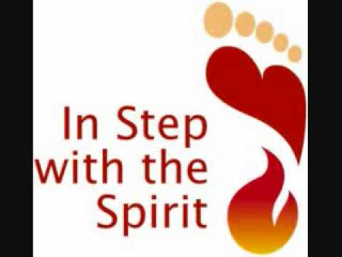
6 Points of Application
2. Follow the leader and keep in step. Let the Holy Spirit lead through the word of God as number one but also through your conscience, Christian counsel, and even circumstances.

Slide 18
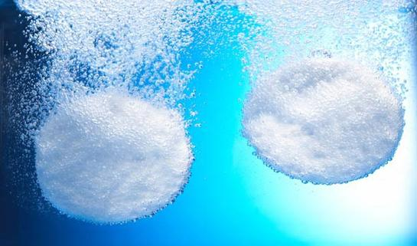
6 Points of Application
3. Open yourself to His leading.

Slide 19

6 Points of Application
4. Beware of pride and selfishness as these are the key aspects of the sinful nature.

Slide 20

6 Points of Application
5. Surrender to the Sprit and enjoy the fruit of a changed life.

Slide 21

6 Points of Application
6. Be kind and do not make following God any more difficult for others than it needs to be.

Slide 22
Next Week:
We look at the Fruit of the Spirit “goodness” in Galatians 6:9-10 and the call to “Let Us Do Good.”

