Slide 1
“Let Us” Thirsty Lessons
September 1st 2024
Galatians 6:9-10 Page 1816
“Let Us Do Good.”

Slide 2

How Was Your Week?
How well did you mix and separate?
What choices did you make to keep in step with the Spirit and to open yourself to His leading?

Slide 3
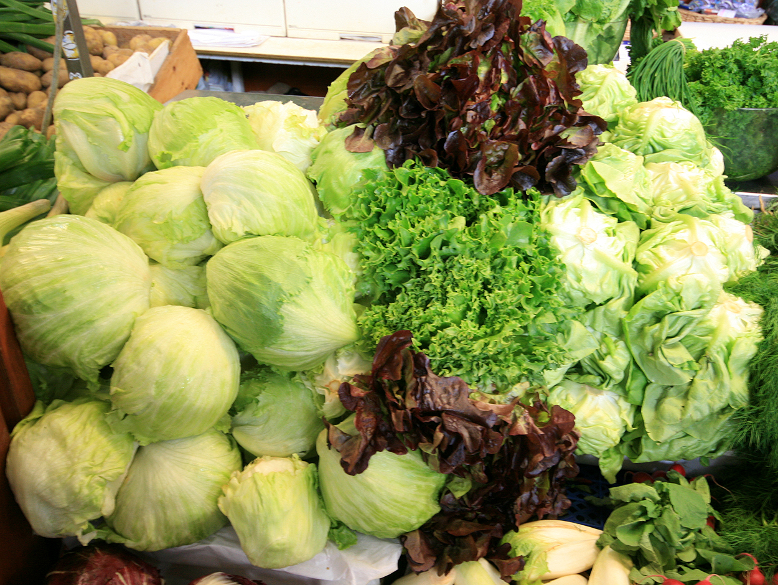
So Far…
Let Us
Enter In – Hebrews 4
Mature – Hebrews 6:1, 10:22-25
Appreciate – Hebrews 12
Look Forward – Hebrews 13
Dress Up in Jesus – Romans 13
Be Considerate – Romans 14be
Clean Up - 2 Corinthians 7:1
Galatians 5 – Let Us Keep in Step
Galatians 6 - “Let Us Do Good.”

Slide 4

“Goodness” in NT Scripture
Galatians 5:22, Romans 15:14, Ephesians 5:9 and 2 Thessalonians 1:11 we have the word for intrinsic goodness as a godly trait [GK 19 ag-ath-a-soo’-nay]
2 Peter 1:5 we have another word for goodness which speaks of virtue, moral excellence, perfection, or uprightness and it is the Greek word [Gk 703 ar-et’-ay]
( Philippians 4:8, 1 Peter 2:9, 2 Peter 1:3 and twice in 2 Peter 1:5).

Slide 5

“Goodness” in the NT
Galatians 6:9-10 [Greek word 2570 kalós]
Attractively good; good that inspires (motivates) others to embrace what is lovely (beautiful, praiseworthy); beautiful, as an outward sign of the inward good, noble, honorable character; good, worthy, honorable, noble, and seen to be so.
Cf. Matthew 3:10, Matthew 5:14, Matthew 13:8, 13…
We are to be “good people” who live “good lives” who do “good deeds.”

Slide 6
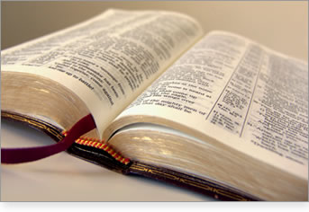
The Context:
“Mini-Romans”
Christianity is not a revision of Judaism.
“Let Us” live by the Spirit and keep in step with the Spirit as we were kind to one another as we read in Galatians 5:25-26.

Slide 7
Today’s Passage
Galatians 6:7-10 is a call for us to let us not become weary in doing good, and let us do good to all people, especially to those who belong to the family of believers.
Pay attention to the mention of the two natures and the results of feeding those natures.

Slide 8
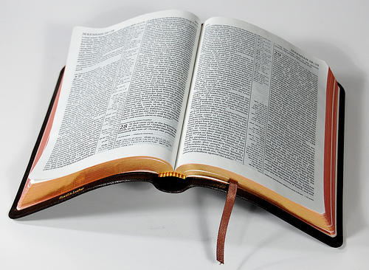
Galatians 6:7-10 Page 1816
7 Do not be deceived: God cannot be mocked. A man reaps what he sows. 8 The one who sows to please his sinful nature, from that nature will reap destruction; the one who sows to please the Spirit, from the Spirit will reap eternal life. 9 Let us not become weary in doing good, for at the proper time we will reap a harvest if we do not give up. 10 Therefore, as we have opportunity, let us do good to all people, especially to those who belong to the family of believers.

Slide 9

Consider Matthew 25:31-40 Page 1542
…35 For I was hungry and you gave me something to eat, I was thirsty and you gave me something to drink, I was a stranger and you invited me in, 36 I needed clothes and you clothed me, I was sick and you looked after me, I was in prison and you came to visit me.’…
…40 “The King will reply, ‘I tell you the truth, whatever you did for one of the least of these brothers of mine, you did for me.’…

Slide 10

The Reminder…
“Let us go and do good.”
Next Week we look at Philippians 3:16 the call to “Let Us Keep Going.”

